Slide 1


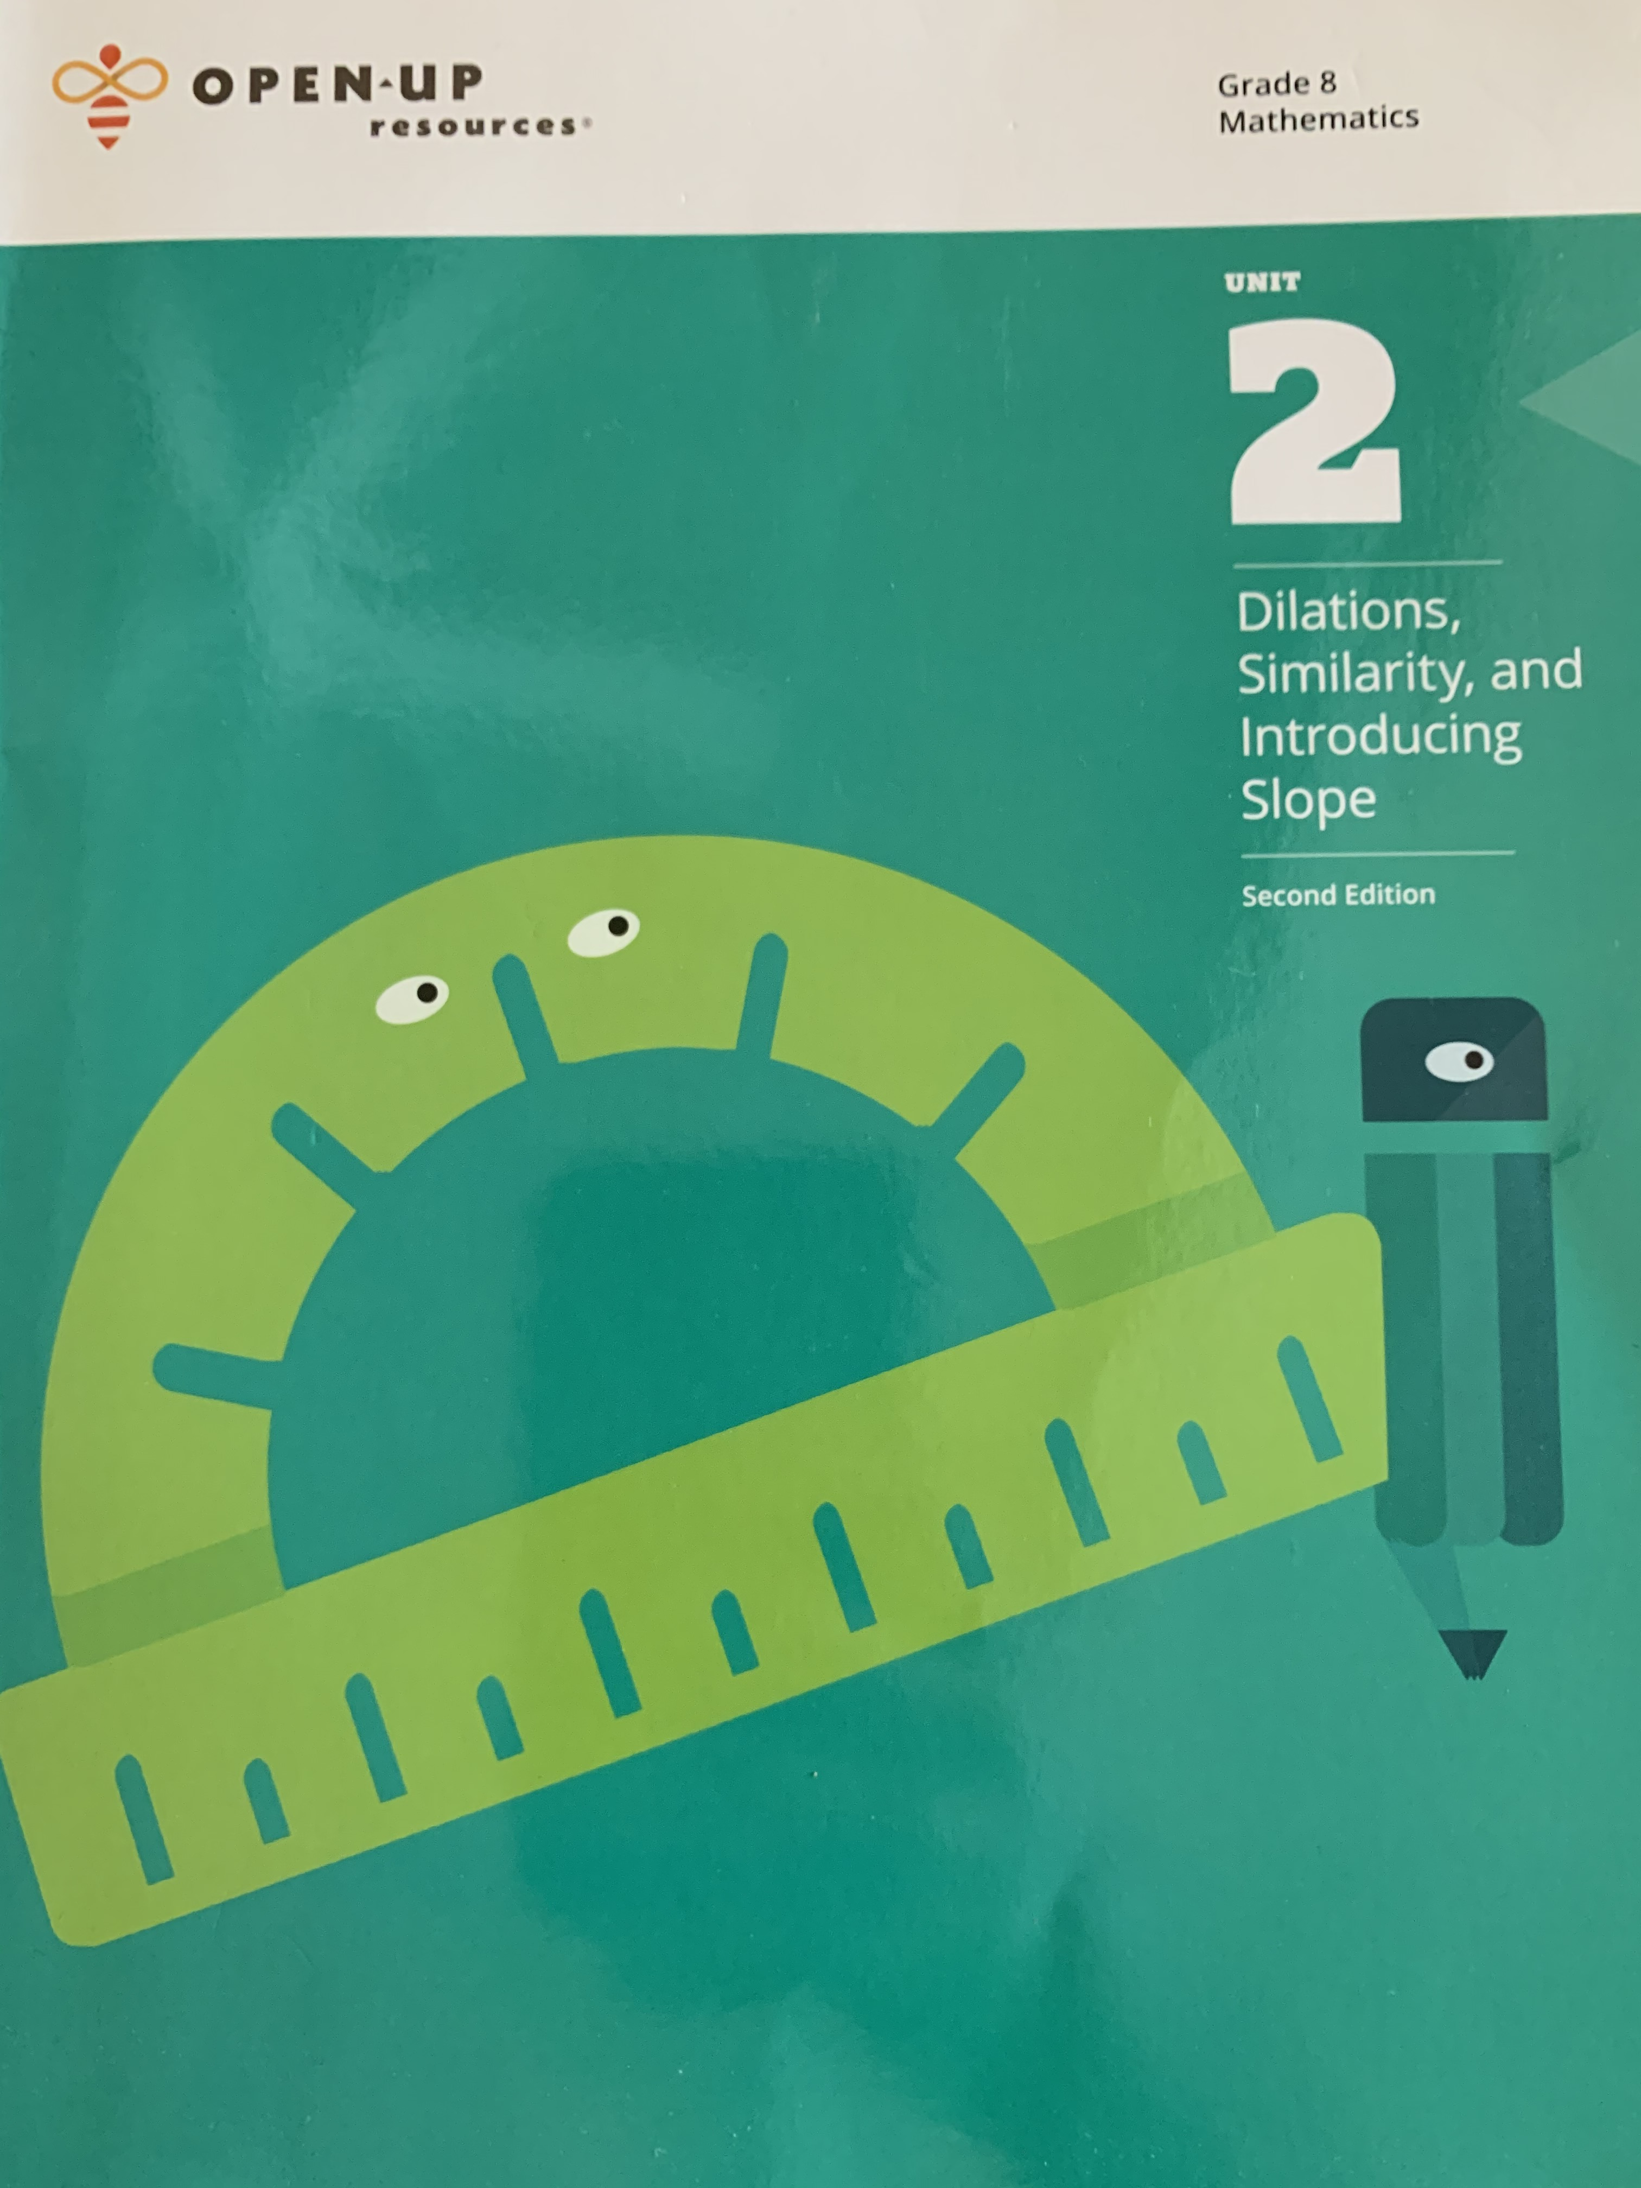
AGENDA FOR THURSDAY 10/22/20 - FRIDAY 10/23/20
You will need your UNIT 2 Illustrative Mathematics Workbooks.
→ Today, we will be working on Lessons 3, 4, and 5 in your Unit 2 workbook
→ Reminder: Complete ANY MISSING WORK (then contact Mr. Pearson
once it is been completed).
→ Unit 1 Test Retakes will be offered on Monday 10/26/20 during office
hours. Stop in via Zoom between 8:00am and 10:00am.
→ Classwork and Independent Practice for these lessons is posted on
www.mathpearson.com for easy reference.
→ Monday’s Asynchronous Assignment posted on www.mathpearson.com
10.19.20 Desmos Activity. Due Date is Friday 10.23.20 at 3:00pm.
Common Core Standards
8.G.3 Describe the effect of dilations, translations, rotations, and reflections on two-dimensional figures using coordinates.
8.G.A Understand congruence and similarity using physical models, transparencies, or geometry software.

Slide 2
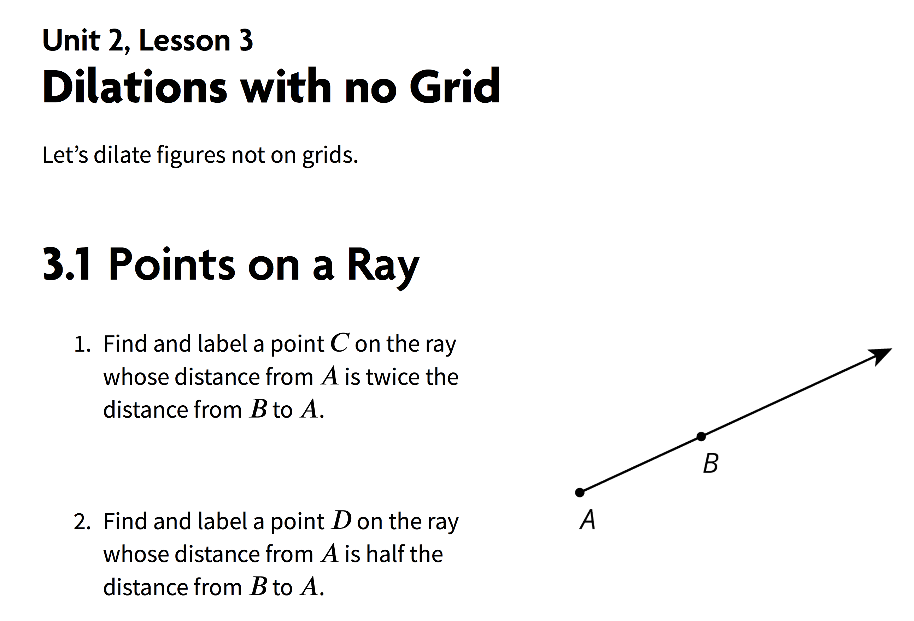
Page 25
You can use a ruler, copy paper, etc. to accurately mark and measure distances.
Rays start at the center of dilation and extend outward through each point.
You will need to read carefully and interpret the meaning contained in each sentence.

Slide 3
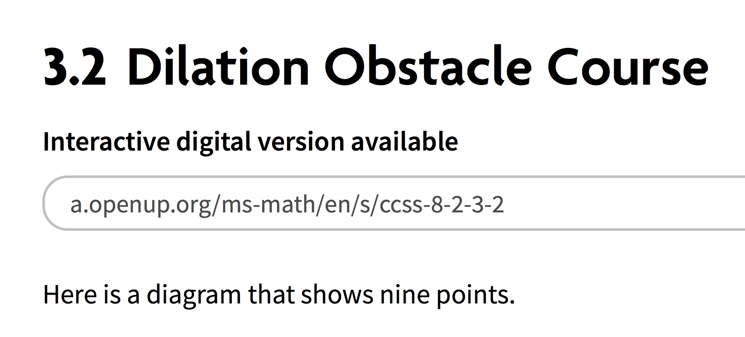
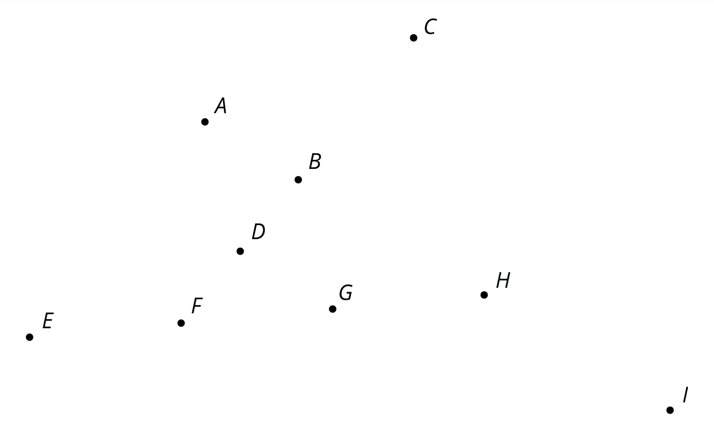
Pages 25-26
Identify what you know in each question already (center of dilation, scale factor to be used, etc.)

Slide 4
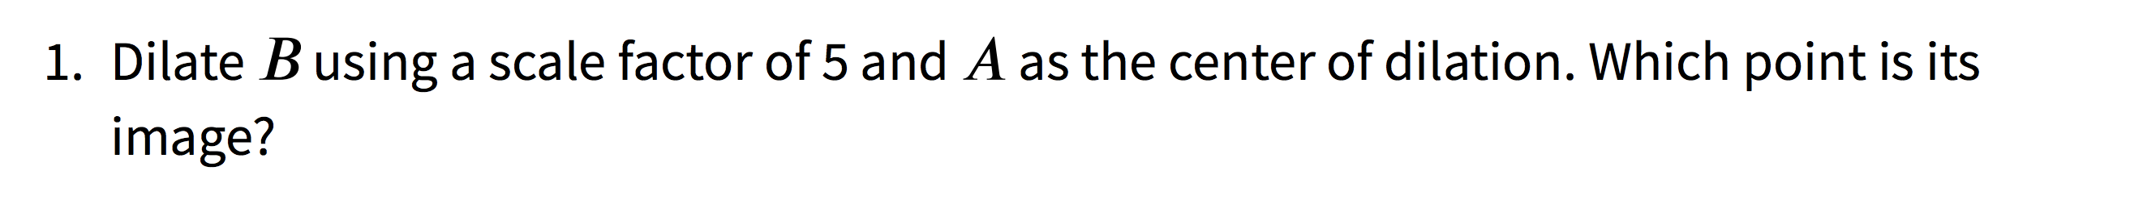
Point A (where ray begins)
Point B
The image of Segment AB will be 5 times longer
What point is your center of dilation?
What point(s) are you drawing a ray through?
If the scale factor is 5, what does that
tell you about the image of Point B?
Pages 25-26

Slide 5
Pages 25-26
What point is your center of dilation?
What point(s) are you drawing a ray through?
If Point E is further than Point G, what does
that tell you about the scale factor?

Slide 6
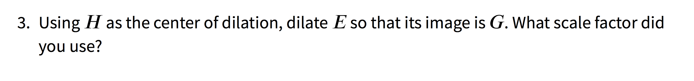
Pages 25-26
What point is your center of dilation?
What point(s) are you drawing a ray through?
If the image is closer to the center of dilation,
what does that tell you about it scale factor?

Slide 7
Pages 25-26
If F is dilated to become B, which points
exist on the ray (vector)?
Can the center of dilation be between
two points or does it have to be beyond
both points?

Slide 8
Pages 25-26
What point is your center of dilation?
What point(s) are you drawing a ray through?
Given the scale factor of 1/3, what does that
tell you about the image of Point H?

Slide 9
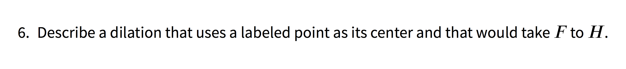
Pages 25-26
What direction takes you from Point F to Point H?
Should the center of dilation be between F and H or to the left of F?

Slide 10
Pages 25-27
What point is your center of dilation?
What point(s) are you drawing a ray through?
What scale factor has to be used so that the image is the same as the pre-image (in other words, unchanged)
THINK:
If a scale factor is less than __ , then the dilation is a _________ of the original figure.
If a scale factor is greater than __ , then the dilation is a _________ of the original figure.

Slide 11
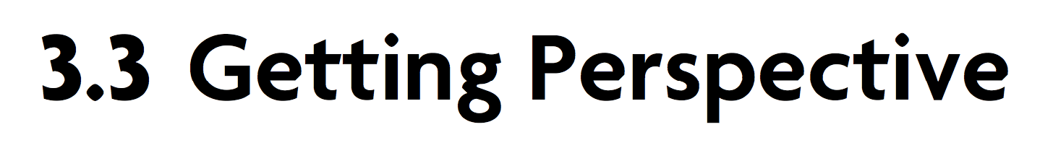
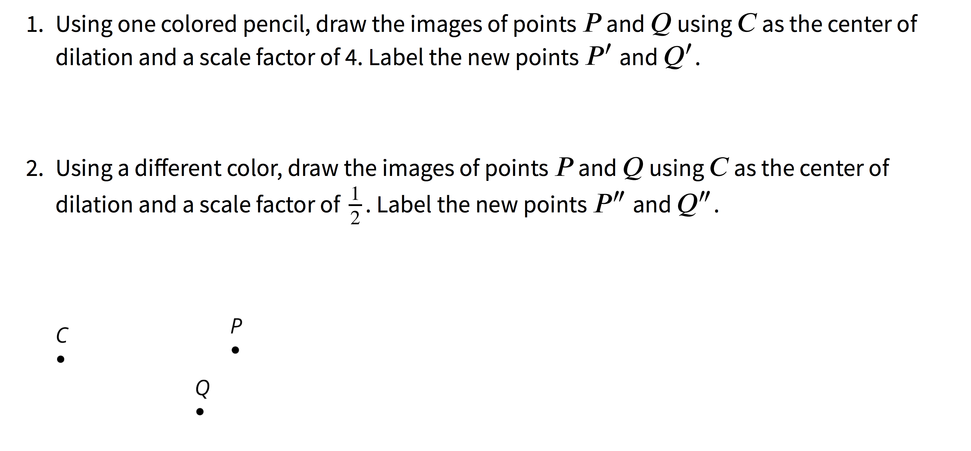
Page 27
What does a scale factor of 4 mean?
What does a scale factor of ½ mean?
Draw rays from Center C extending through each of the Points P and Q. This will be used for Questions 1 and 2.

Slide 12
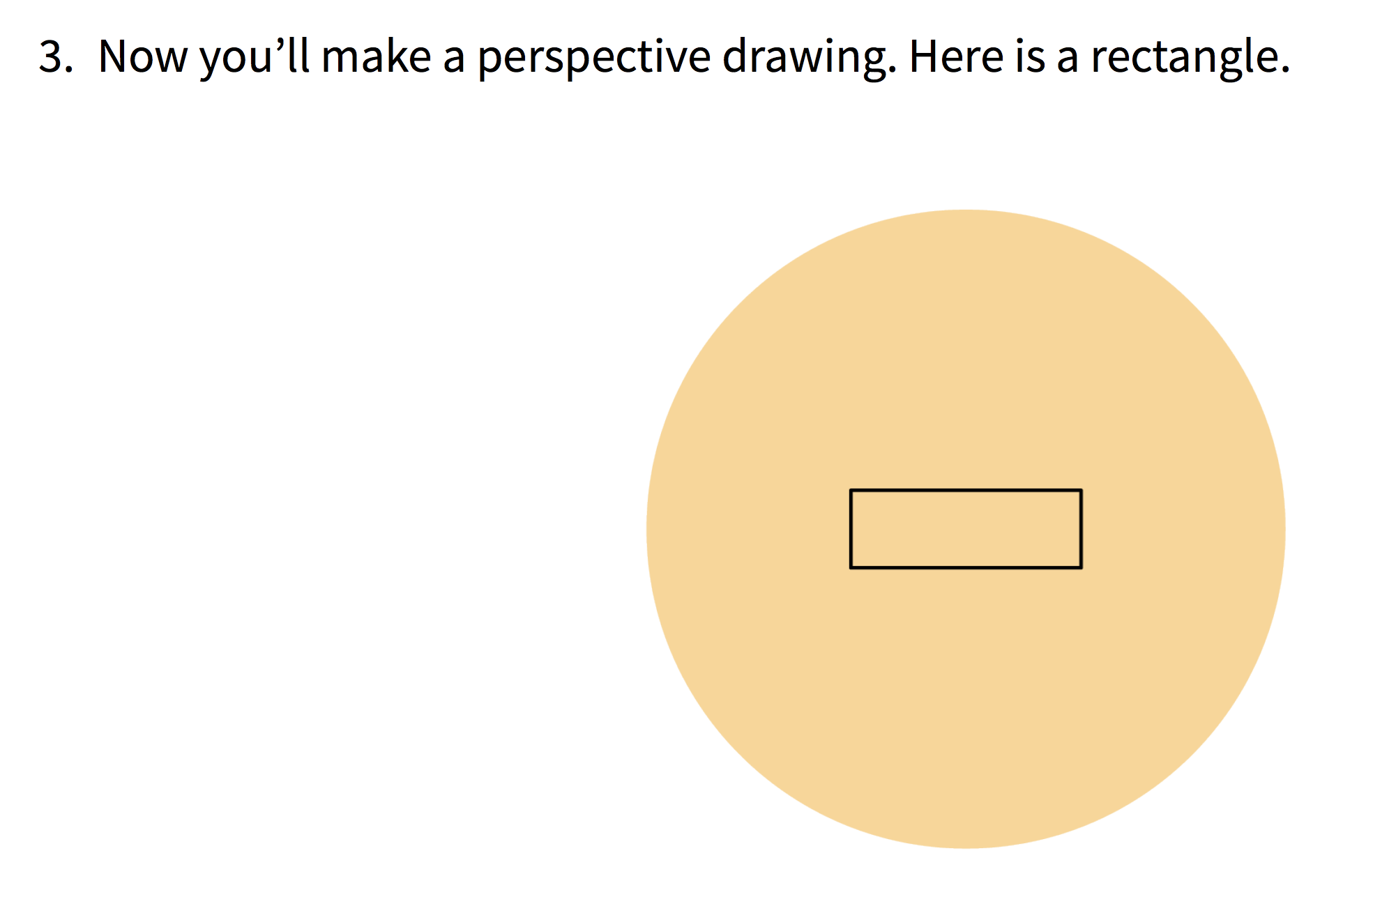
Page 28
Choose a point inside the shaded circular region but outside the rectangle to use as the center of dilation. Draw it. Label it C.
Using your center C and the scale factor you were given, draw the image under the dilation of each vertex of the rectangle, one at a time. Connect the dilated vertices to create the dilated rectangle.
Draw a segment that connects each of the original vertices with its image.
USE A SCALE FACTOR OF 2
Follow the directions on the right.
C

Slide 13
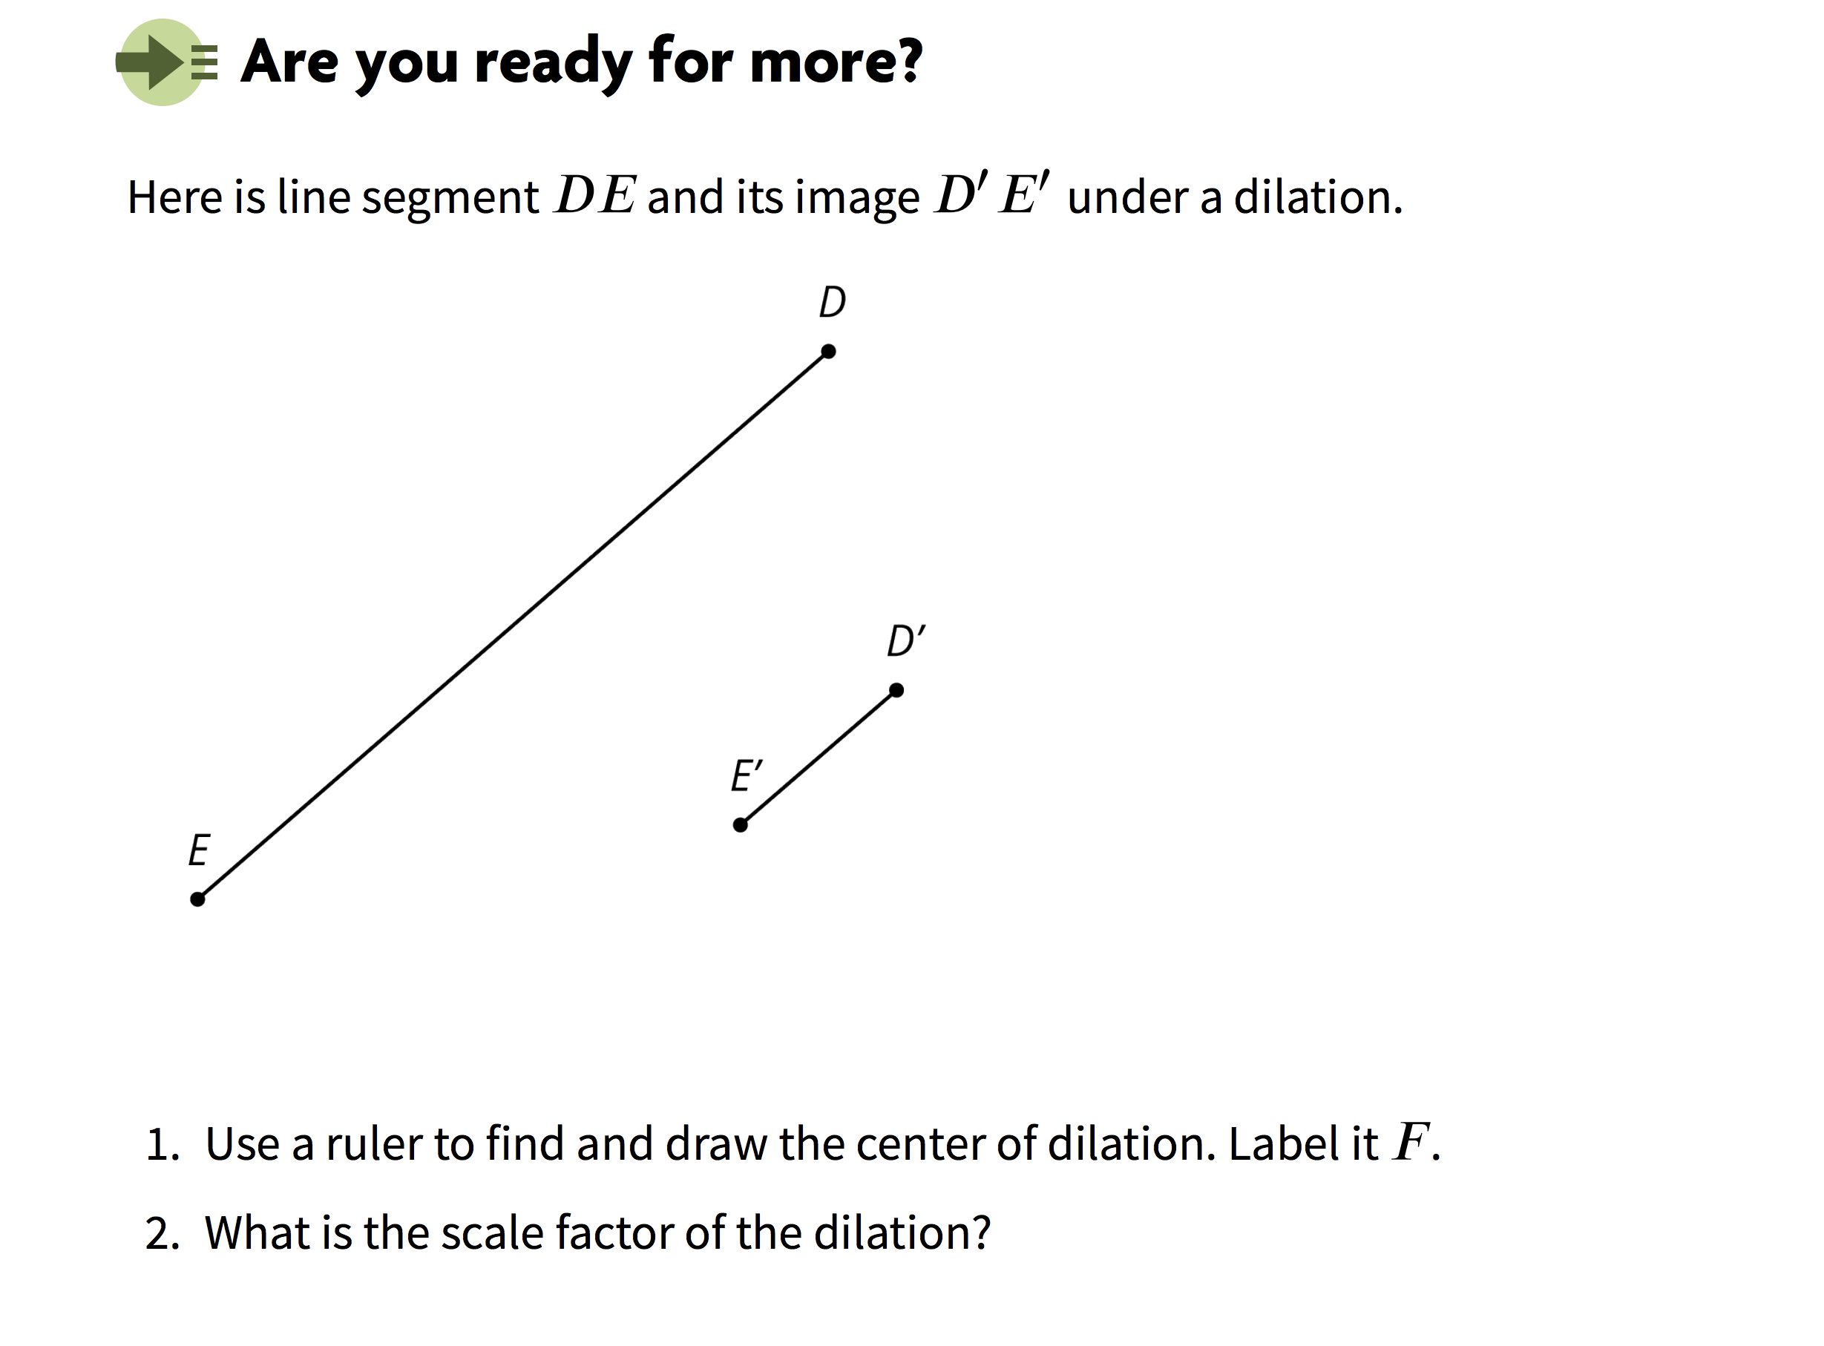

Pages 28-29
F

Slide 14
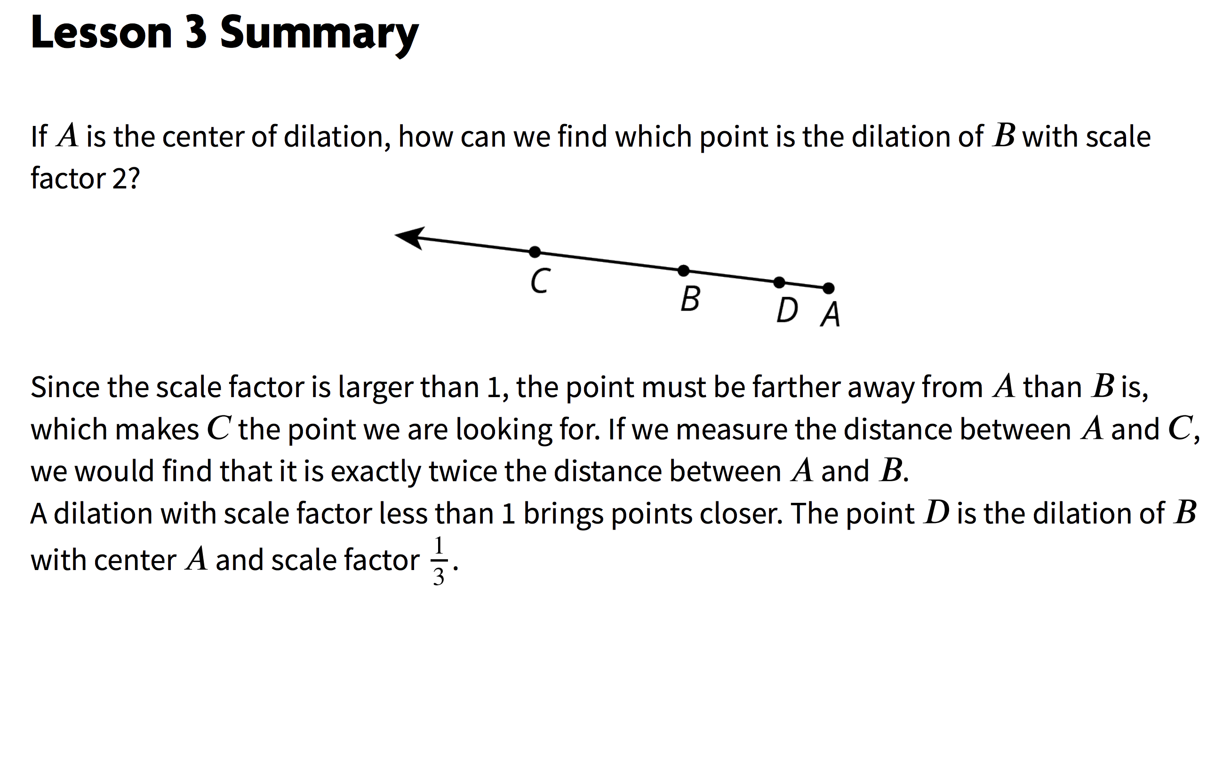
Page 29

Slide 15
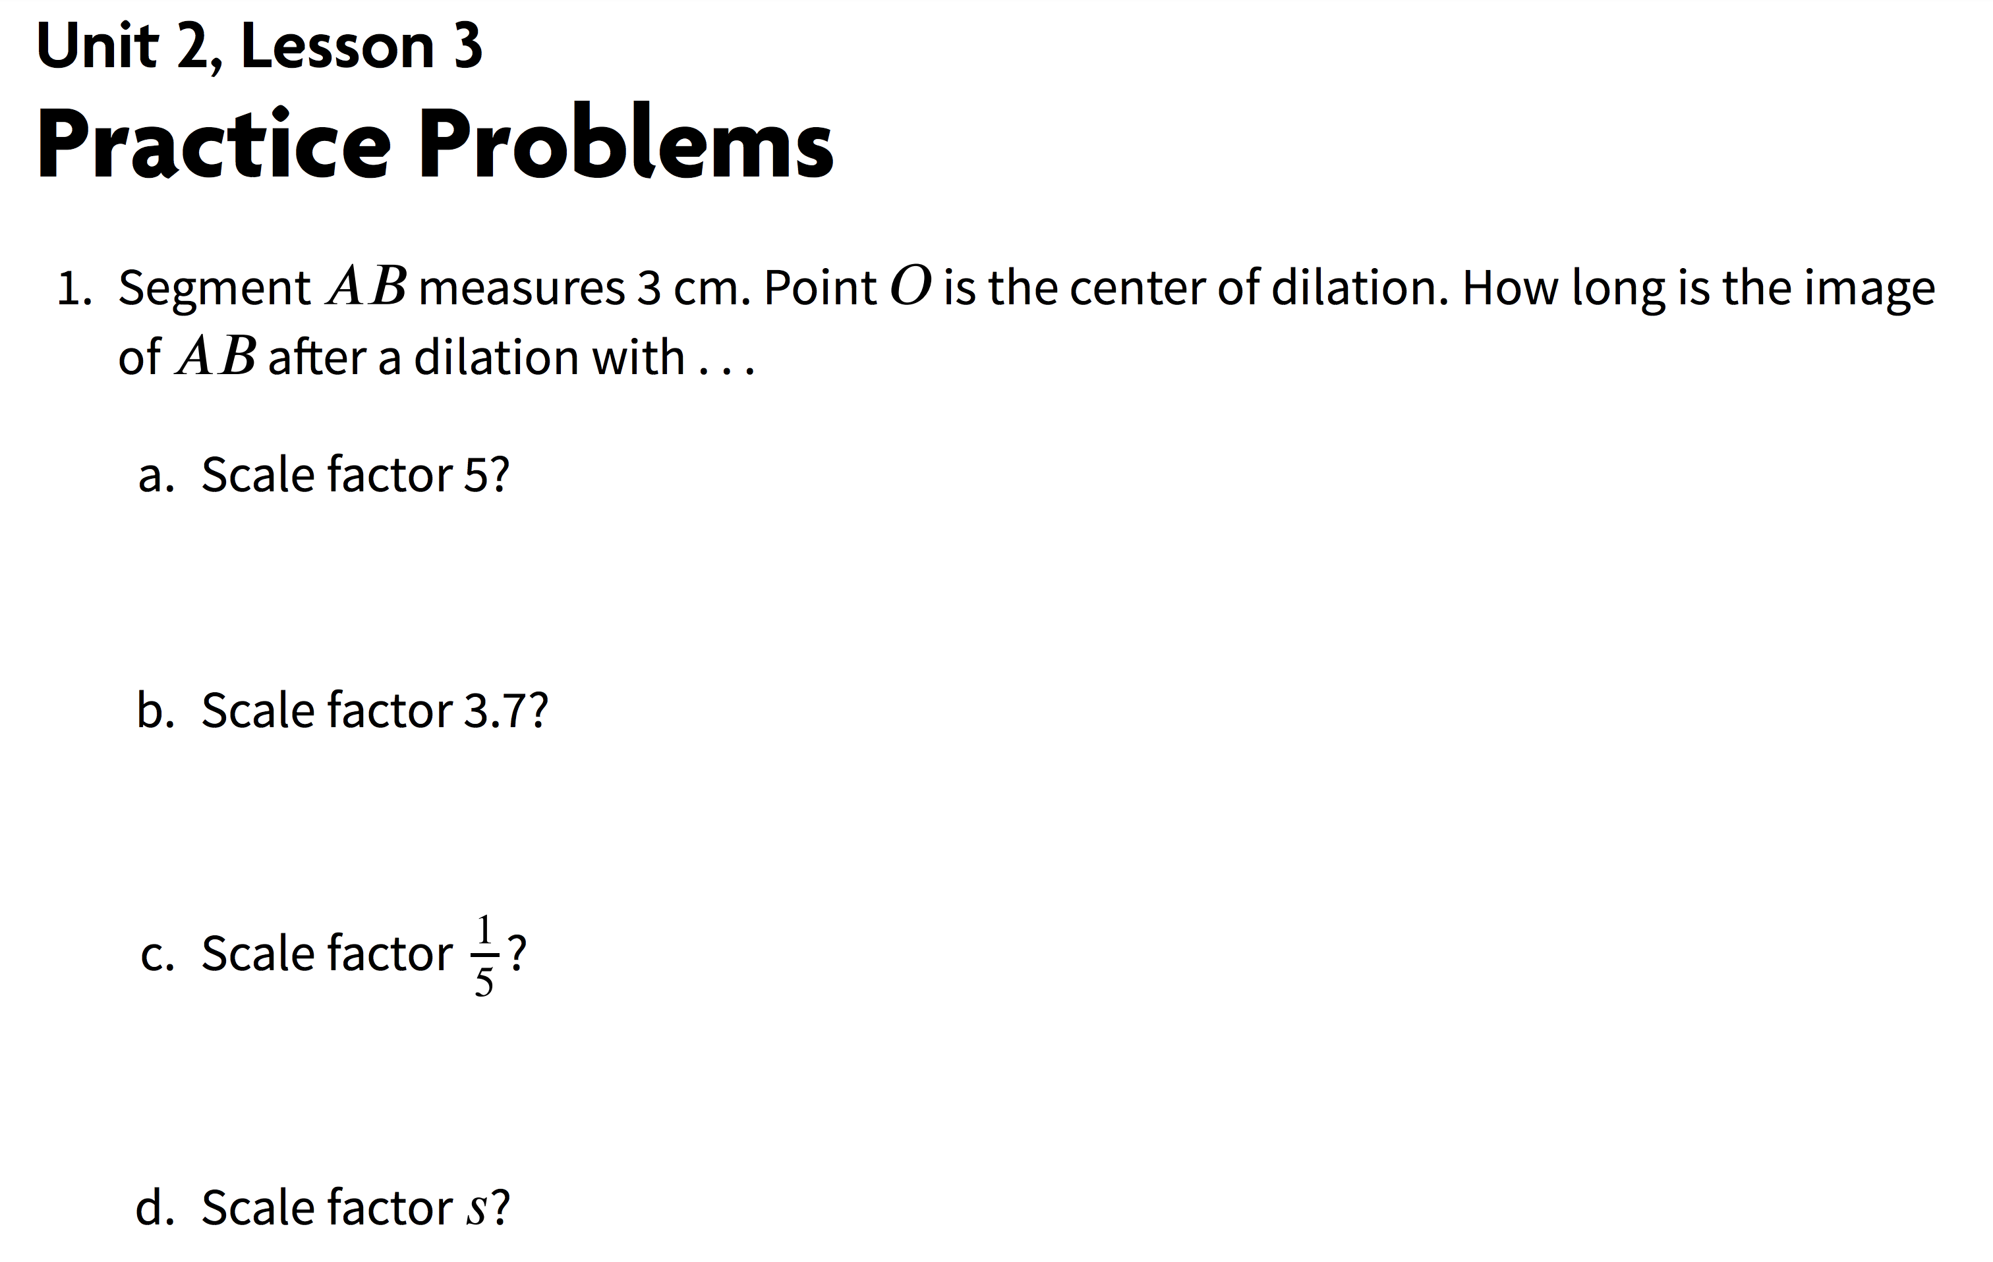

Page 30
3 cm

Slide 16
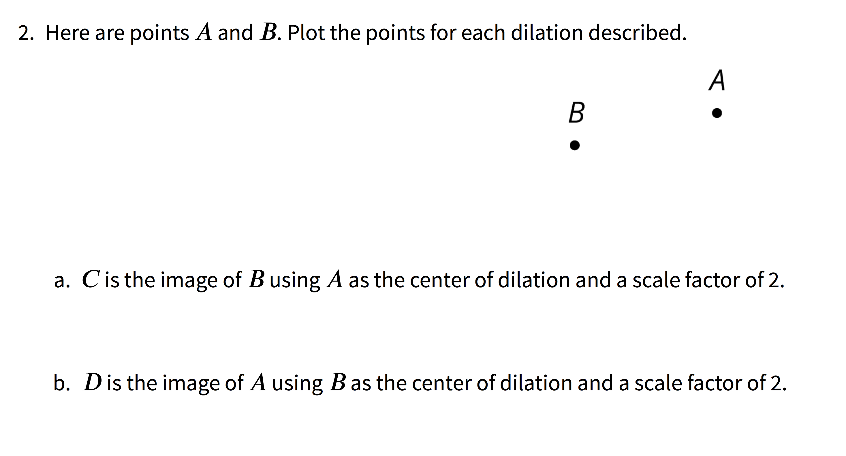
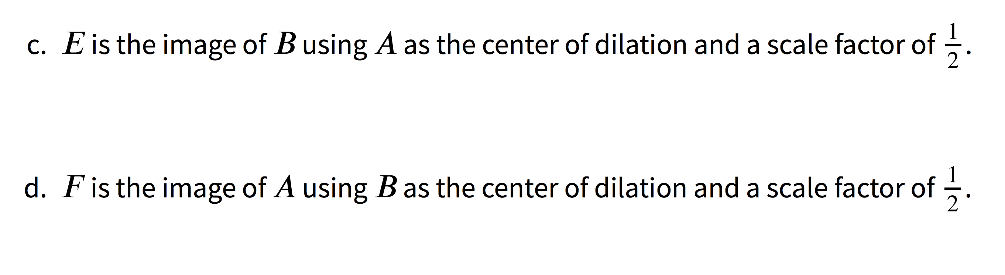
Pages 30-31

Slide 17
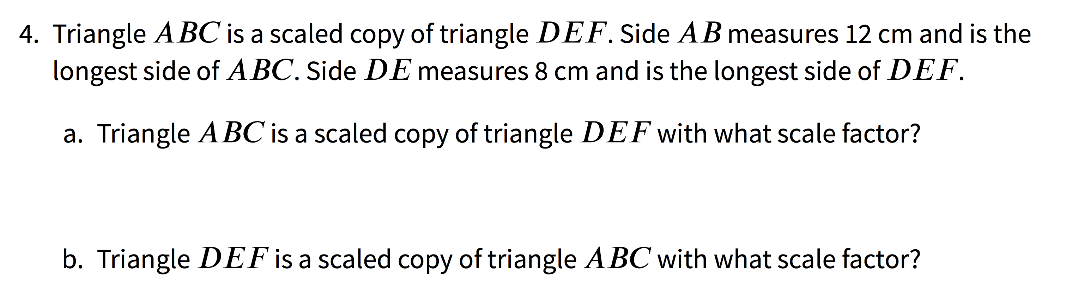
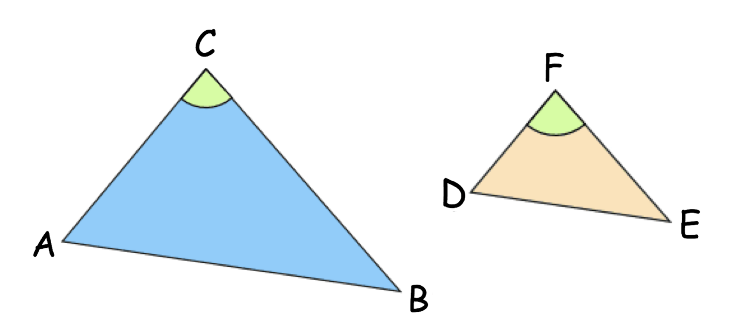
Page 31
Which triangle in this statement is the pre-image and which one is the image?
Which triangle in this statement is the pre-image and which one is the image?
Draw and label the triangles as well as the given information for segments AB and DE

Slide 18
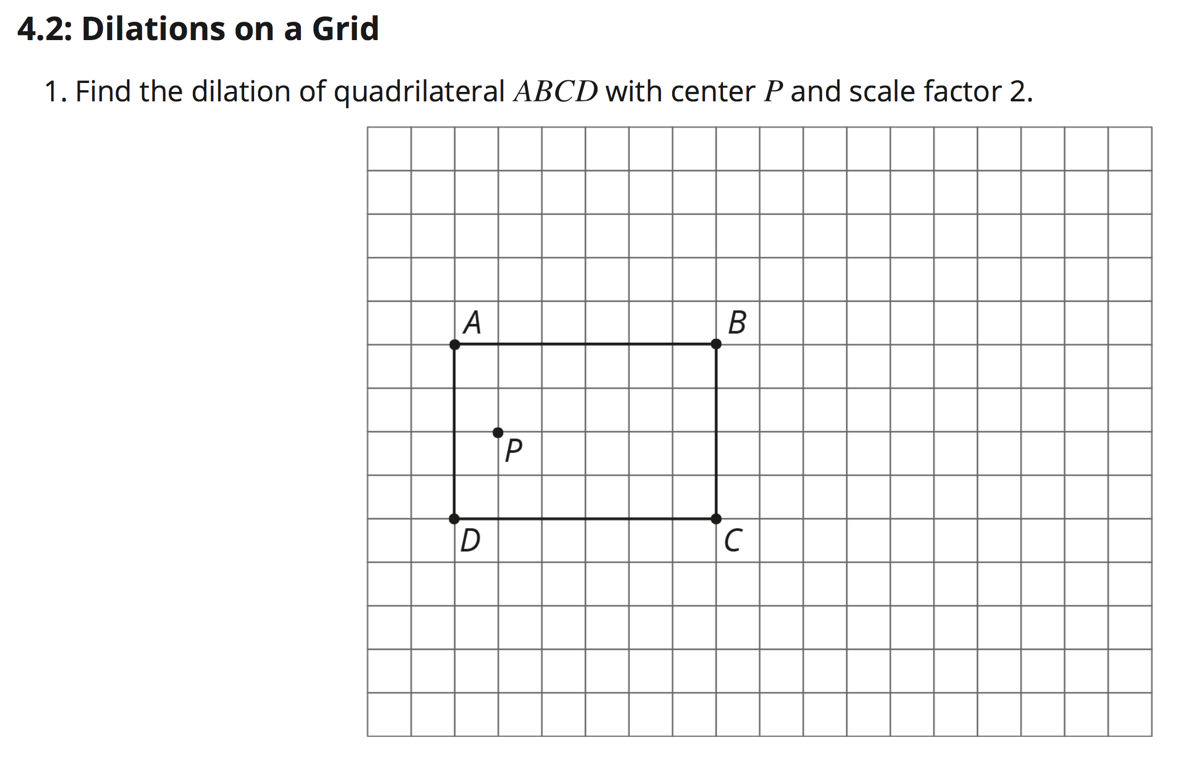
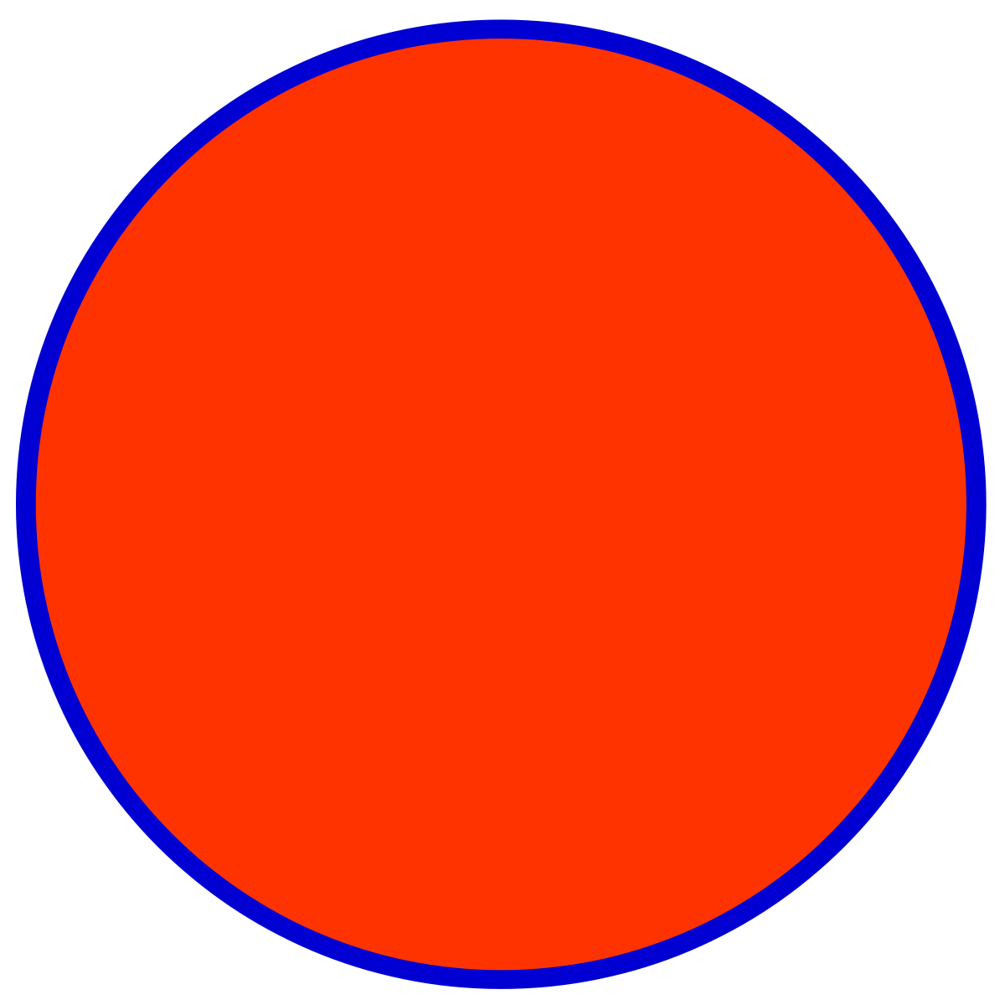
Pages 35-36
Draw a Point at the center of dilation (Point P).
Draw rays from Center P extending through Points A, B, C, and D.
What does scale factor of 2 mean?
Will A’B’C’D’ be an enlargement or a reduction of the pre-image?
A’
B’
D’
C’

Slide 19
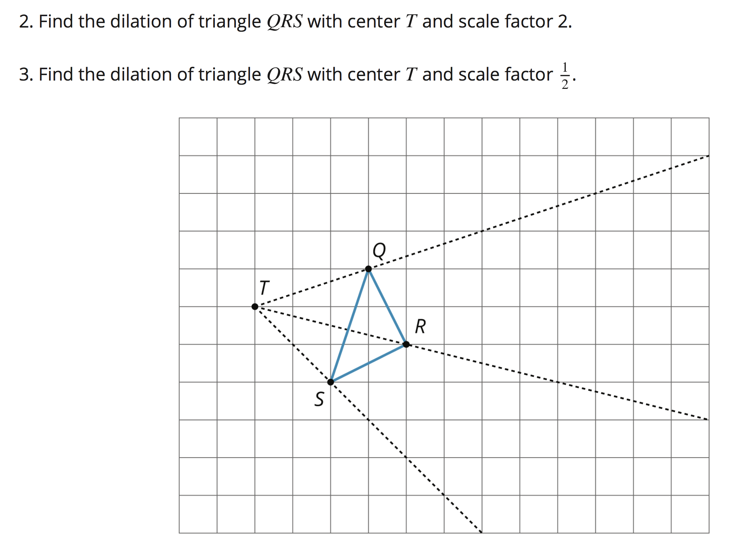
→ Plot new points then label image as Q’R’S’
→ Plot new points then label image as Q”R”S”
Page 36
Q’
Q’’
R’’
S’’
R’
S’

Slide 20
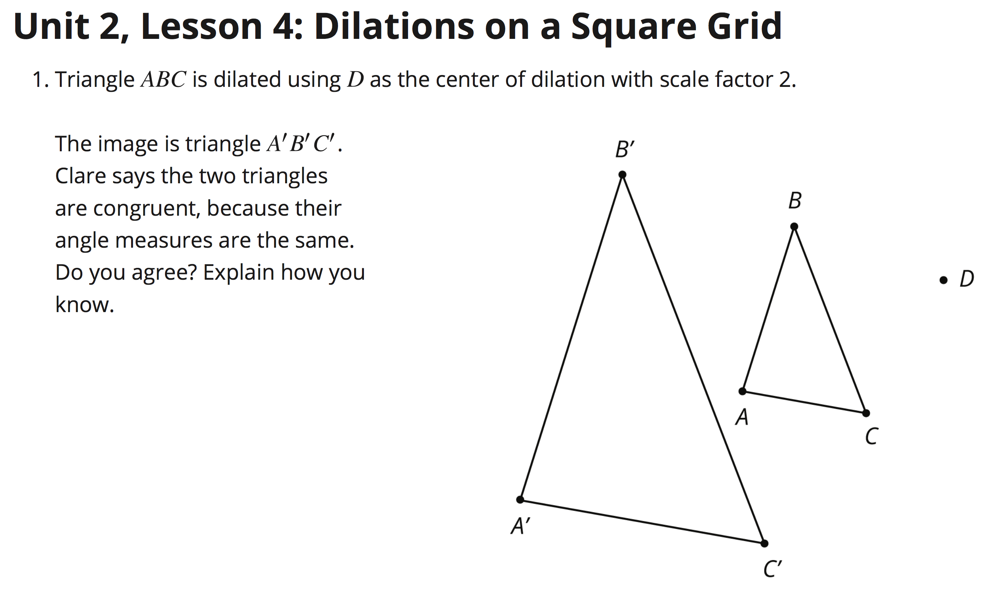
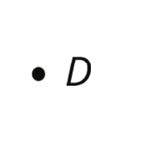
Page 39
Find the Center of Dilation D. Draw Rays from this point, through Points A / A’, B / B’, and C / C’.

Slide 21
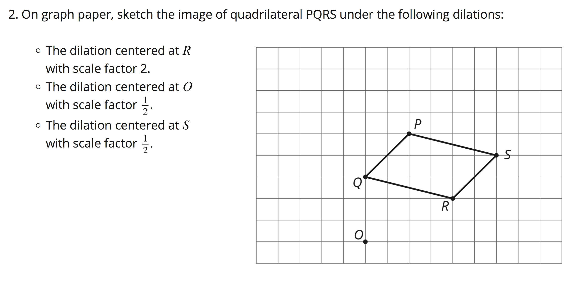
Perform the following dilation. Draw rays from the center of dilation through each of the points P, Q, R, and S.
PART ONE:
After performing this dilation, plot and label each of your points P’, Q’, R’, and S’.
Page 40

Slide 22
Perform the following dilation. Draw rays from the center of dilation through each of the points P, Q, R, and S.
PART TWO:
After performing this dilation, plot and label each of your points P’’, Q’’, R’’, and S’’.
Page 40

Slide 23
Perform the following dilation. Draw rays from the center of dilation through each of the points P, Q, R, and S.
PART THREE:
After performing this dilation, plot and label each of your points P’’’, Q’’’, R’’’, and S’’’.
Page 40

Slide 24
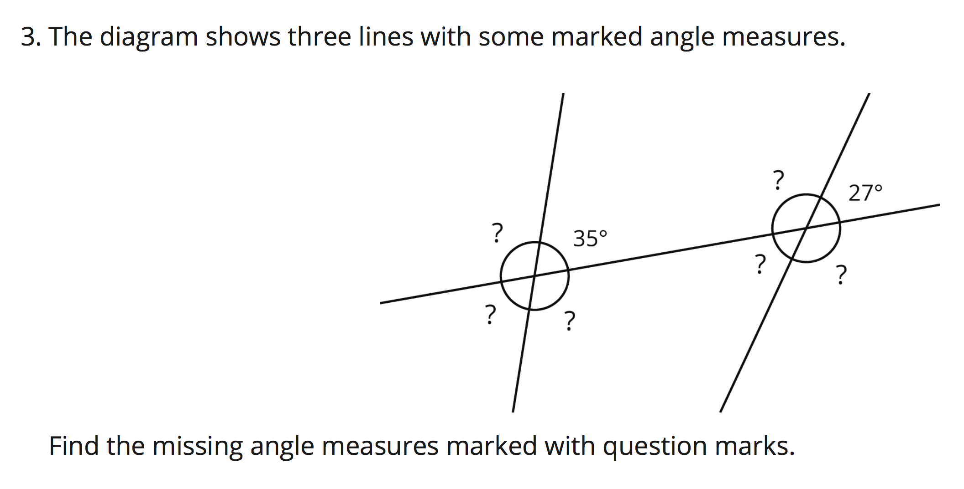
Page 40
NOTE: The following lines are NOT Parallel.
Circles have an angle sum of 360 degrees.
Supplementary Angles have an angle sum of 180 degrees.
Vertical Angles are congruent in their angle measure.

Slide 25
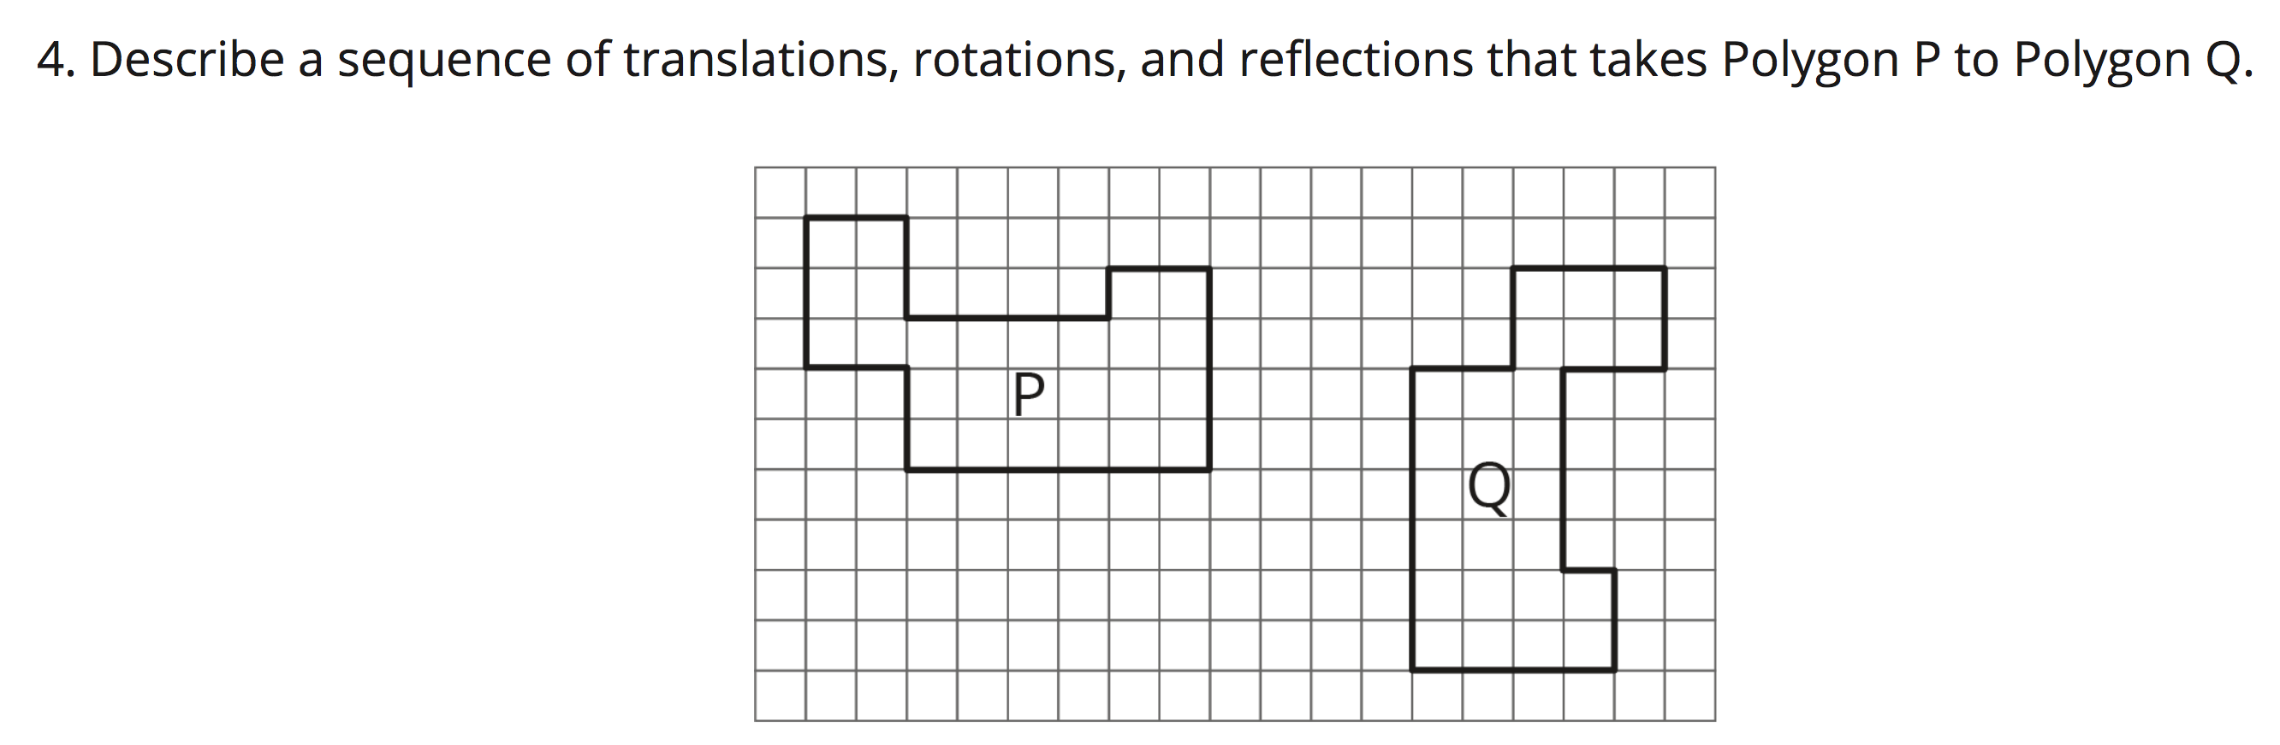
Page 41
When describing your rigid transformations, your descriptions should include:
Translation:
Number of units traveled
Direction of travel
Rotation:
Number of degrees turned Clockwise or Counter-clockwise
Center point of rotation
Reflection:
Line of reflection

Slide 26
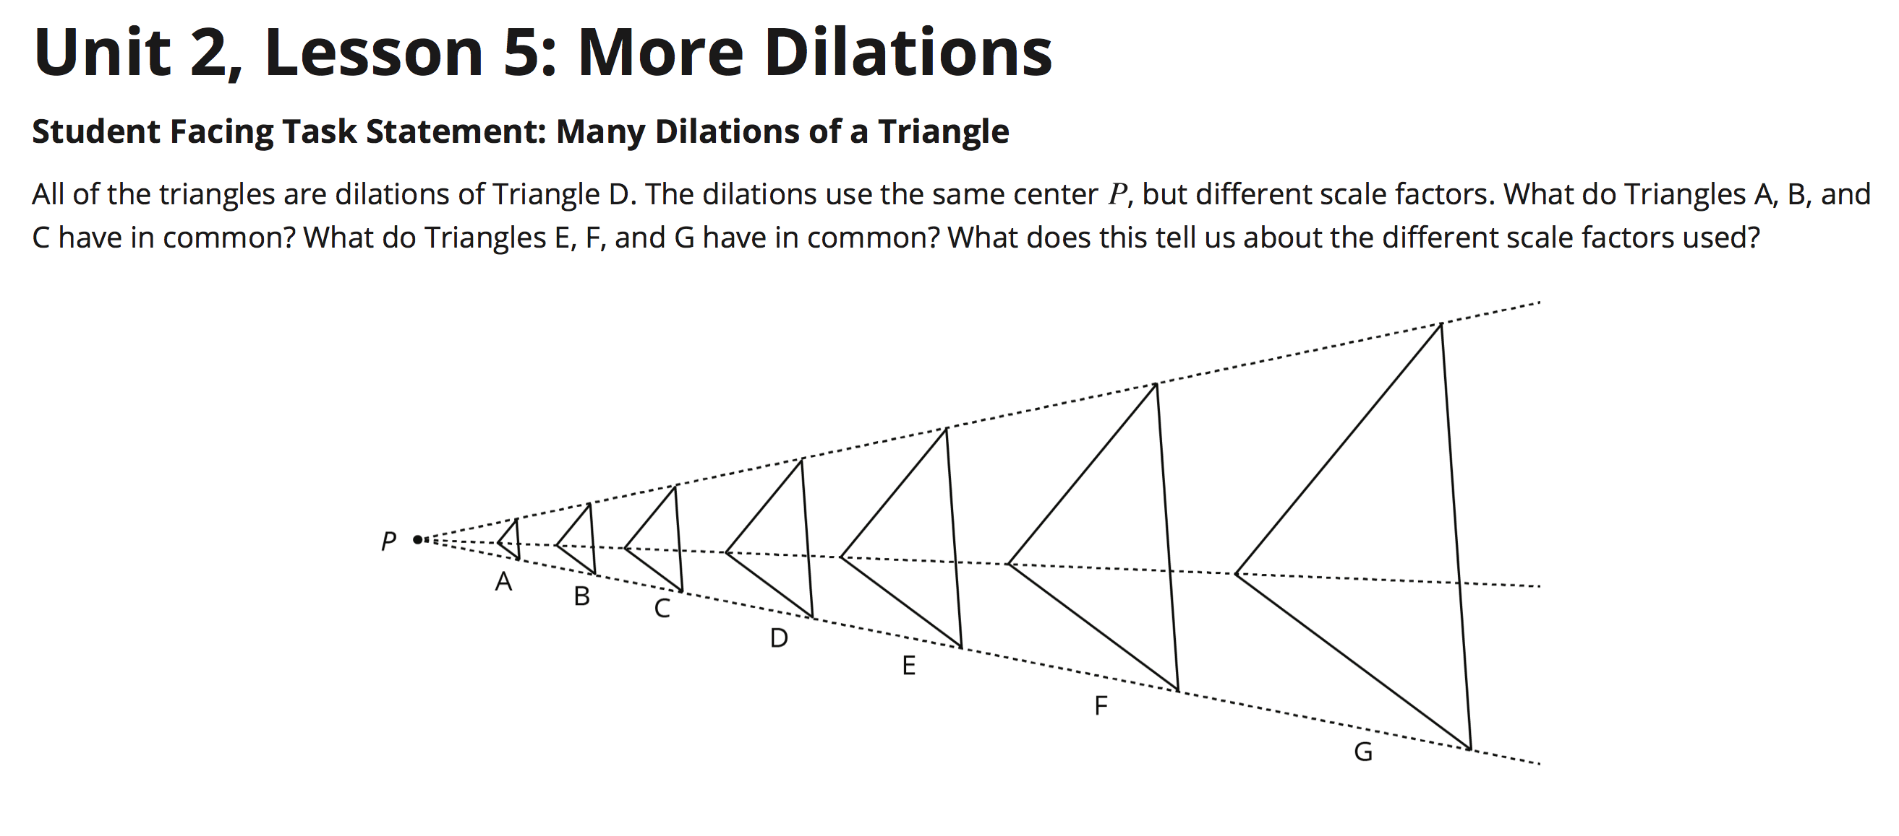

Slide 27
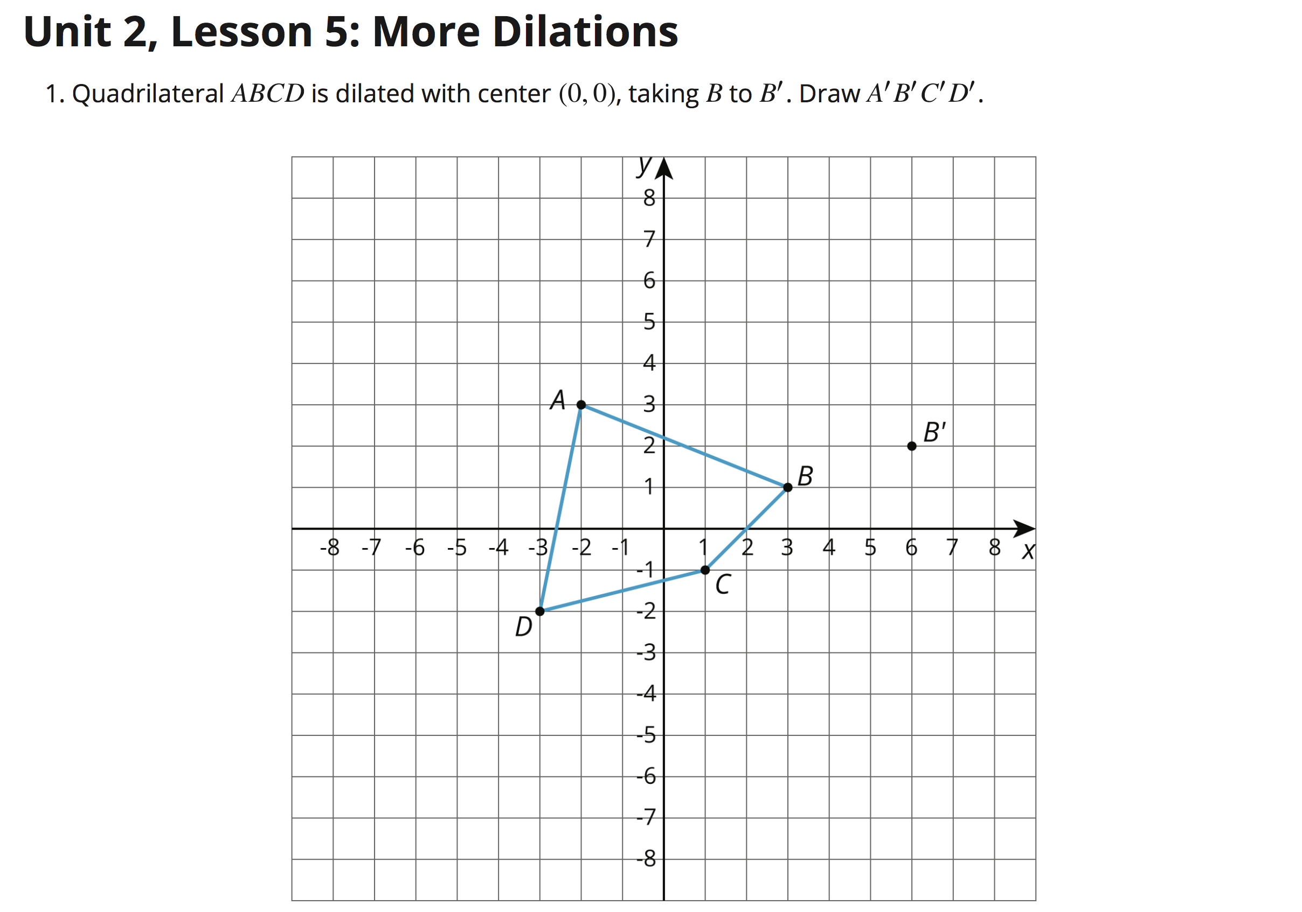
Page 46

Slide 28
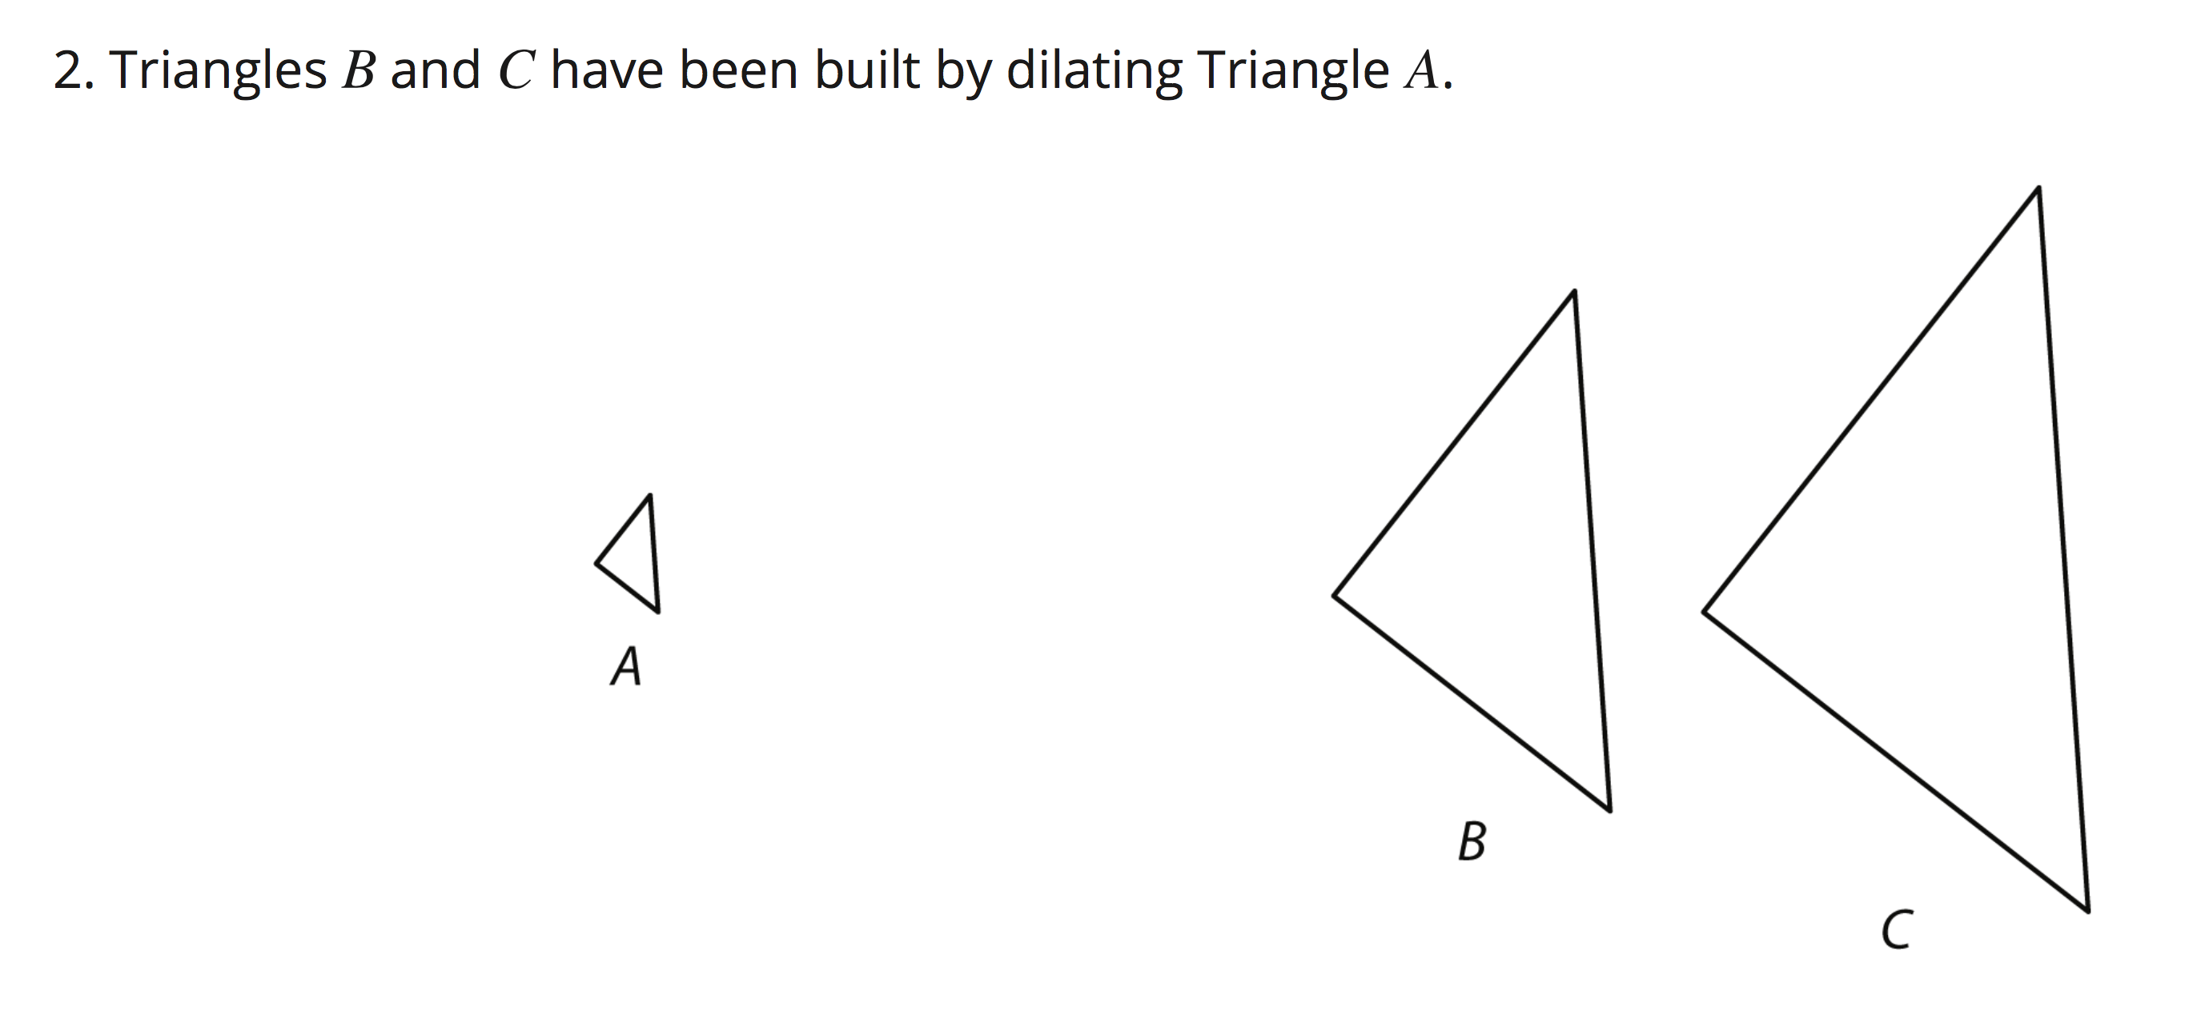

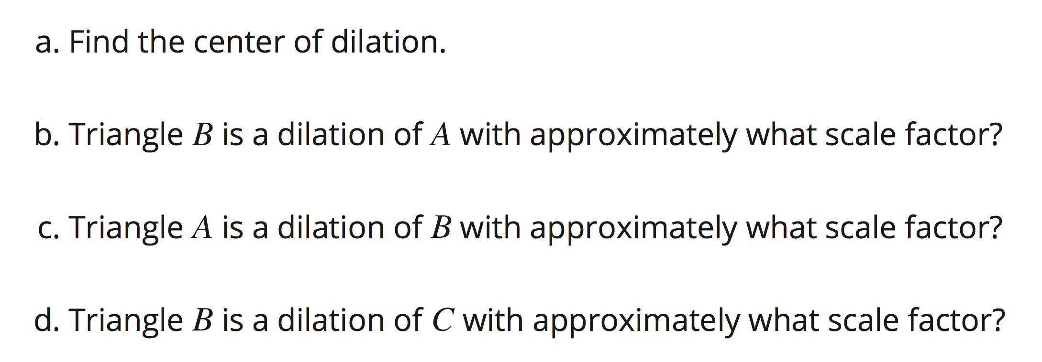
Pages 46-47

Slide 29
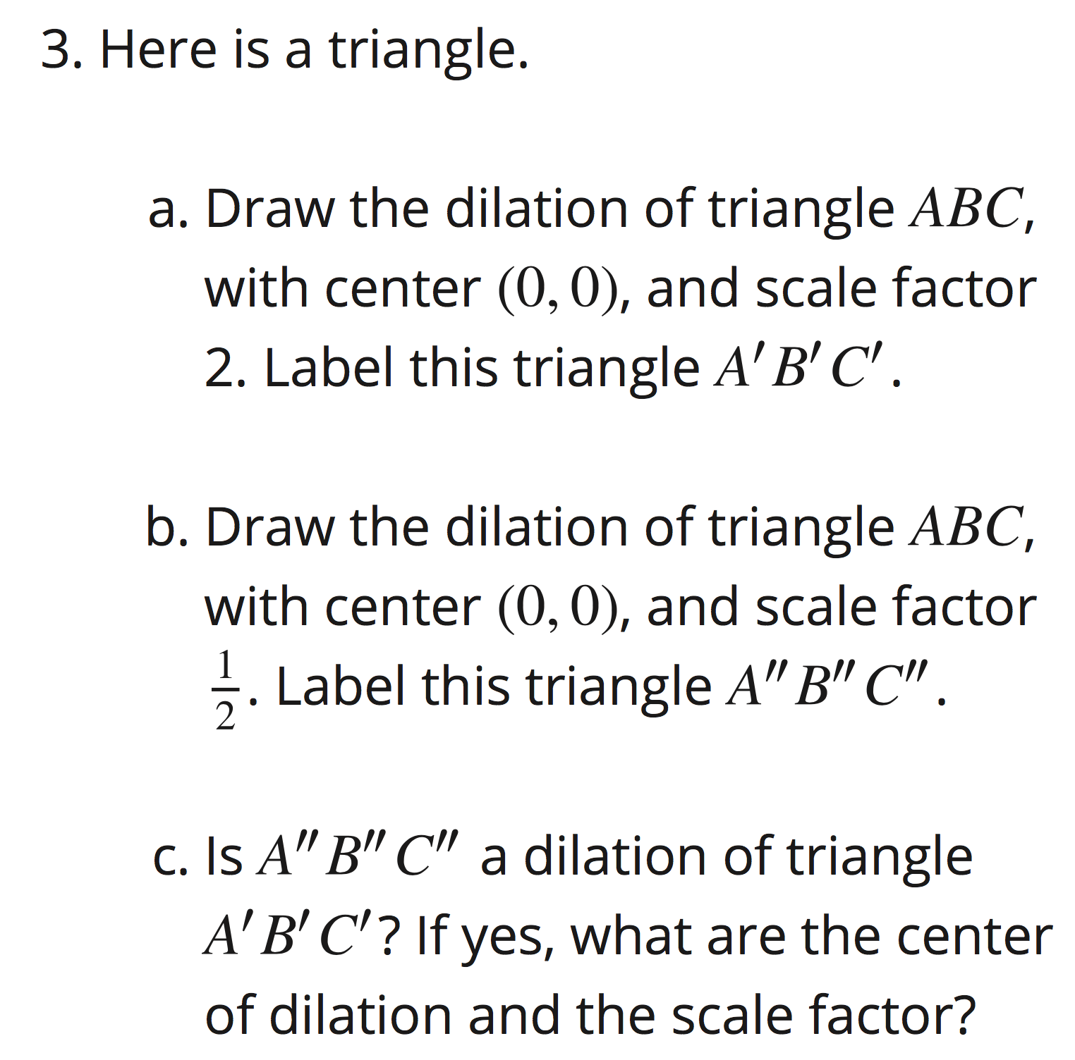
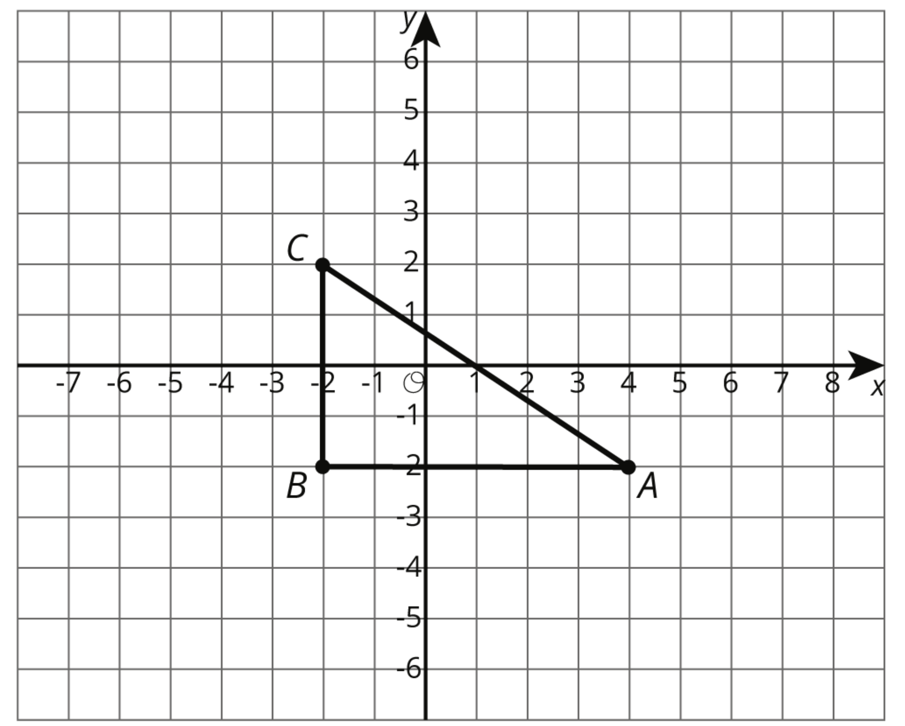
Page 48

Slide 30
Page 48
What must be true about the angle sum for ANY triangle?
Find the measures of the other two angles?
A = _______
B = _______
C = _______
28
o
o
o
You may use the triangle shown above
(from Question # 3) to guide your thinking.

