Slide 1
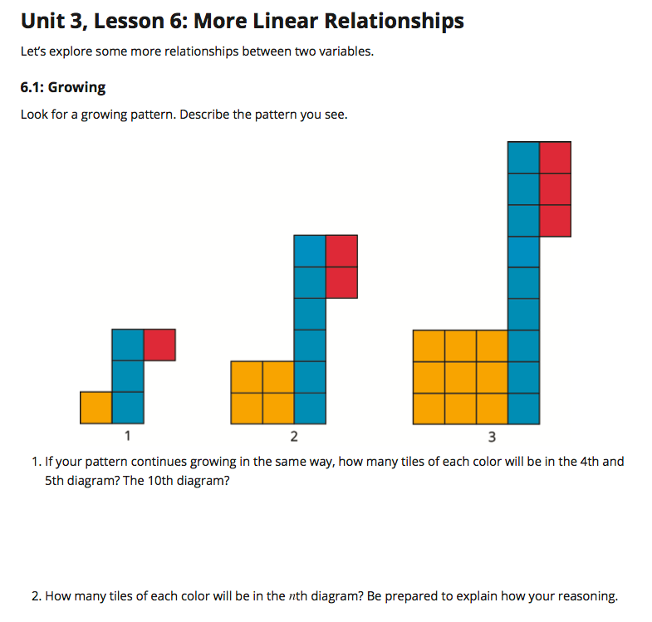

Construct a table with the following rows and columns. Leave room for additional rows to be added later.
Page 40
 | Number of Orange Squares | Number of Blue Squares | Number of Red Squares
Figure 1
Figure 2
Figure 3
Figure 4
Figure 5
Figure 10
Figure n
1 3 1
4 6 2
9 9 3
2
n 3n n

Slide 2
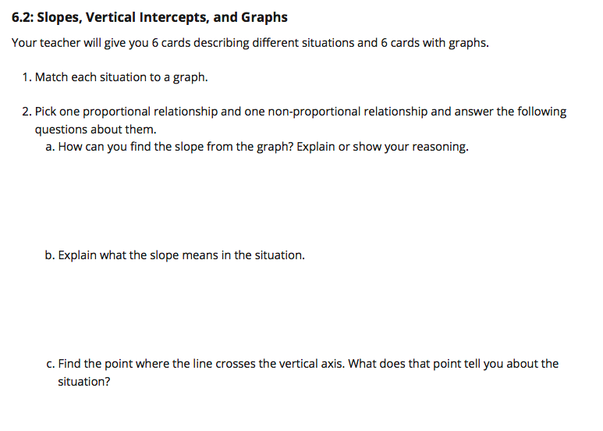
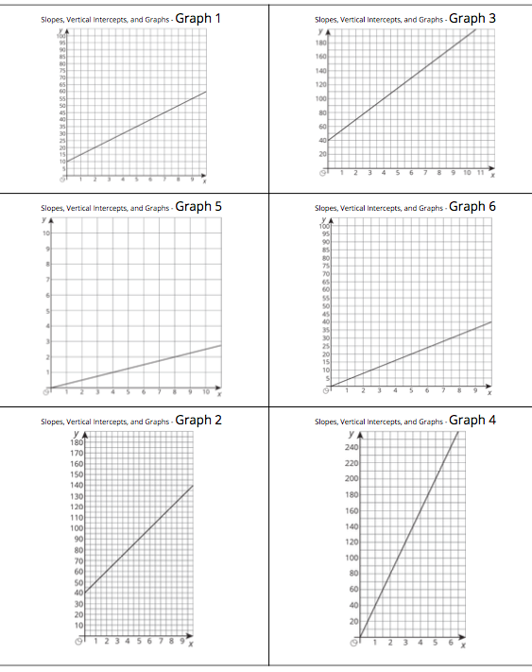
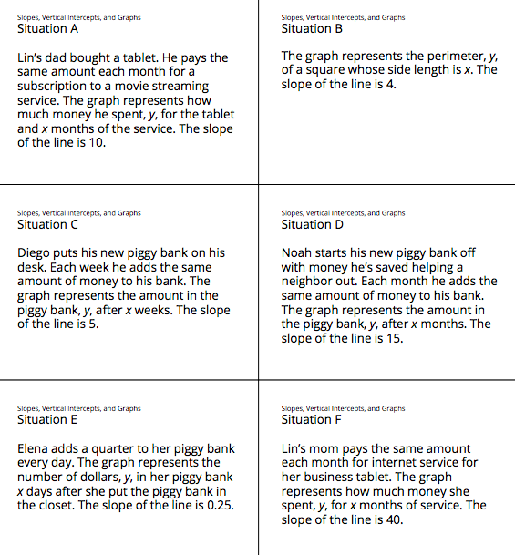
Page 41

Slide 4
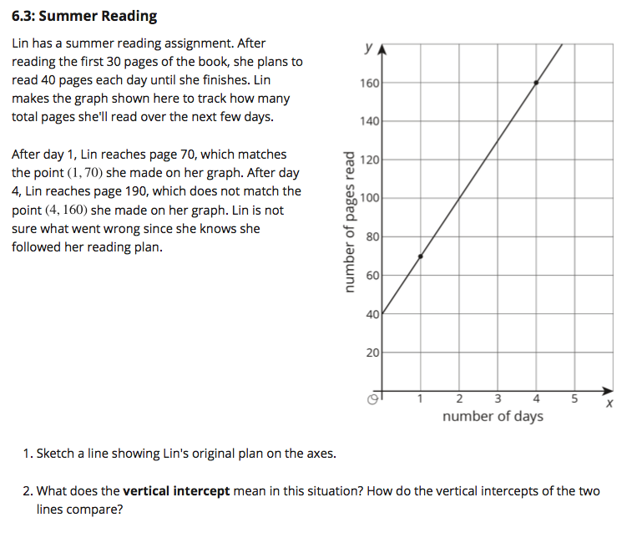

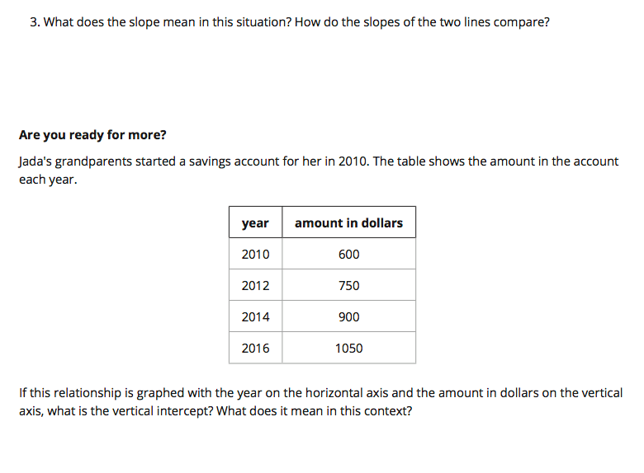
Page 42

Slide 5

Page 43
x y

Slide 6
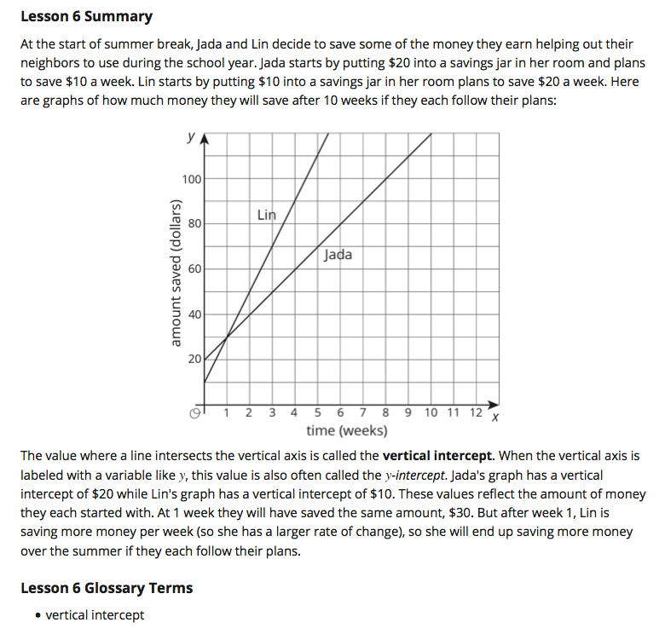
Page 44

Slide 7
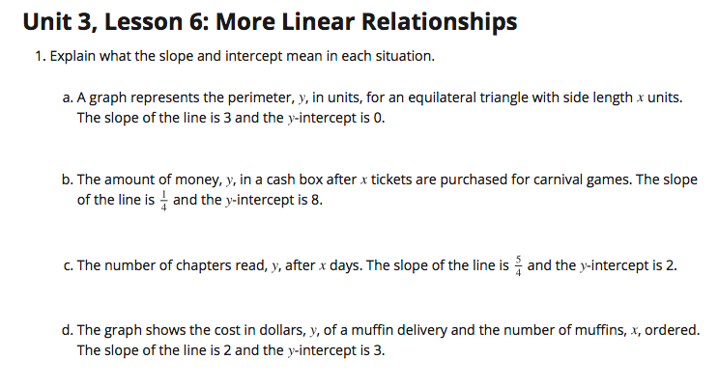
Page 45

Slide 8
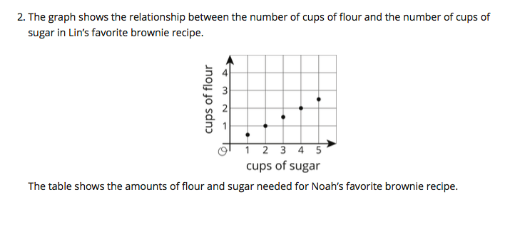
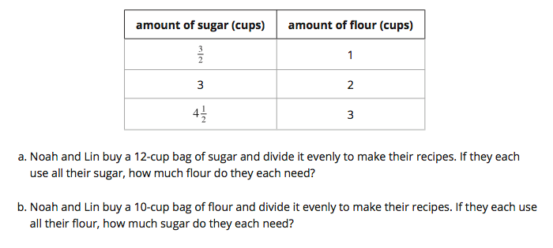
Pages 45-46
Lin’s Recipe
Noah’s Recipe

Slide 9
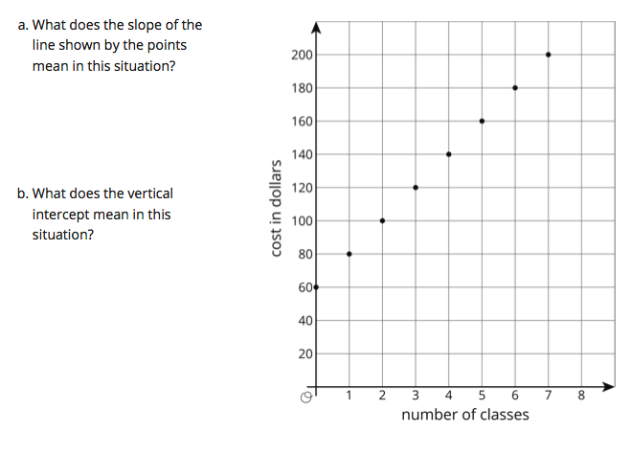
Page 46
(y)

Slide 10
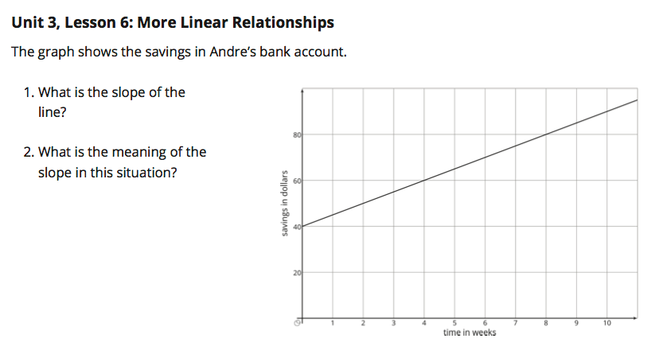
Closing Question (not in your book)
Questions:
What is the slope of the line in this graph?
What is the meaning of the slope in the context of this graph?
What is the y-intercept in this graph?
What is the meaning of the y-intercept in the context of this graph?

