Slide 1
What am I learning?
How to write equations in slope-intercept form.
How to determine if equations have equivalent meanings when written in different forms (such as order).
How to use the slope (m) and y-intercept (b) when interpreting rate of change in a graph, table, or equation.
How will I know if I have learned the lesson’s objective?
Students can write equations of lines using y=mx+b.
Students can explain where to find the slope and vertical intercept in both an equation and its graph.
Students understand that parts of equations can be given in a different order without altering the meaning. In the case of slope-intercept form y=mx+b, understand that if an equation were given in the form of y=b+mx would have the same value (b would still represent the y-intercept, and mx would still represent the coefficient multiplied by x).
8.G.1 Verify experimentally the properties of rotations, reflections, and translations.
8.EE.B Understand the connections between proportional relationships, lines, and linear equations.

Slide 2
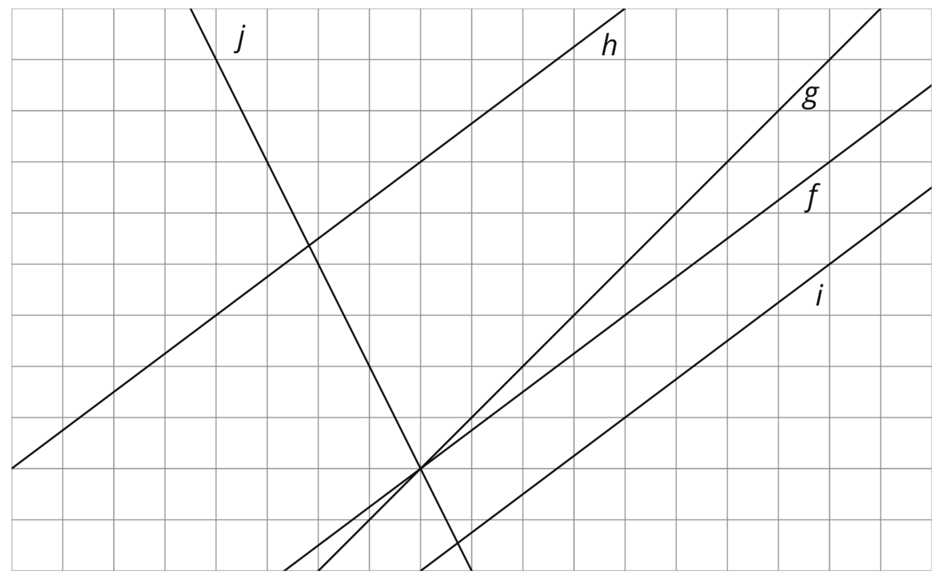
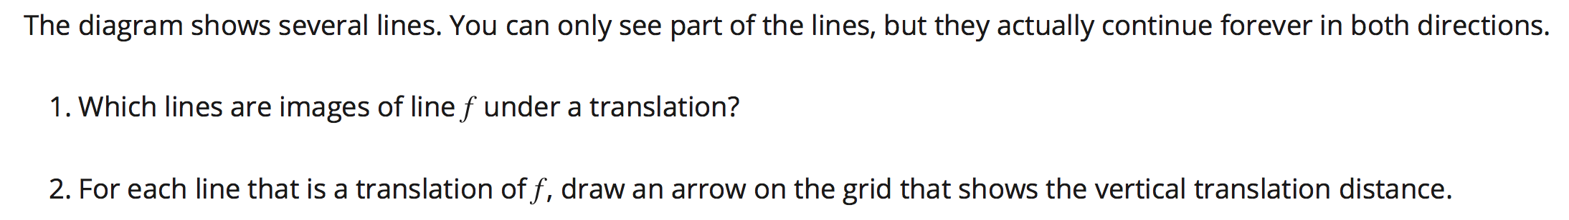
8.1 Lines that are Translations
Page 55

Slide 3
Unit 1 Vocabulary:
Translation
Rotation
Reflection
Pre-Image
Image
→ Materials issued: Tracing paper, Protractor, Working Copy (Half Sheet of Paper)
The diagram shows several lines. You can only see part of the lines, but they actually continue forever in both directions.
1. Which lines are images of line f under a translation?
2. For each line that is a translation of f , draw an arrow on the grid that shows
the vertical translation distance.

Slide 4

.
.
.
g h i j

Slide 5
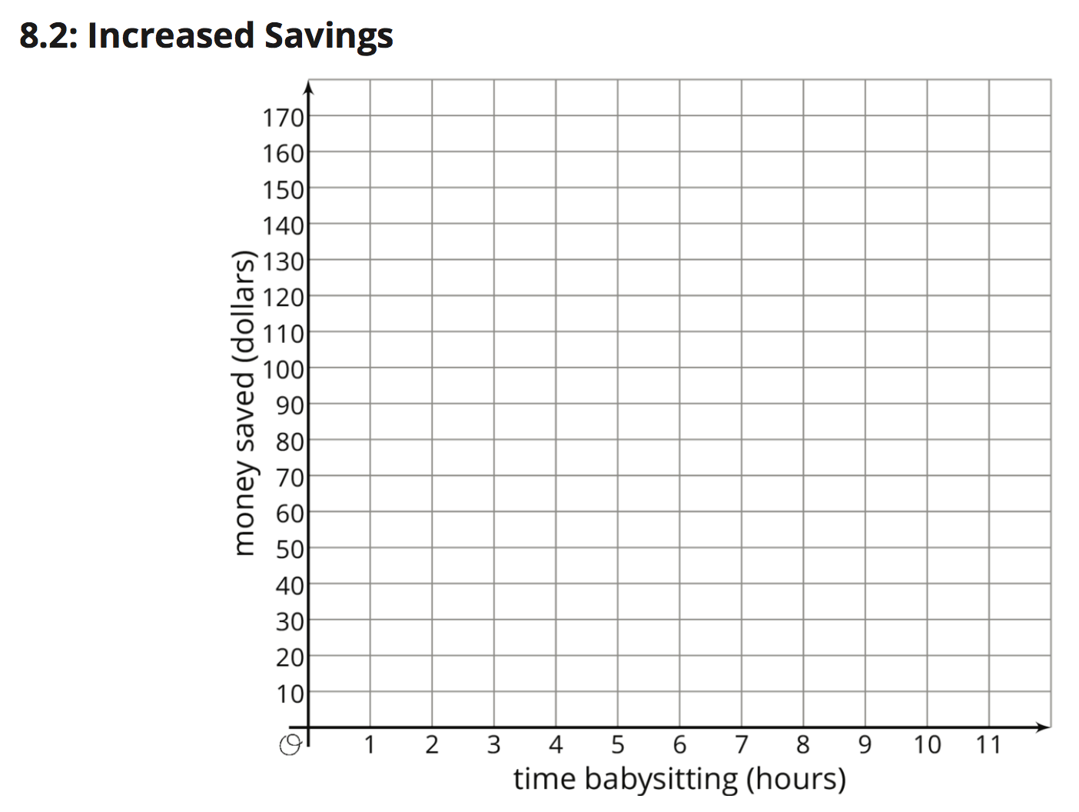
8.2 Increased Savings Page 56

Slide 6
y
x
Diego earns $10 per hour babysitting. Assume that he has no money saved before he
starts babysitting and plans to save all of his earnings. Graph how much money, y, he has
after x hours of babysitting.

Slide 7
y
.
.
.
.
.
.
.
.
.
.
.
.
.
x
Diego earns $10 per hour babysitting. Assume that he has no money saved before he
starts babysitting and plans to save all of his earnings. Graph how much money, y, he has
after x hours of babysitting.
Now imagine that Diego started with $30 saved before he starts babysitting. On the same
set of axes, graph how much money, y , he would have after x hours of babysitting.

Slide 8
y
.
.
.
.
.
.
.
.
.
.
.
Line 2
.
.
.
.
.
.
.
.
.
.
.
.
Line 1
.
.
.
x
Diego earns $10 per hour babysitting. Assume that he has no money saved before he starts
babysitting and plans to save all of his earnings. Graph how much money, y, he has after x hours of
babysitting.
Now imagine that Diego started with $30 saved before he starts babysitting. On the same set of
axes, graph how much money, y , he would have after x hours of babysitting.
Compare the second line with the first line. How much more money does Diego have after
1 hour of babysitting? 2 hours? 5 hours? x hours?

Slide 9
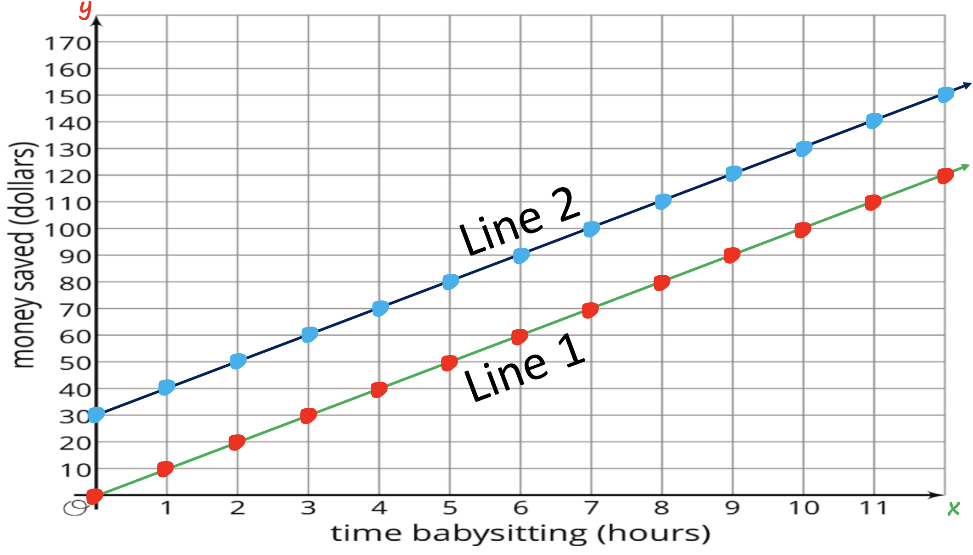
Diego earns $10 per hour babysitting. Assume that he has no money saved before he starts
babysitting and plans to save all of his earnings. Graph how much money, y, he has after x hours of
babysitting.
Now imagine that Diego started with $30 saved before he starts babysitting. On the same set of
axes, graph how much money, y , he would have after x hours of babysitting.
Compare the second line with the first line. How much more money does Diego have after
1 hour of babysitting? 2 hours? 5 hours? x hours?
Write an equation for each line.

Slide 10
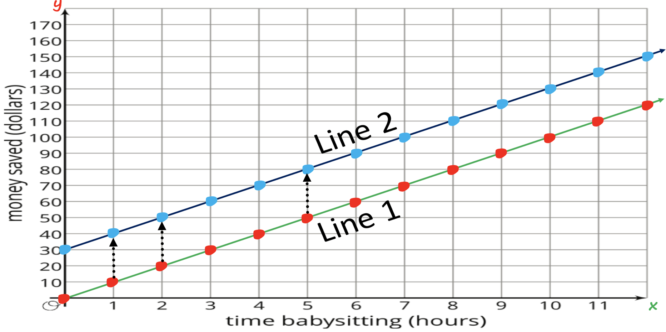
y=10x+30
y=10x
4. Write an equation for each line.
(Use slope-intercept form y=mx+b)

Slide 11
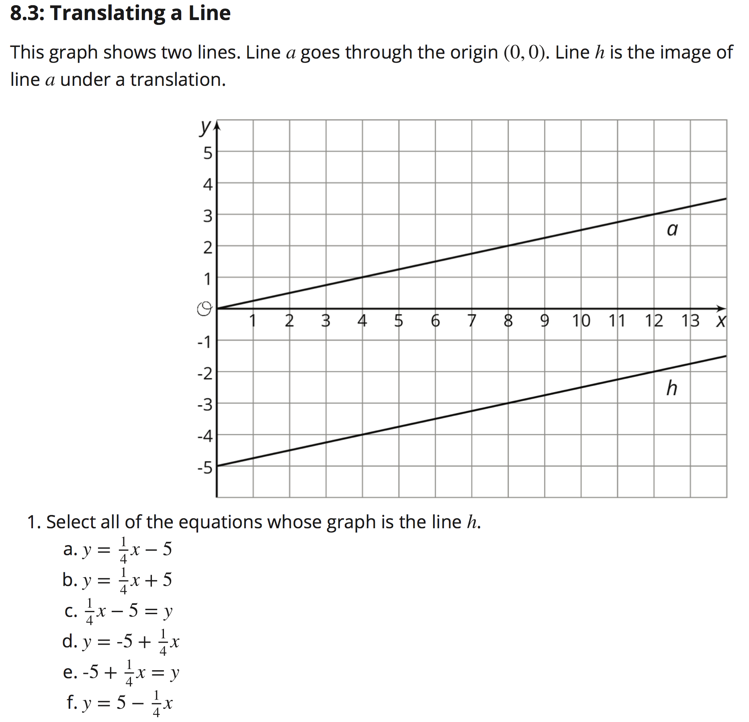



8.3 Translating a Line Page 57
This graph shows two lines. Line a goes through the origin (0,0). Line h is the image of line a under a translation.
1. Select all the
equations
whose graph
is the line h.
.
.
y = ¼ x
.
.

Slide 12
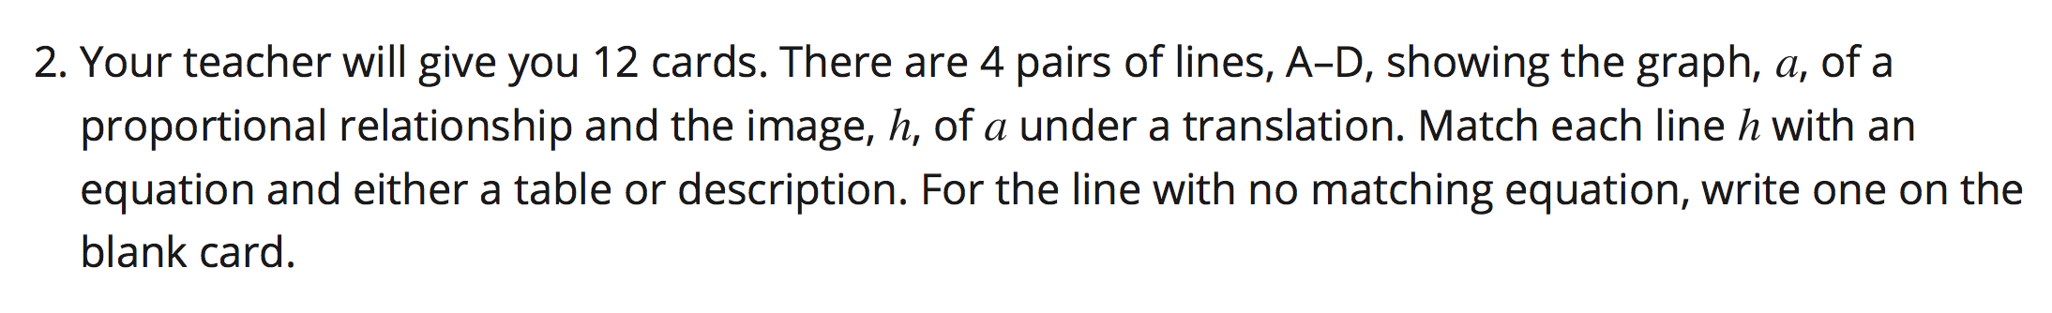
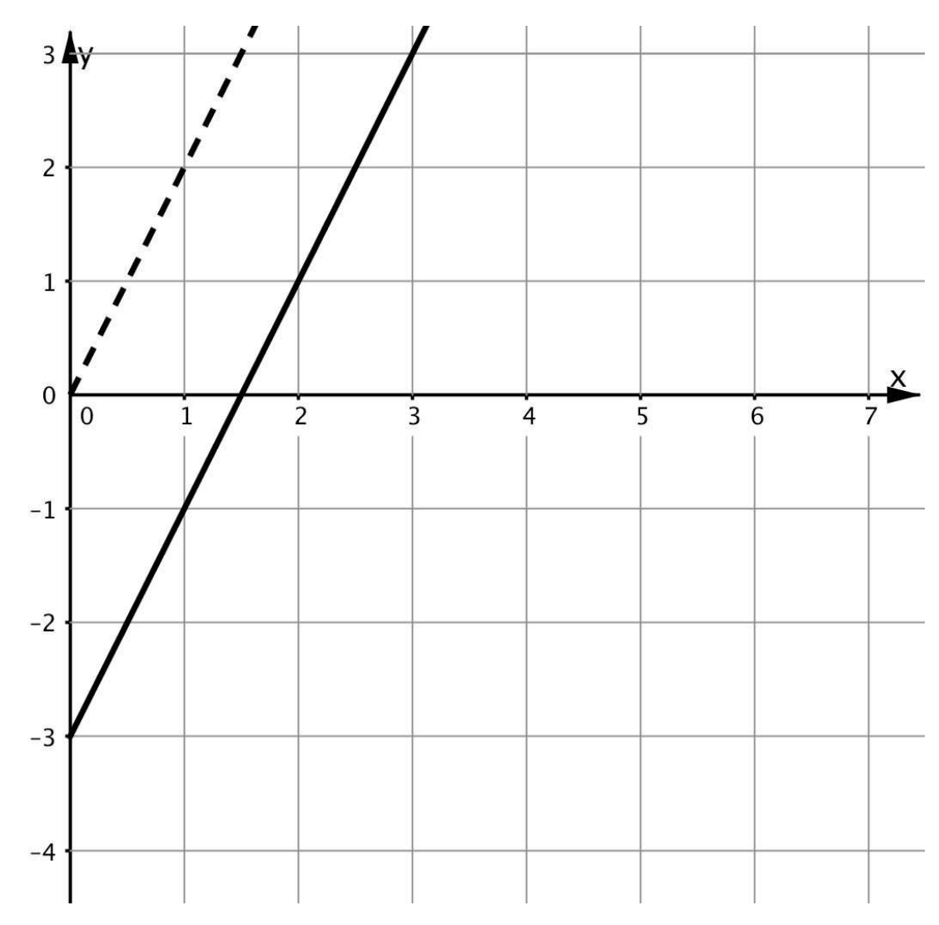
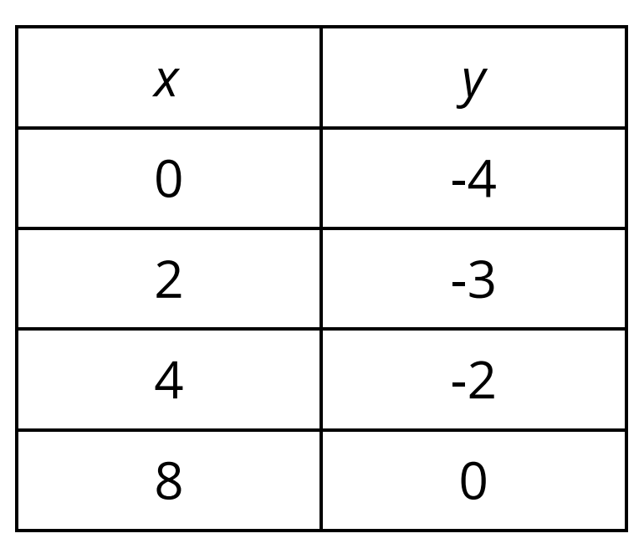
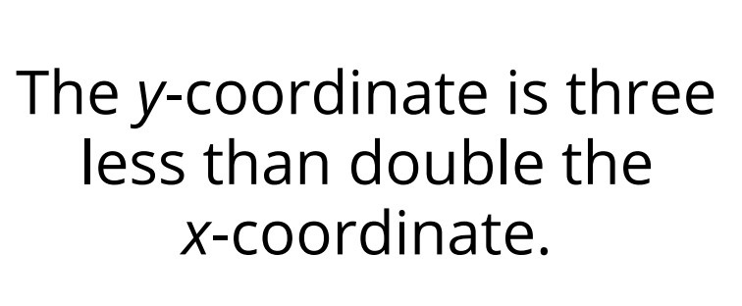
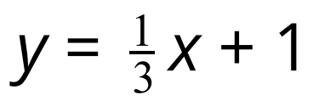

Slide 13
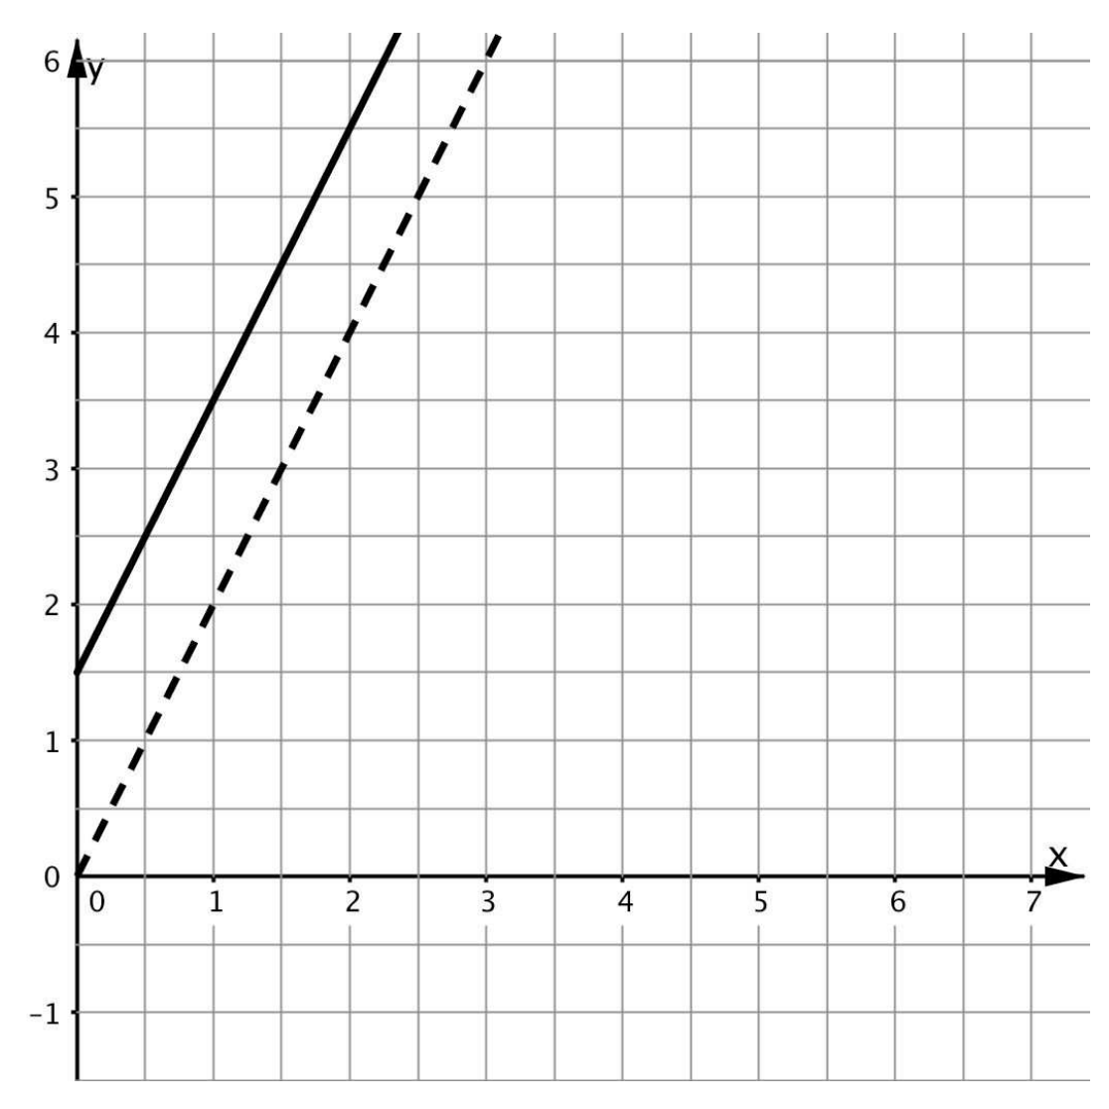
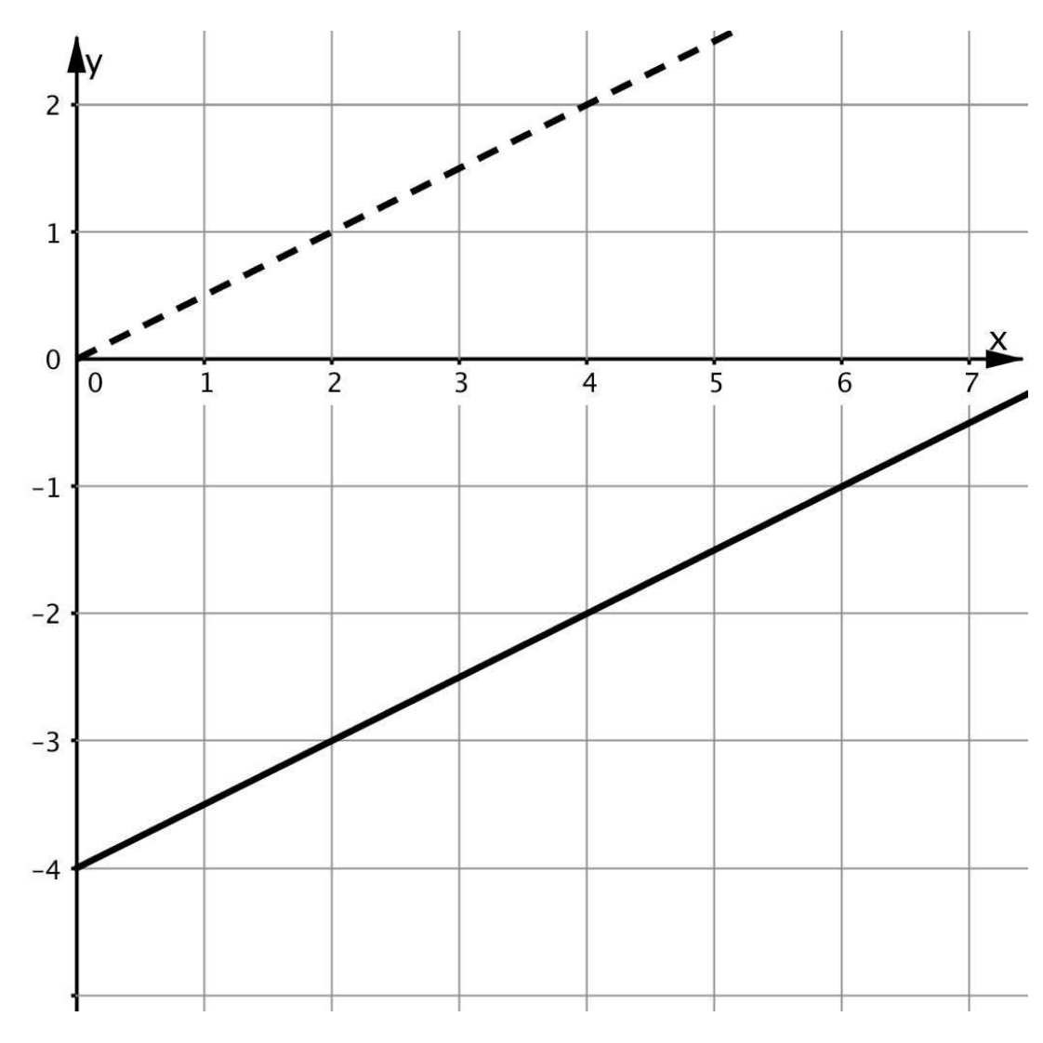
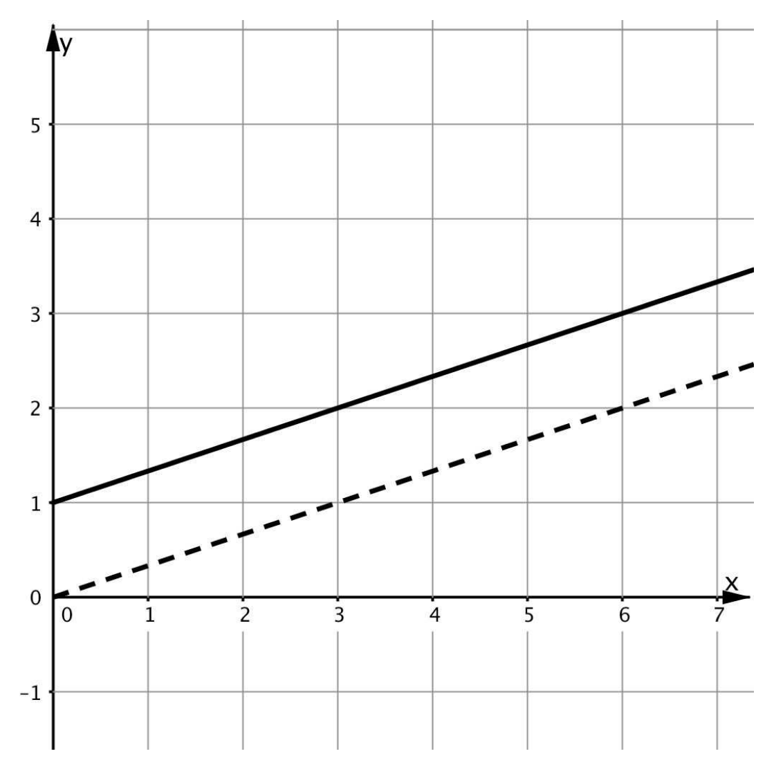

Slide 14
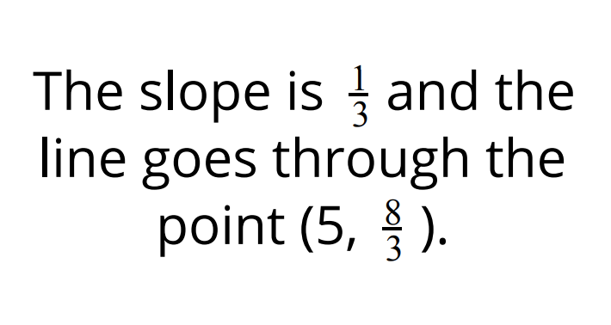
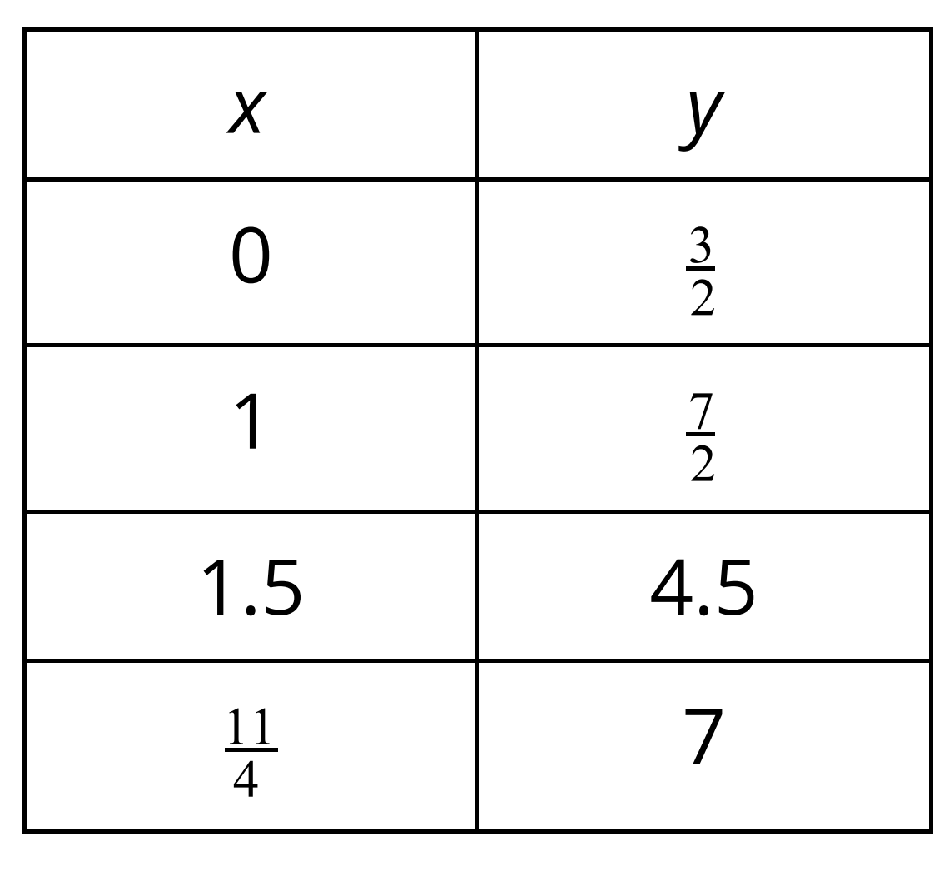

Slide 15
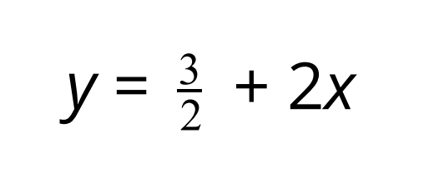
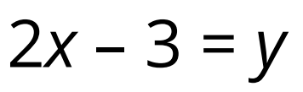
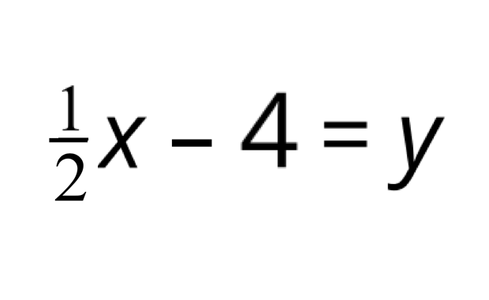
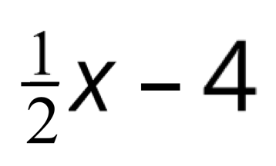

Slide 16
What am I learning?
How to write equations in slope-intercept form.
How to determine if equations have equivalent meanings when written in different forms (such as order).
How to use the slope (m) and y-intercept (b) when interpreting rate of change in a graph, table, or equation.
How will I know if I have learned the lesson’s objective?
Students can write equations of lines using y=mx+b.
Students can explain where to find the slope and vertical intercept in both an equation and its graph.
Students understand that parts of equations can be given in a different order without altering the meaning. In the case of slope-intercept form y=mx+b, understand that if an equation were given in the form of y=b+mx would have the same value (b would still represent the y-intercept, and mx would still represent the coefficient multiplied by x).
8.G.1 Verify experimentally the properties of rotations, reflections, and translations.
8.EE.B Understand the connections between proportional relationships, lines, and linear equations.

Slide 17
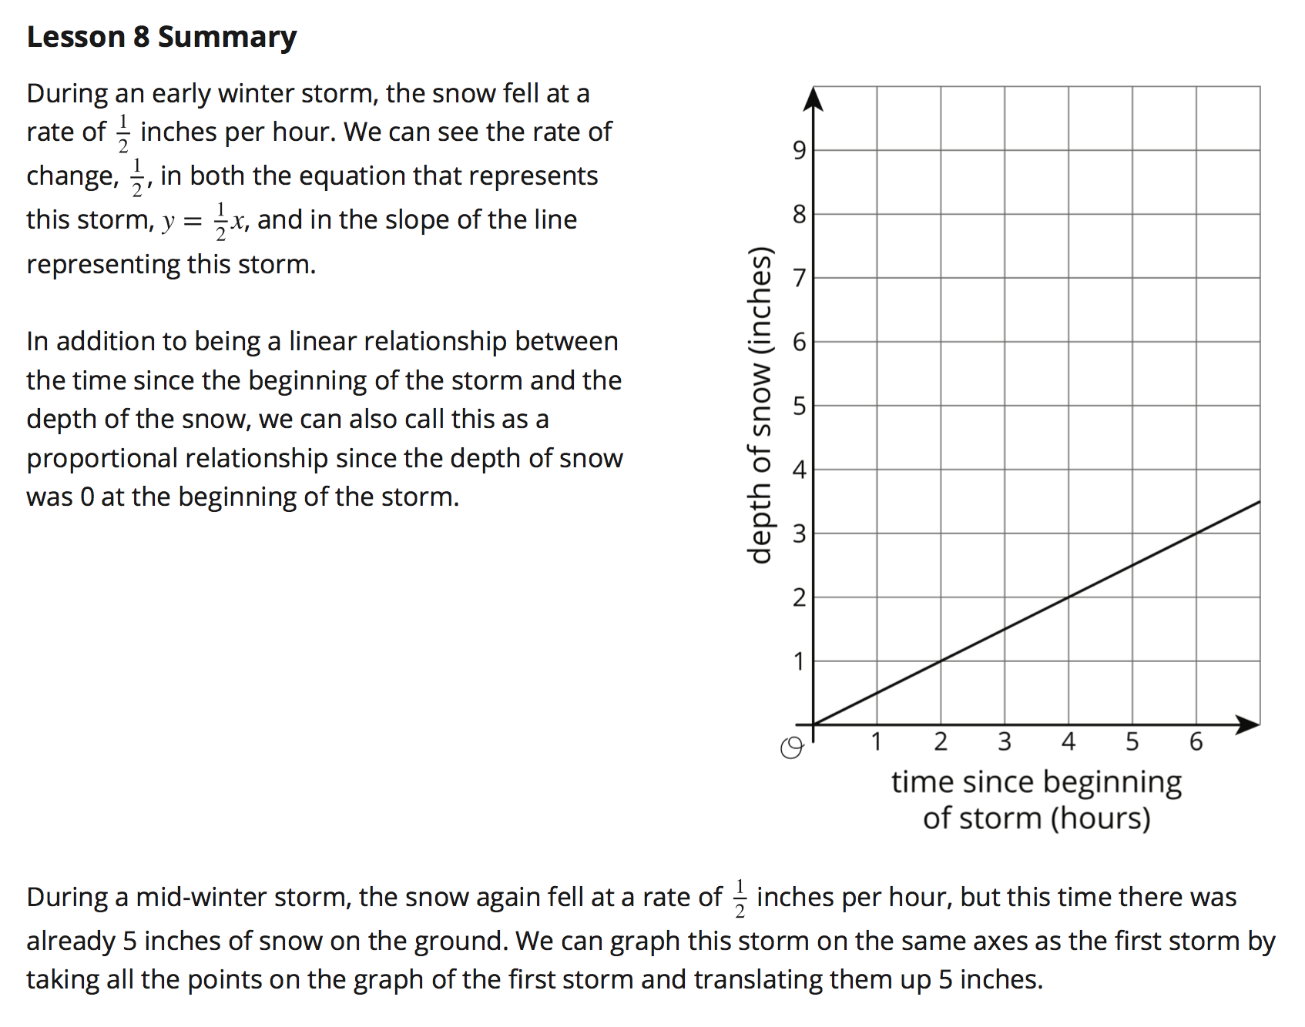
Page 58-59

Slide 18
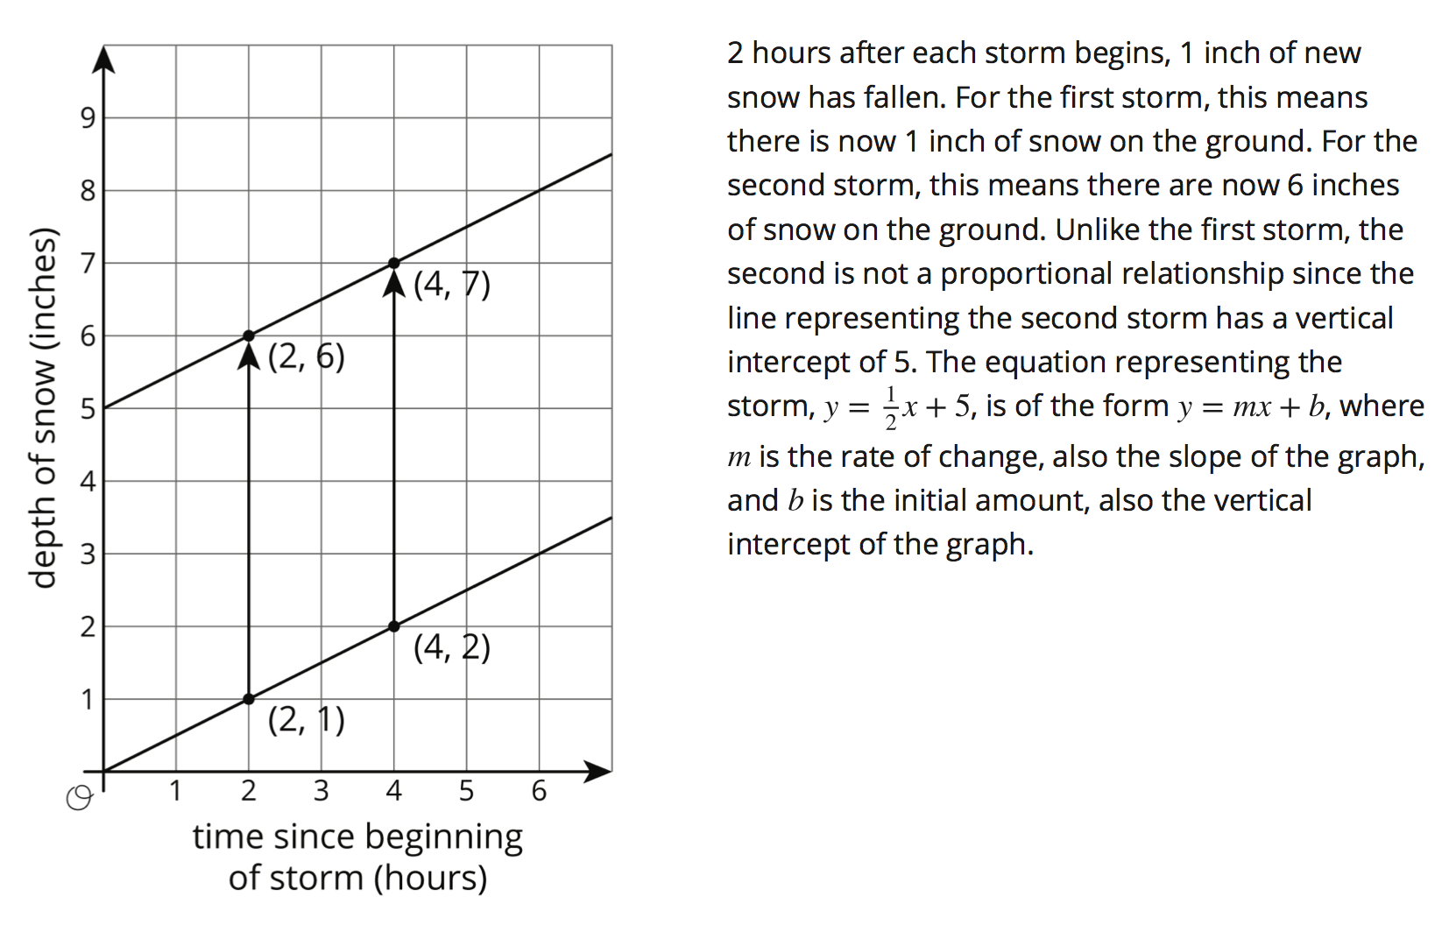
Page 58-59

Slide 19


Describe to your partner what you see when comparing the equations below. What is the similar? What is different? What does their graph look like?
y = ½ x y = ½ x + 5
Exit Ticket

Slide 20
Homework:
Page 60 Problem # 1
Page 61 Problem # 4

