Slide 1


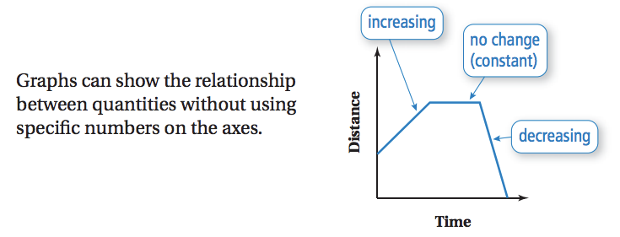
Turn in your Homework to the box before the tardy bell rings.
Which variable is your independent variable?
Which variable is your dependent variable?

Slide 2
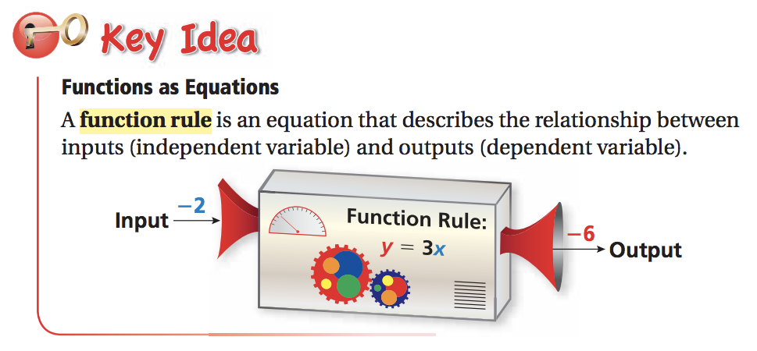
An output value is a function of the input value.
The input value is not a function of the output value.

Slide 3
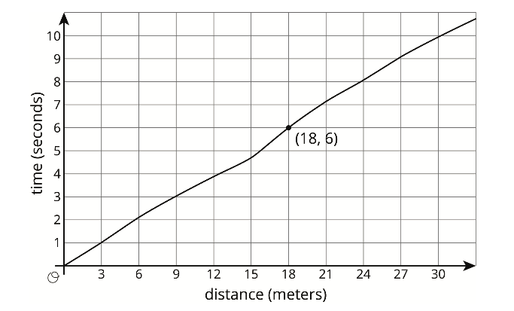
In this graph, what does the the ordered pair (18, 6) refer to ?
What is the independent variable?
What is the dependent variable?
Determine another (input, output) value from this graph and describe what it means in context.

Slide 4
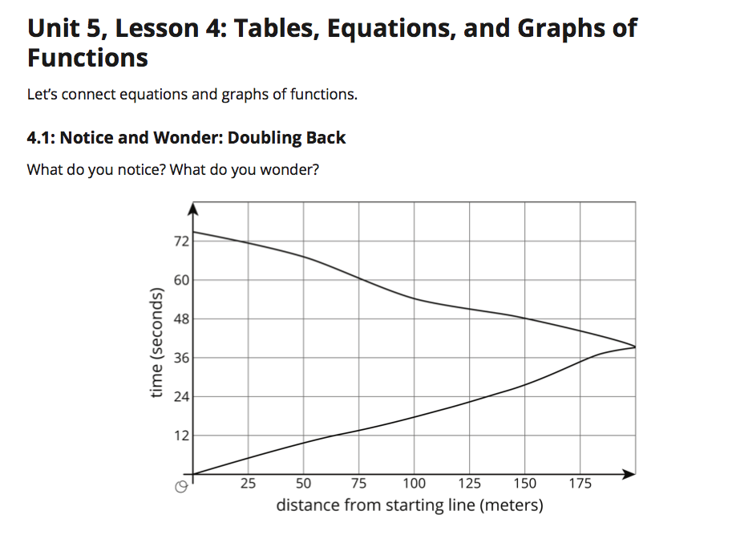
Page 24

Slide 5
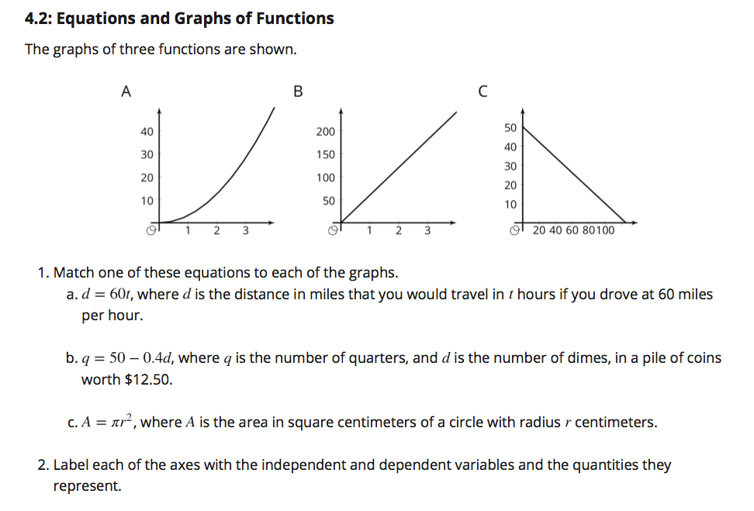
Page 24

Slide 6
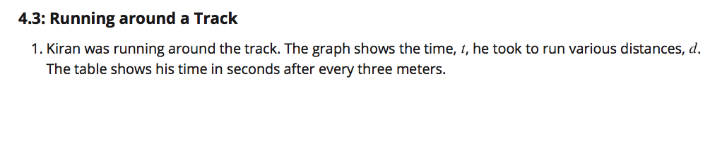
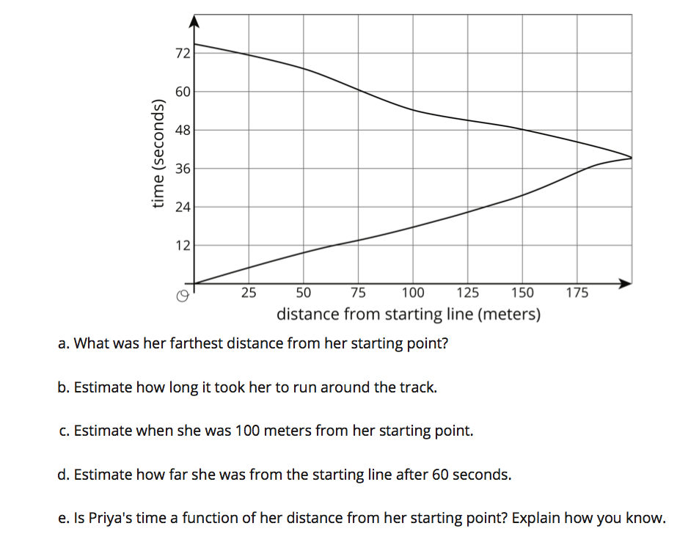
Pages 26-27

Slide 7

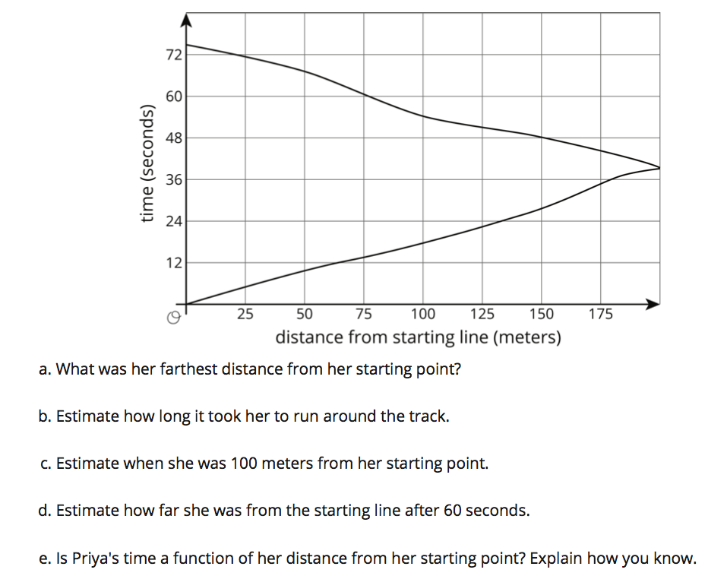
Page 27

Slide 8
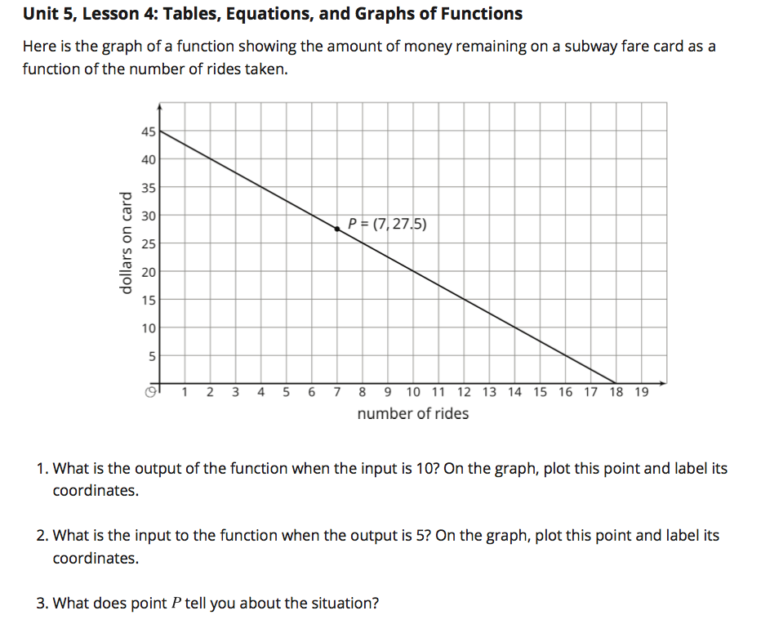
Cool Down

Slide 9
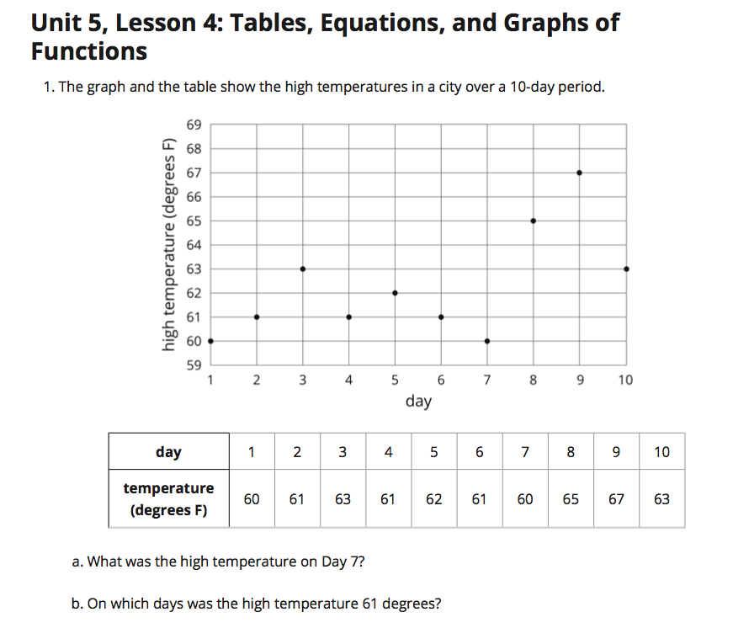
Page 29

Slide 10
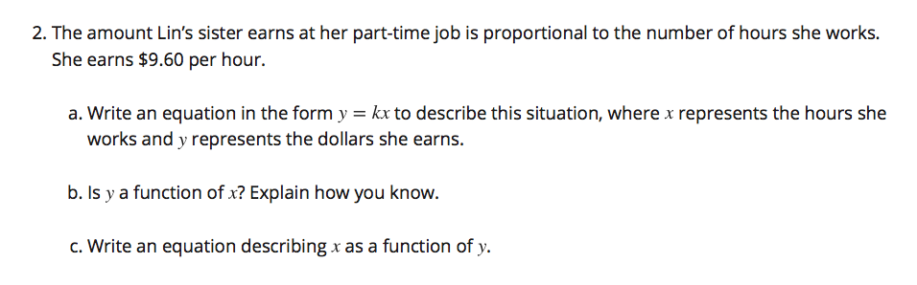
Page 30

Slide 11
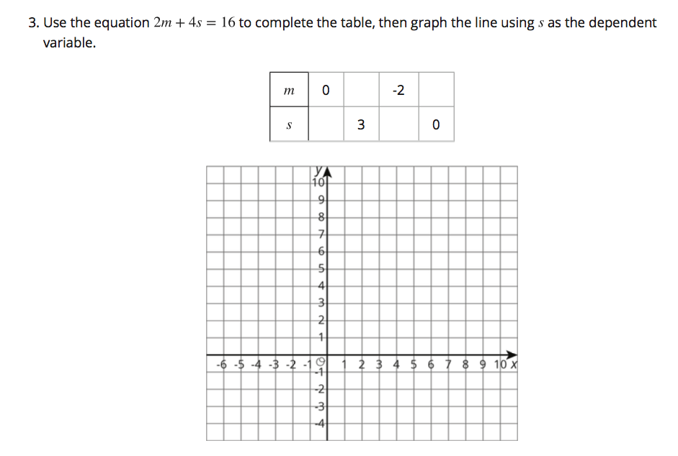
Page 30

Slide 12
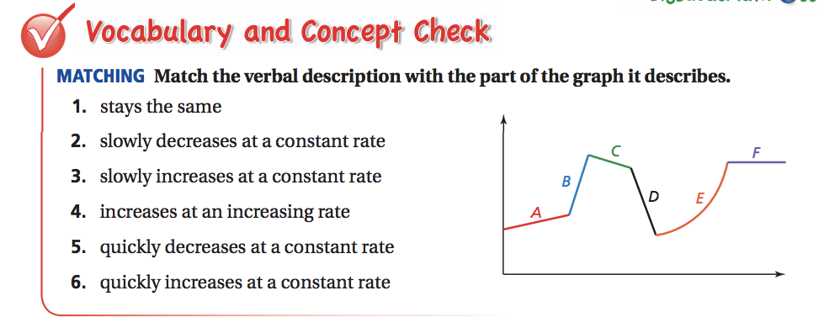


Slide 13
