Slide 1
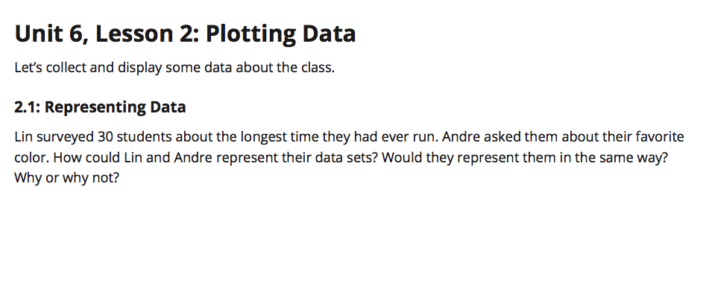
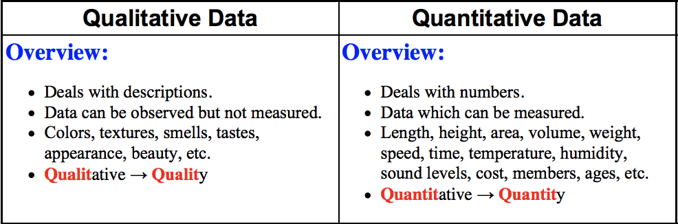

Page 13

Slide 2
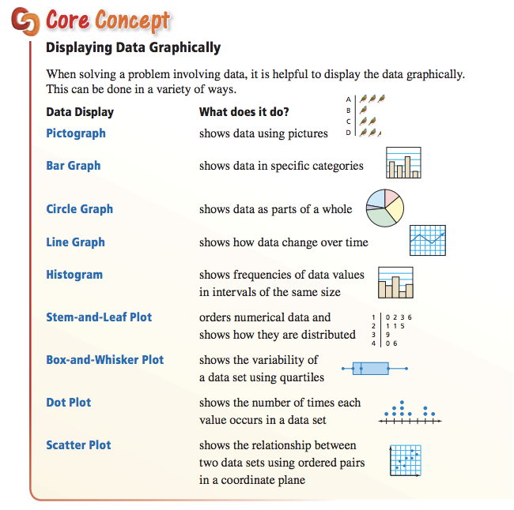

Slide 3
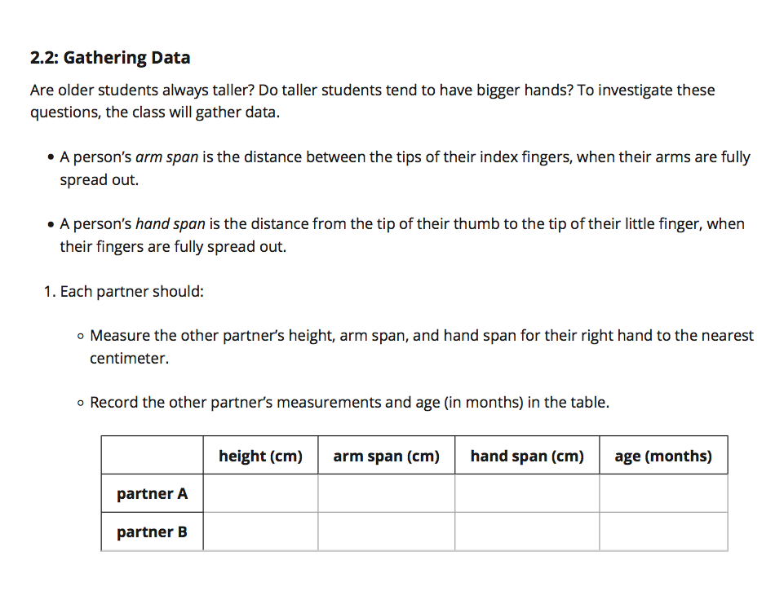
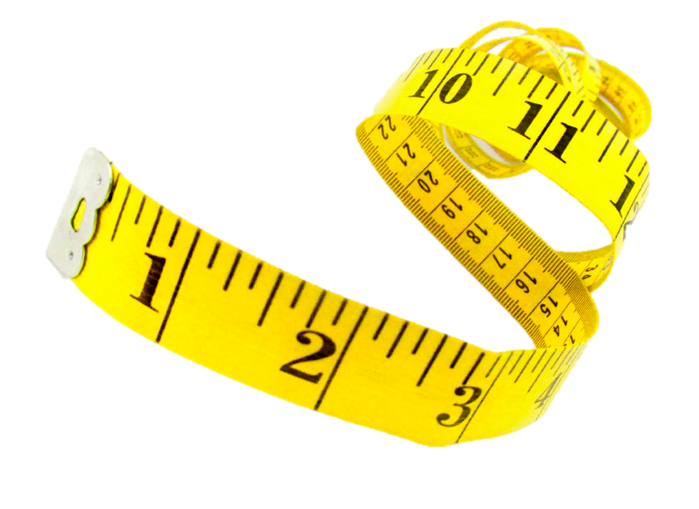
Page 13
→ We are going to use inches for height since most students know how tall they are.
Height
(in inches)
Arm Span
(in cm)
Hand Span
(in cm)
Age
(in years)

Slide 4
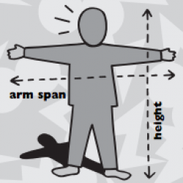
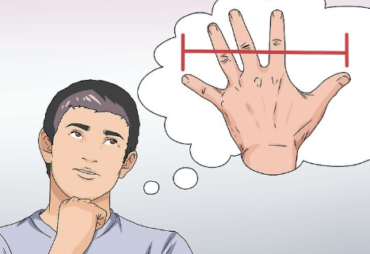

Slide 5
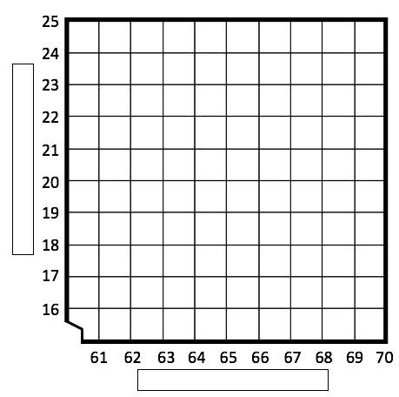
2.3: Scatter Plots (Modified – Keep this paper in your book) PART 1
Page 14
Graph the relationship between height of students (in inches) vs. their hand span (in cm).
Place data for your self and your partner into the graph using a STAR ☆.
Find 10 other students. Record their data, then graph with points. If any data exceeds the graph, place at farthest point possible.
Name of Student | Height (in) | Hand Span (cm)
YOU
Partner
After completing your table and graphing your data into the scatter plot, describe the correlation you see between a student’s height compared to their hand span.
______________________________________________________________________________________________________________________________________________________________________________________________________________________________________________________________________________________________________________________________

Slide 6
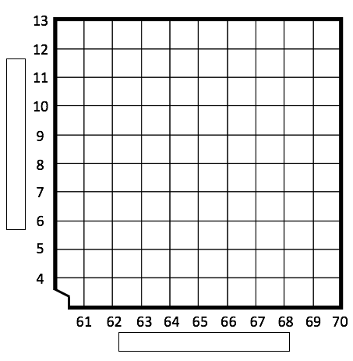
2.3: Scatter Plots (Modified – Keep this paper in your book) PART 2
Page 14
Graph the relationship between height of students (in inches) vs. their Shoe Size (in U.S. size).
Place data for your self and your partner into the graph using a STAR ☆.
Find 10 other students. Record their data, then graph with points. If any data exceeds the graph, place at farthest point possible.
Name of Student | Height (in) | Shoe Size (in U.S. size)
YOU
Partner
After completing your table and graphing your data into the scatter plot, describe the correlation you see between a student’s height compared to their shoe size.
______________________________________________________________________________________________________________________________________________________________________________________________________________________________________________________________________________________________________________________________

Slide 7
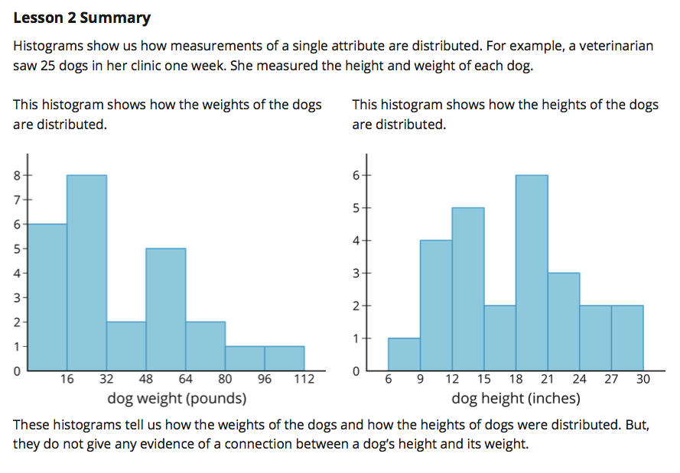
Page 16

Slide 8
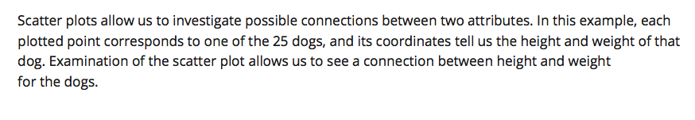
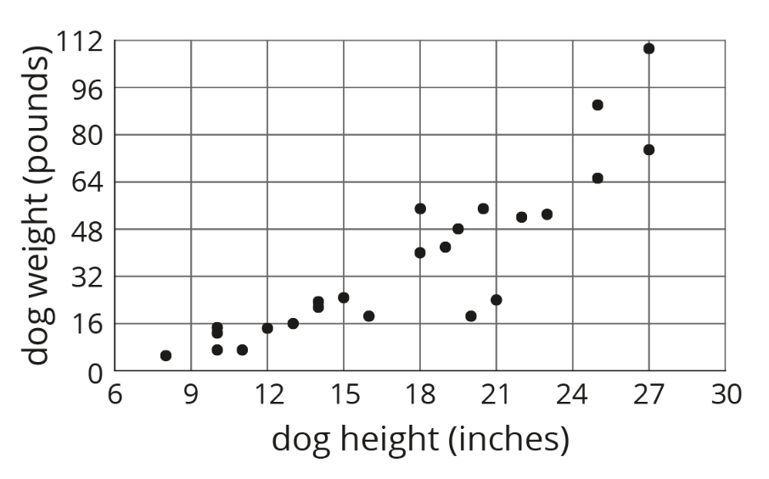
Page 16

Slide 9
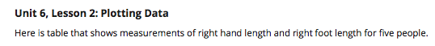
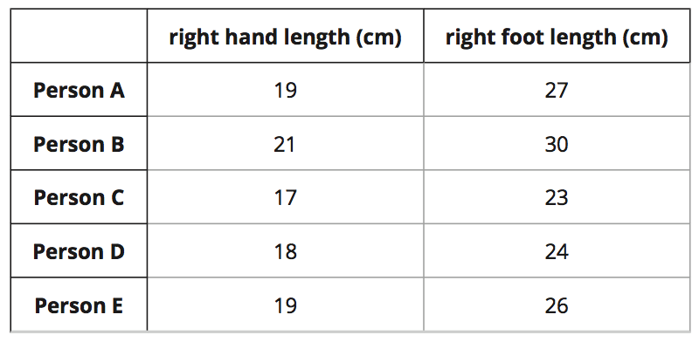
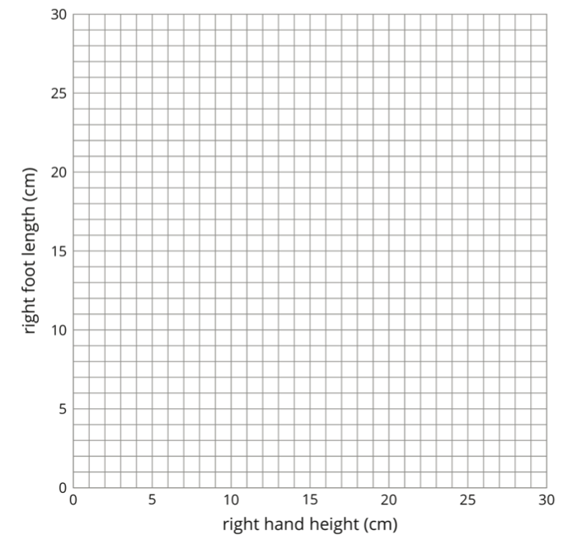
Name: __________________________ 3.4.19
Cool Down Question
(not on your book)
Directions:
Draw a scatter plot for the data in the table above.
Circle the point in the scatter plot that represents Person D’s measurements.
Write a brief description describing the correlation between right hand length and right foot length.
___________________________________________________________________________________________________________________________________________________________

Slide 10
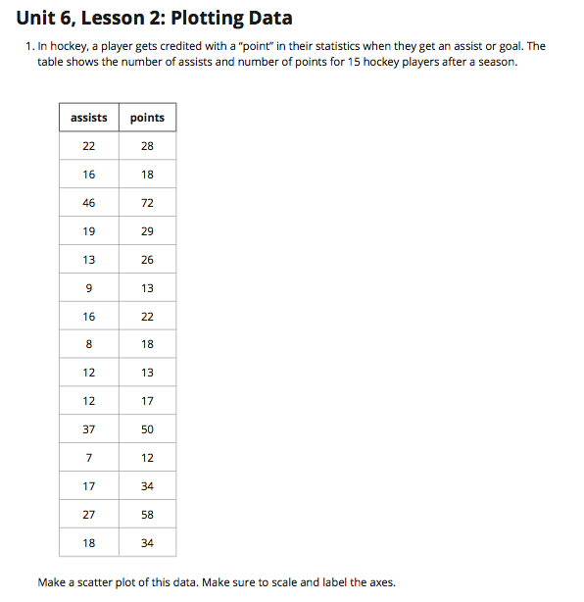
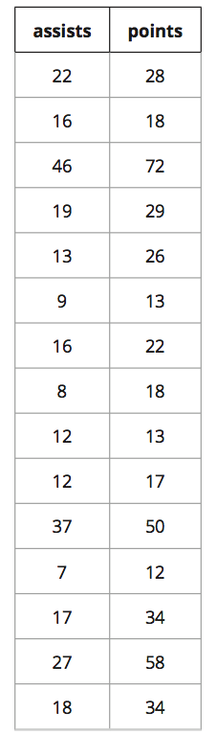
Practice Problem # 1 Page 17
50
45
40
35
30
25
20
15
10
5
Data
A. Label the x and y axis with
appropriate variable.
Plot each set of points into
the graph to form a scatter plot.
Describe the correlation shown in
the graph between assists and points.
_______________________________
_______________________________
_______________________________
______________________________________________________________
0
5 10 15 20 25 30 35 40 45 50

