Slide 1





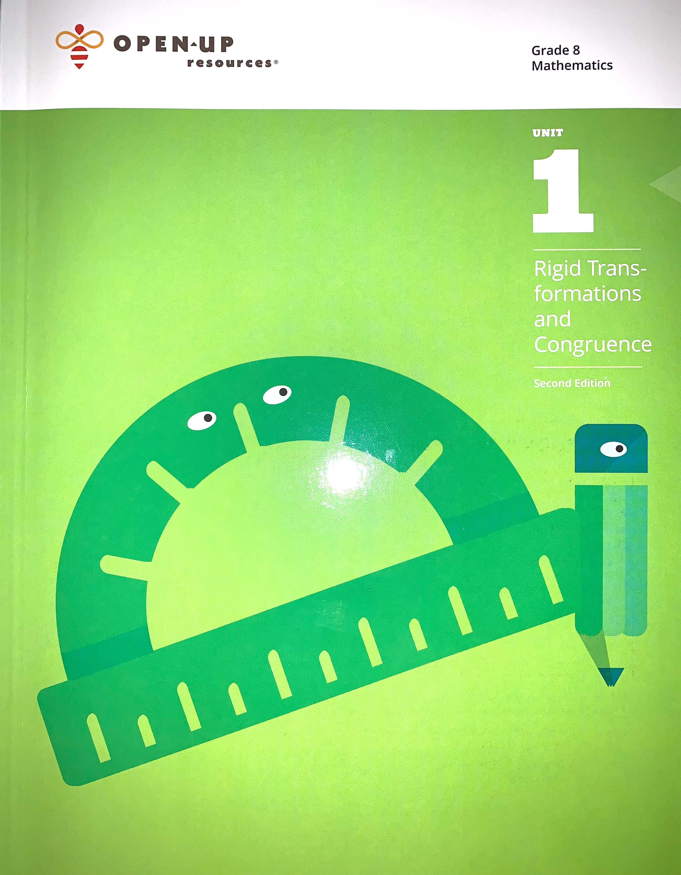
AGENDA FOR THURSDAY 9/10/20 – FRIDAY 9/11/20
Illustrative Mathematics UNIT 1 Lesson 6
→ Please make sure you have your Workbooks ready (open to Lesson 6 pg.47)
→ Our focus for today will be using and applying vocabulary from Unit 1 .
→ Classwork: Pages 47, 50, and 51.
Today’s Assignment (During Asynchronous ? Time):
→ Activity 9.10.20-9.11.20 on Desmos – the hyperlinked code will be on Mr.
Pearson’s website www.mathpearson.com after the lesson today.
Lesson Standard(s):
8.G.1 Verify experimentally the properties of rotations, reflections, and translations.
​8.G.3 Describe the effect of dilations, translations, rotations, and reflections on two-dimensional figures using coordinates.

Slide 2
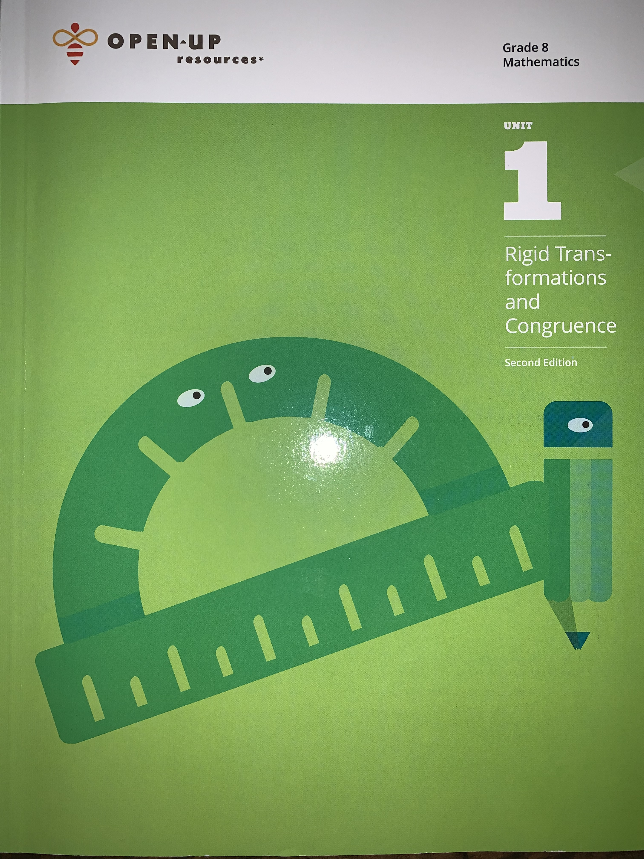
At this time, please prepare to go to take out your Unit 1
Illustrative Mathematics Workbooks and wait for instructions.
After completing this unit, you’ll be able to:
Navigate around the system.
View your daily tasks, leads, and referrals on your home page.
Display details about a client or customer.

Slide 3
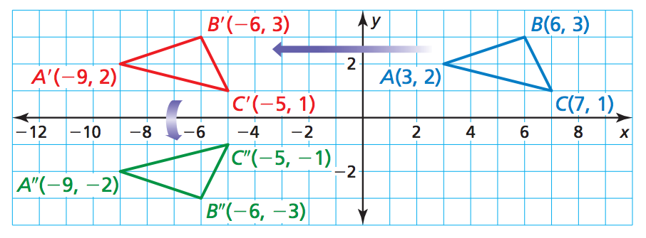

Which figure shown is the Pre-Image?
Describe the first transformation:
CHOOSE ONE: Rotation / Reflection / Translation, then add more details.
Describe the second transformation:
CHOOSE ONE: Rotation / Reflection / Translation, then add more details.
1
2

Slide 4
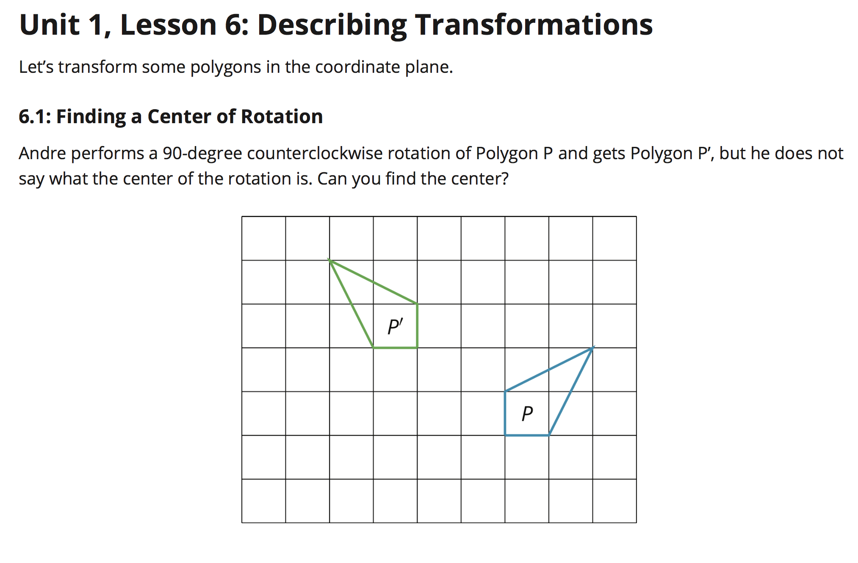


Page 47
You will need:
→ Copy paper / pencil
Step 1:
Trace the pre-image (Figure P) on your copy paper
Step 2:
Experiment with different points of rotation to determine how P maps to P’ using a counter-clockwise rotation.
Recall, the center is where you place your pencil when rotating your tracing paper clockwise or counter-clockwise.

Slide 5
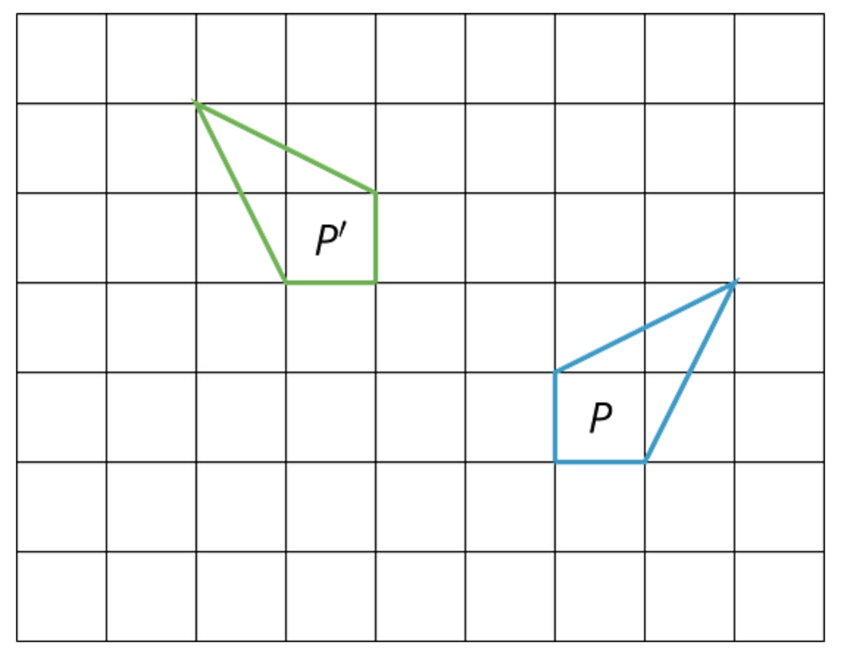

Page 47
Place a sheet of copy paper over the grid as shown on the left.
6
Step 1:
Trace the pre-image (Figure P) on your copy paper
Step 2:
Experiment with different points of rotation to determine how P maps to P’ using a counter-clockwise rotation. If you are unsure of where to begin, you may test out the points shown (1 through 9).
Place your pencil on a point to use as your center of rotation.
As you get closer or further away from your intended mapping, re-adjust your center of rotation.
3
7
2
4
8
1
5
9
NOTE: Only one of the points above is the correct center of rotation.

Slide 6
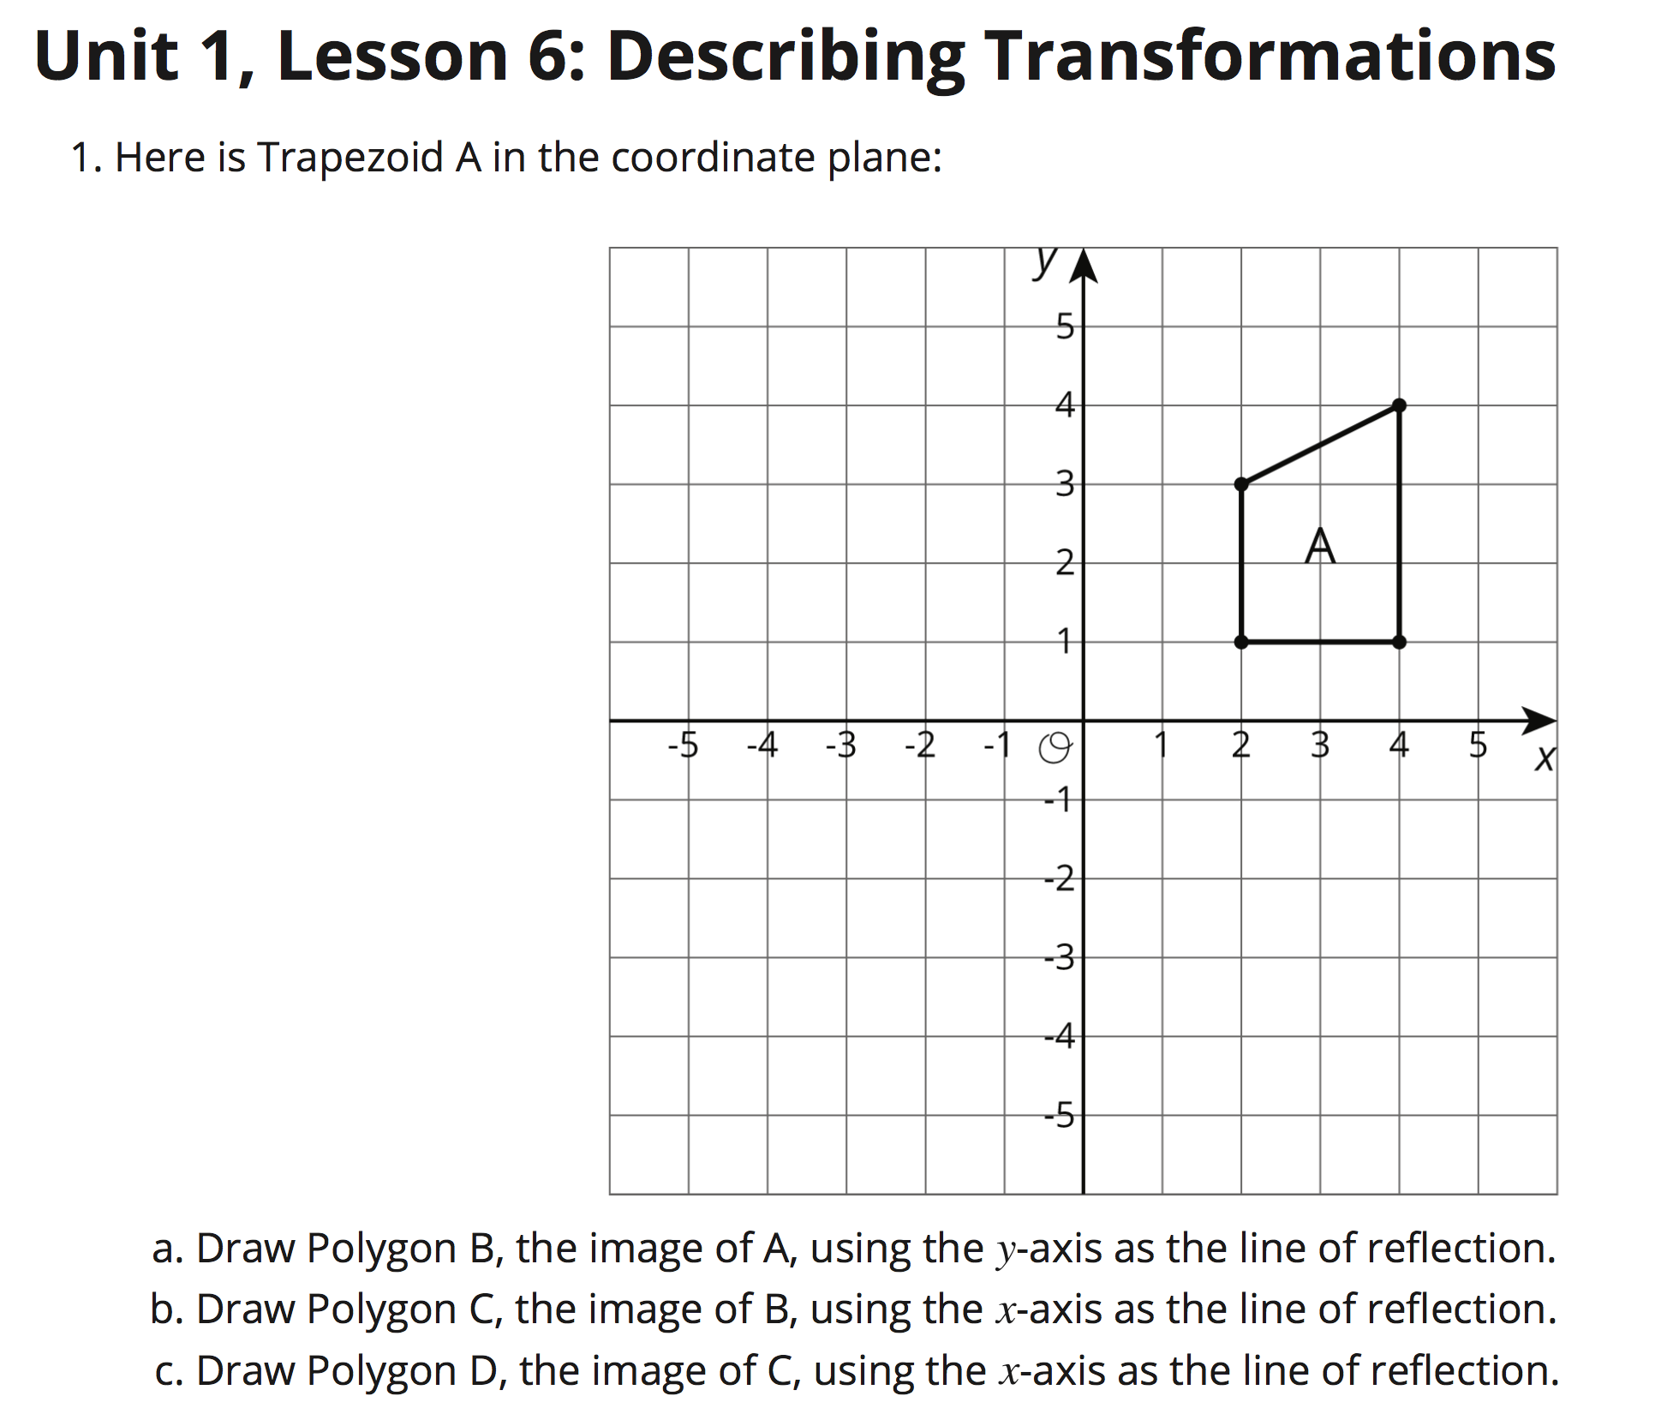
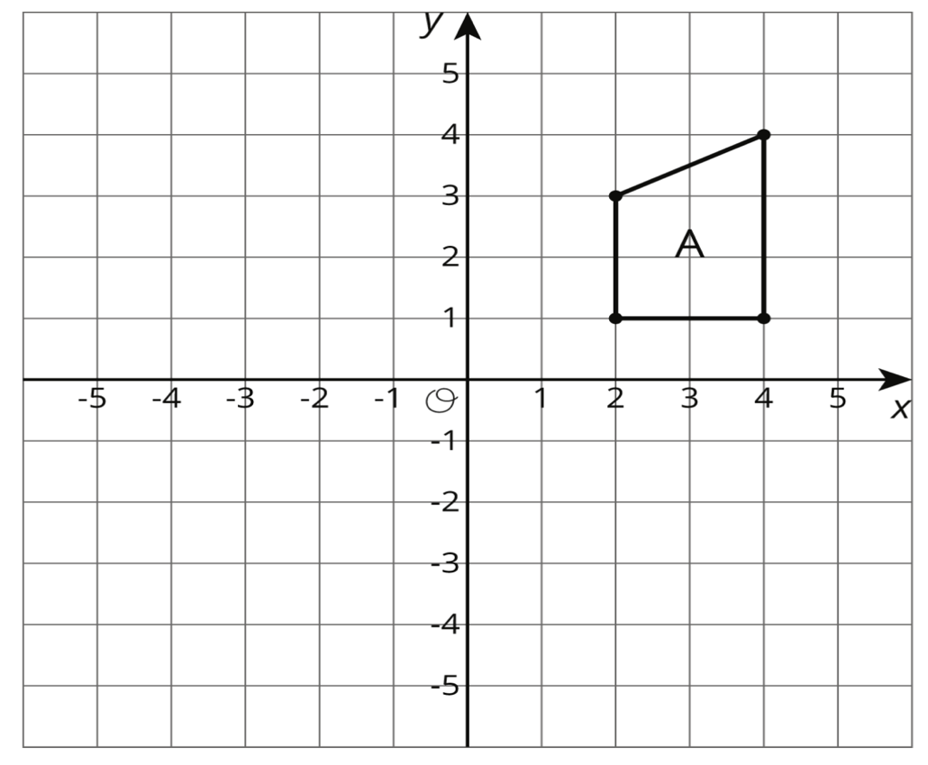
Page 50
The transformations that you perform here are REFLECTIONS of the named figure across either the x-axis or the y-axis.
The size and shape of the figure are preserved, but will be mirrored either vertically or horizontally.

Slide 7

a. Draw Polygon B, the image of A, using in
the y-axis as the line of reflection.
Page 50
B
In your own words, what does this direction tell you to do?

Slide 8
b. Draw Polygon C, the image of B, using in
the x-axis as the line of reflection.
Page 50
B
C

Slide 9
c. Draw Polygon D, the image of C, using in
the x-axis as the line of reflection.
Page 50
B
,D
C

Slide 10
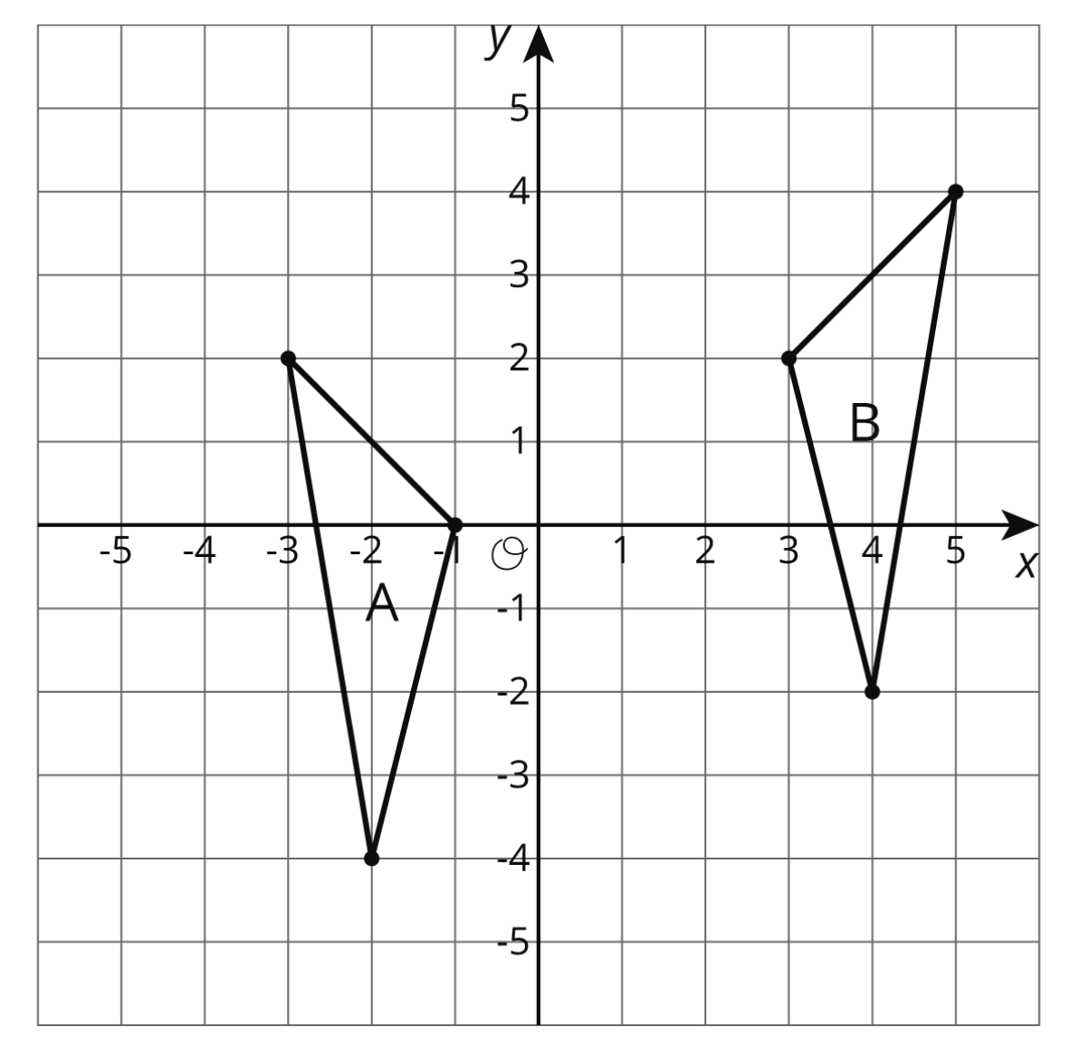
Page 51
What series of translations, reflections, rotations or combinations of these will bring Figure A to Figure B?
Use your tracing paper to guide your movements.
Write your sequences in the order you would use:
First, I need to ___________________________________________
Second, I need to __________________________________________
Third, I need to __________________________________________
Translations should include:
Direction – Up, Down, Left, or Right and
distances moved in those directions.
Rotations should include:
The number of degrees / how far the Figure
was turned and whether the rotation was
clockwise or counter-clockwise.
Reflections should include:
The line of reflection such as “Over the x-axis
or Over the y-axis, etc.”

Slide 11



Mondays
9:00 am – 10:00 am
Tuesdays
12:45pm – 1:15 pm
Wednesdays
11:15 am – 12: 15 pm; 12:45pm – 1:15 pm
Thursdays
12:45pm – 1:15 pm
Fridays
11:15 am – 12: 15 pm; 12:45pm – 1:15 pm

Slide 12

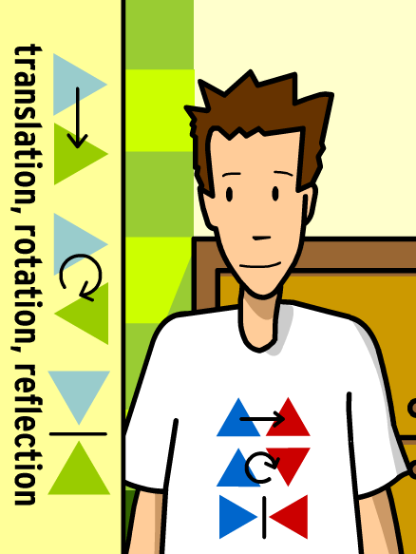
Asynchronous Assignment:
This assignment is hyperlinked on www.mathpearson.com
Due by 3:00pm Monday 9.14.20

