Slide 1





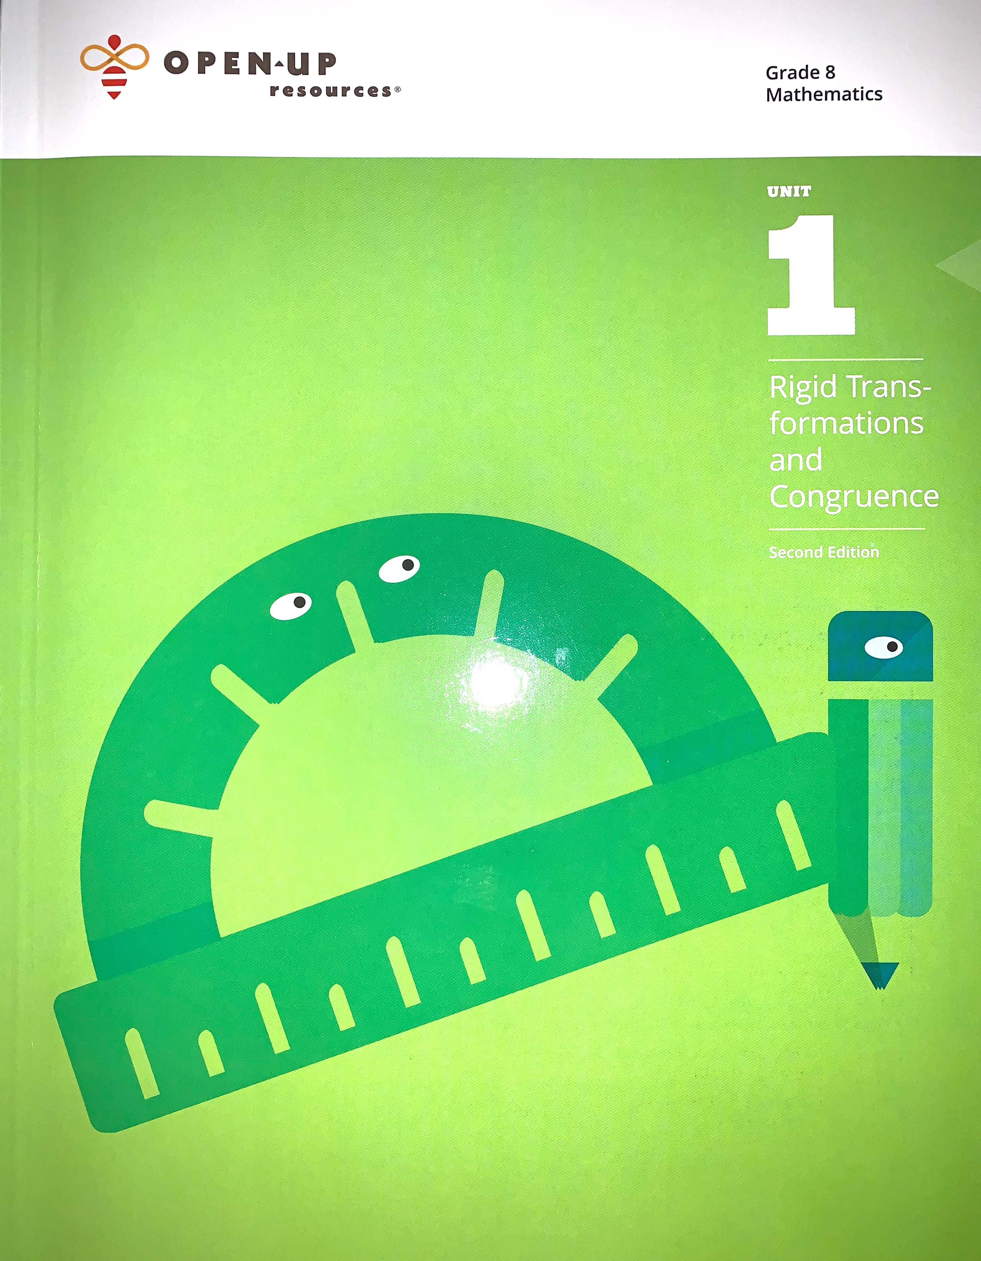
AGENDA FOR THURSDAY 9/17/20 – FRIDAY 9/18/20
Illustrative Mathematics UNIT 1 Lesson 7
→ Please make sure you have your Workbooks ready (open to Lesson 7 pg. 53)
→ Our focus for today will be using and applying vocabulary from Unit 1 .
→ Classwork: Pages 53 through 60.
Today’s Assignment (During Asynchronous Time):
→ Activity 9.17.20-9.18.20 on Desmos – the hyperlinked code will be on Mr.
Pearson’s website www.mathpearson.com after the lesson today.
Lesson Standard(s):
8.G.1 Verify experimentally the properties of rotations, reflections, and translations.
​8.G.3 Describe the effect of dilations, translations, rotations, and reflections on two-dimensional figures using coordinates.

Slide 2
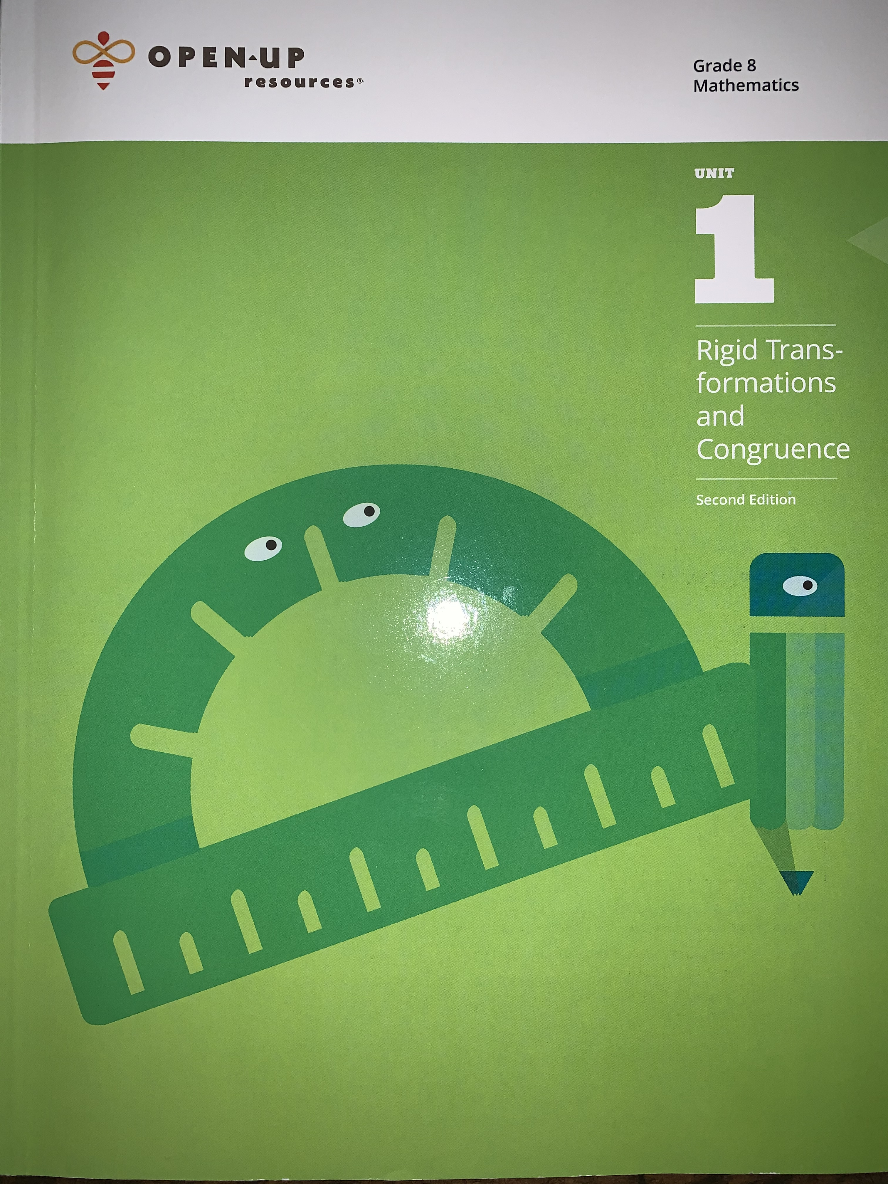
At this time, please prepare to go to take out your Unit 1
Illustrative Mathematics Workbook, Copy Paper, and wait for instructions.
After completing this unit, you’ll be able to:
Navigate around the system.
View your daily tasks, leads, and referrals on your home page.
Display details about a client or customer.

Slide 3
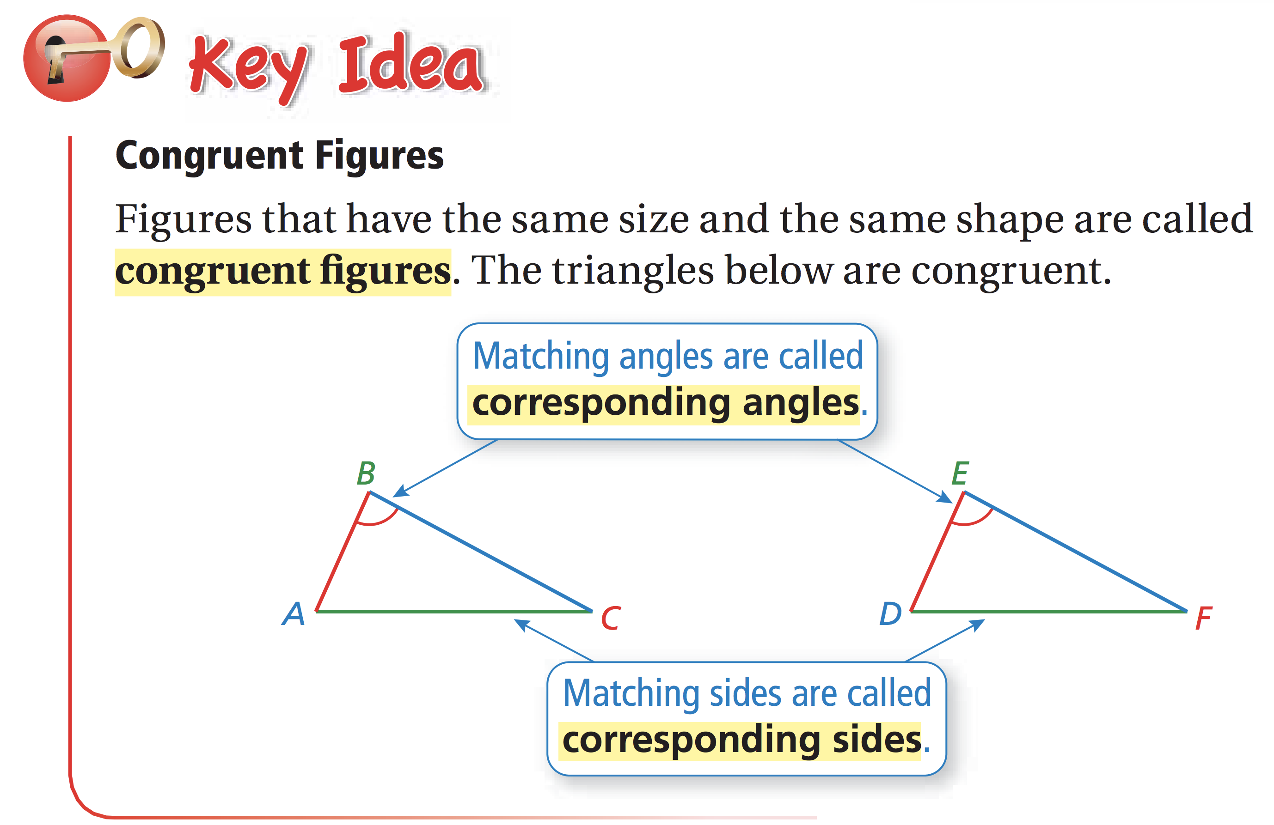

Slide 4

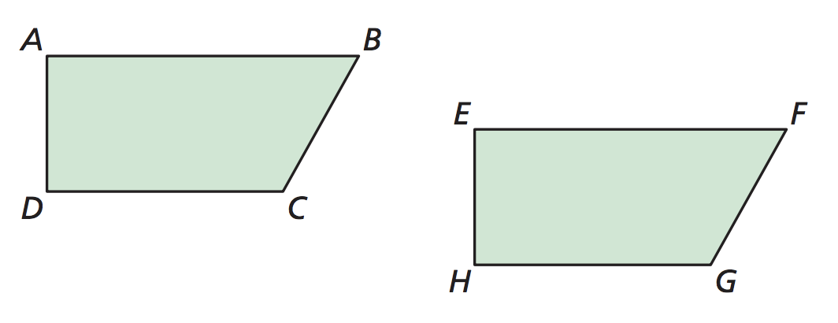
9.17.20-9.18.20
What Rigid Transformation (Rotation, Reflection, or Translation) will take Figure ADCB to Figure EHGF?
Angle A corresponds to Angle ____
Angle B corresponds to Angle ____
Angle C corresponds to Angle ____
Angle D corresponds to Angle ____
Line Segment EF corresponds to Line Segment _____
Line Segment FG corresponds to Line Segment _____
Line Segment GH corresponds to Line Segment _____
Line Segment EH corresponds to Line Segment _____

Slide 5
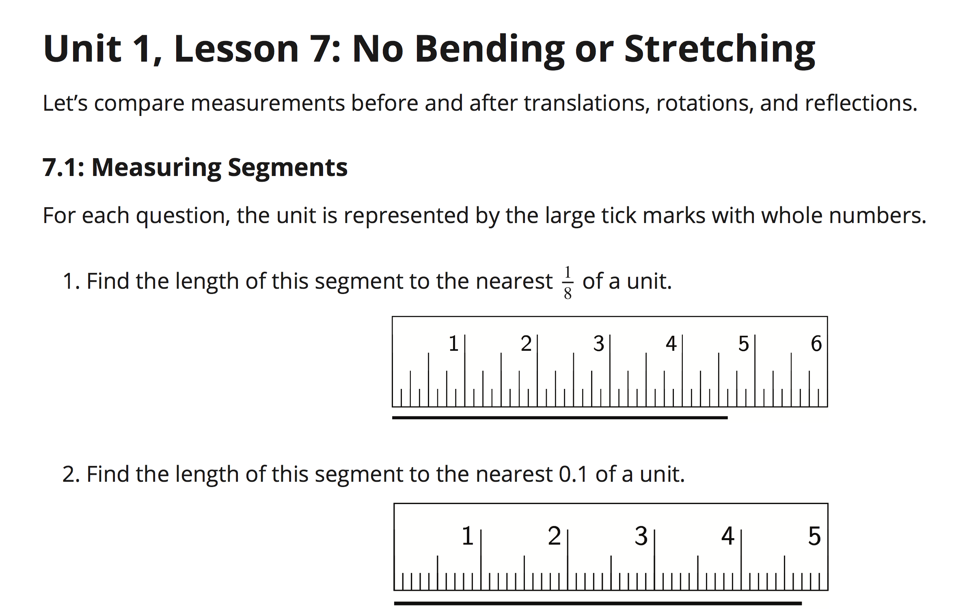
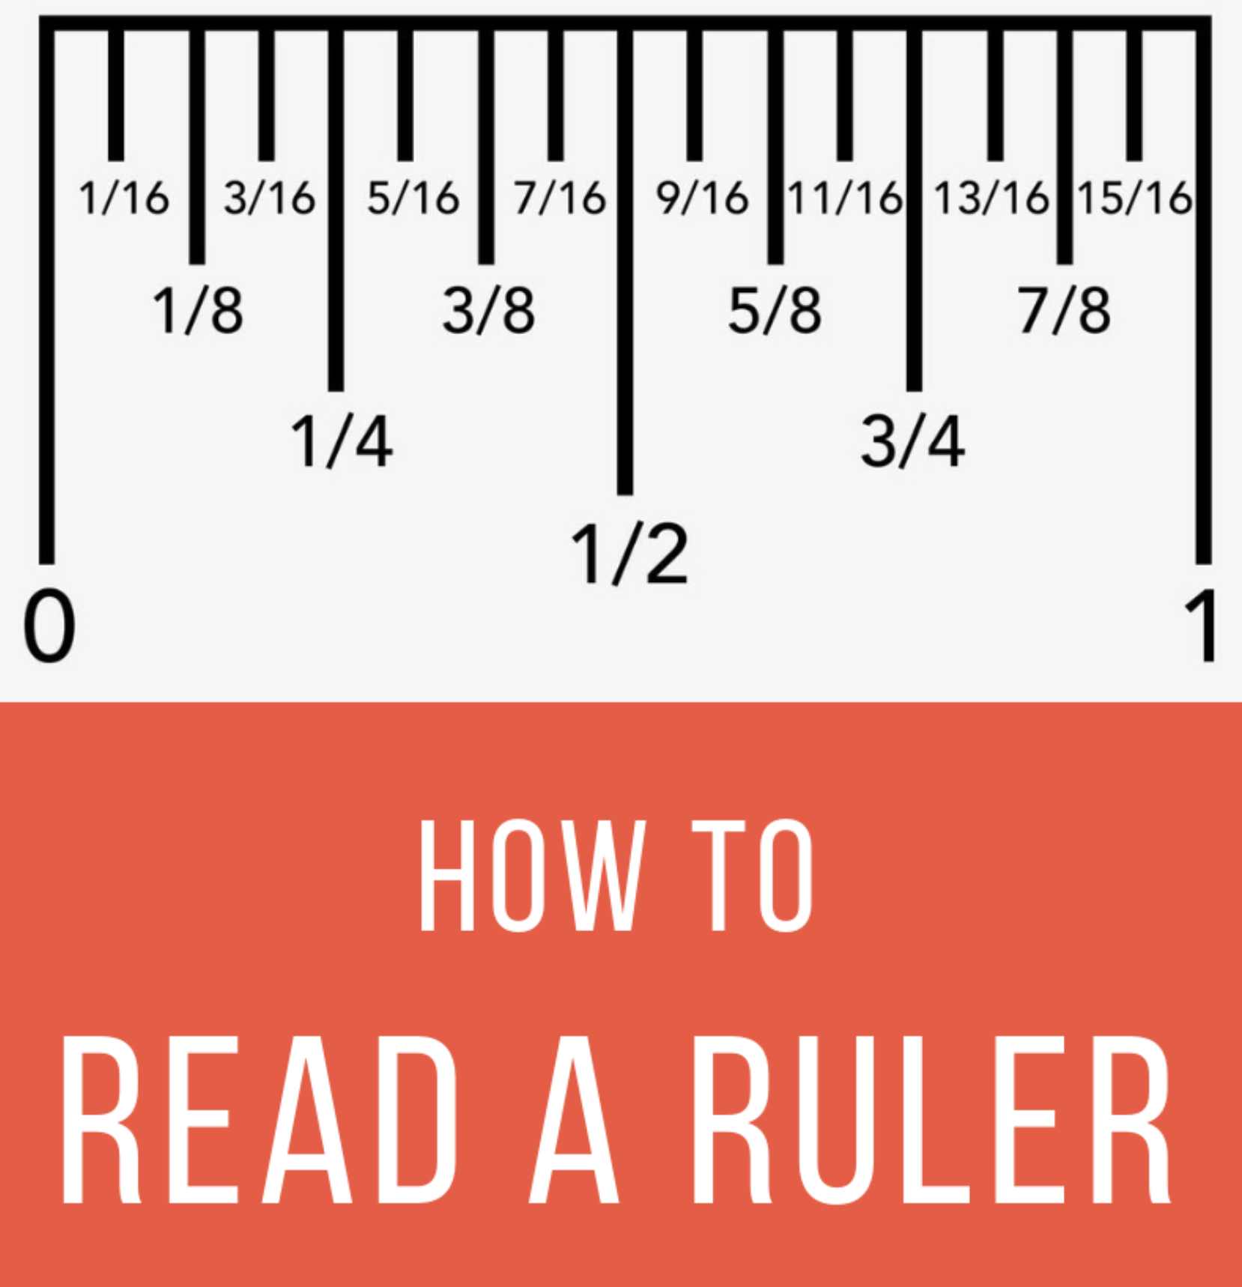

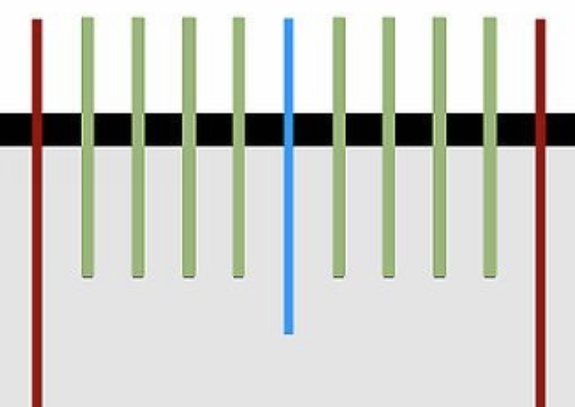
Page 53
Rulers do not always use the same increments.

Slide 6
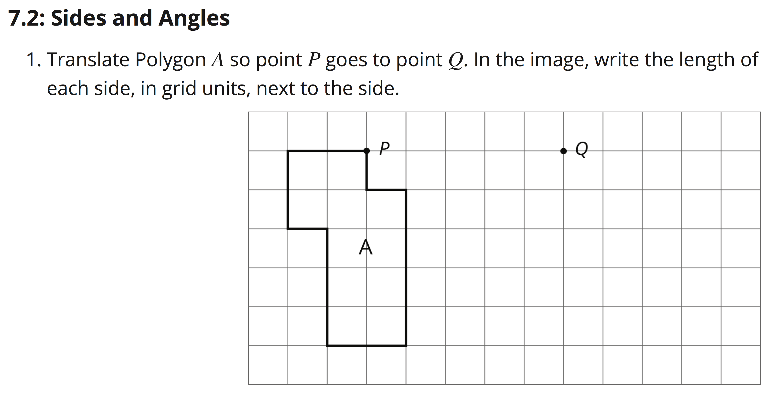

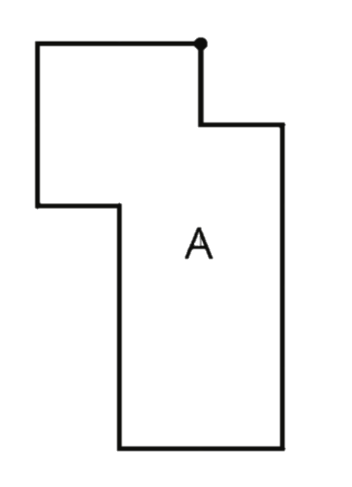

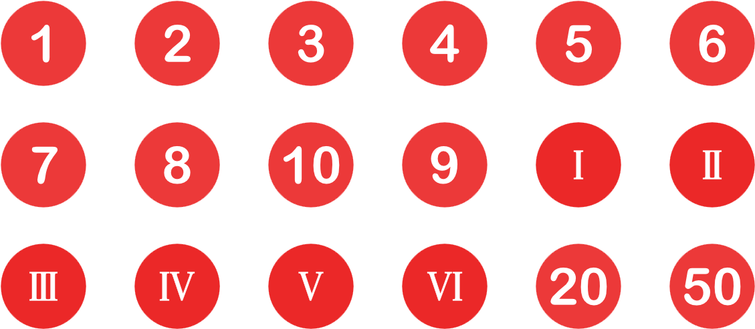

Page 54
In order to translate from Point P to Point Q, what movement(s) must be made?
Describe the movement(s) in terms of both direction and distance.
The rest of Figure A will follow this movement. Sketch the image of Figure A related to Point Q.
In order to translate from Point P to Point Q, we must translate 5 units to the right.

Slide 7
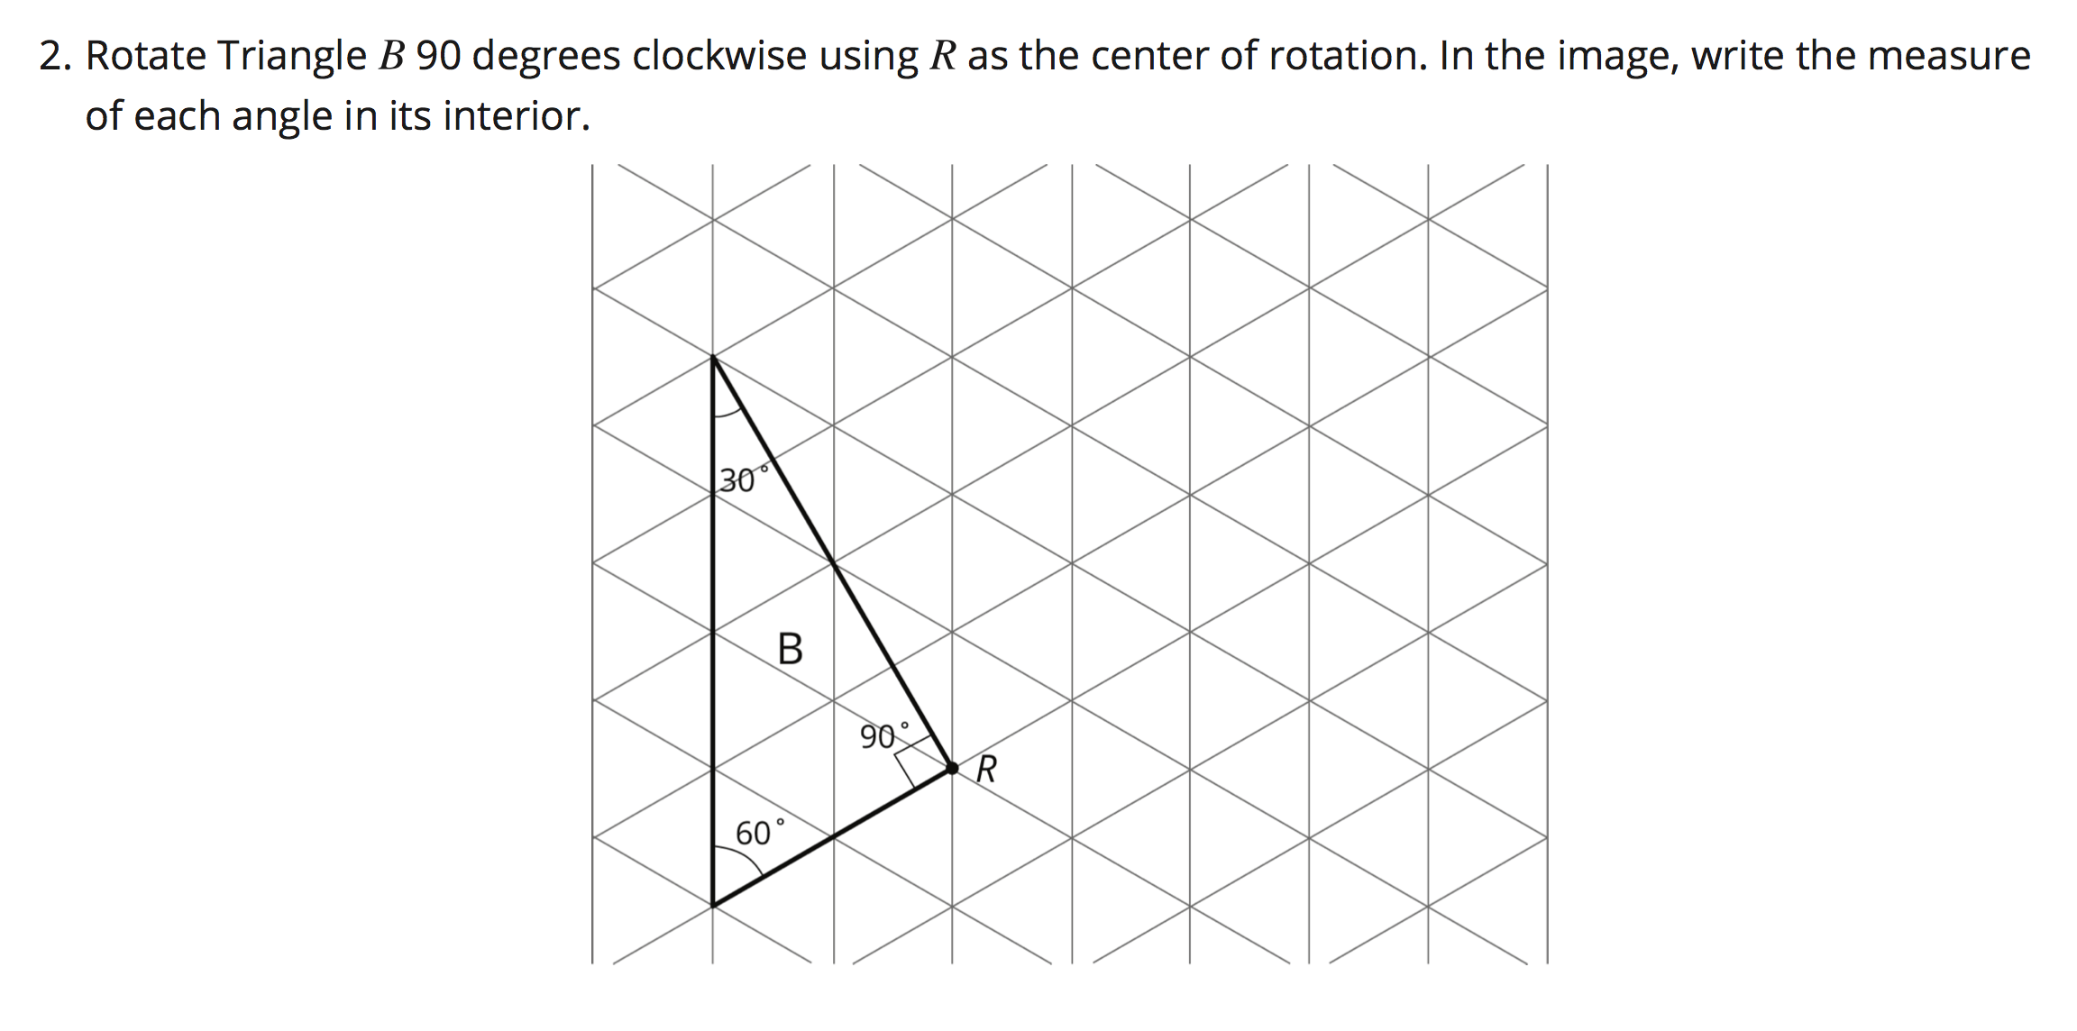
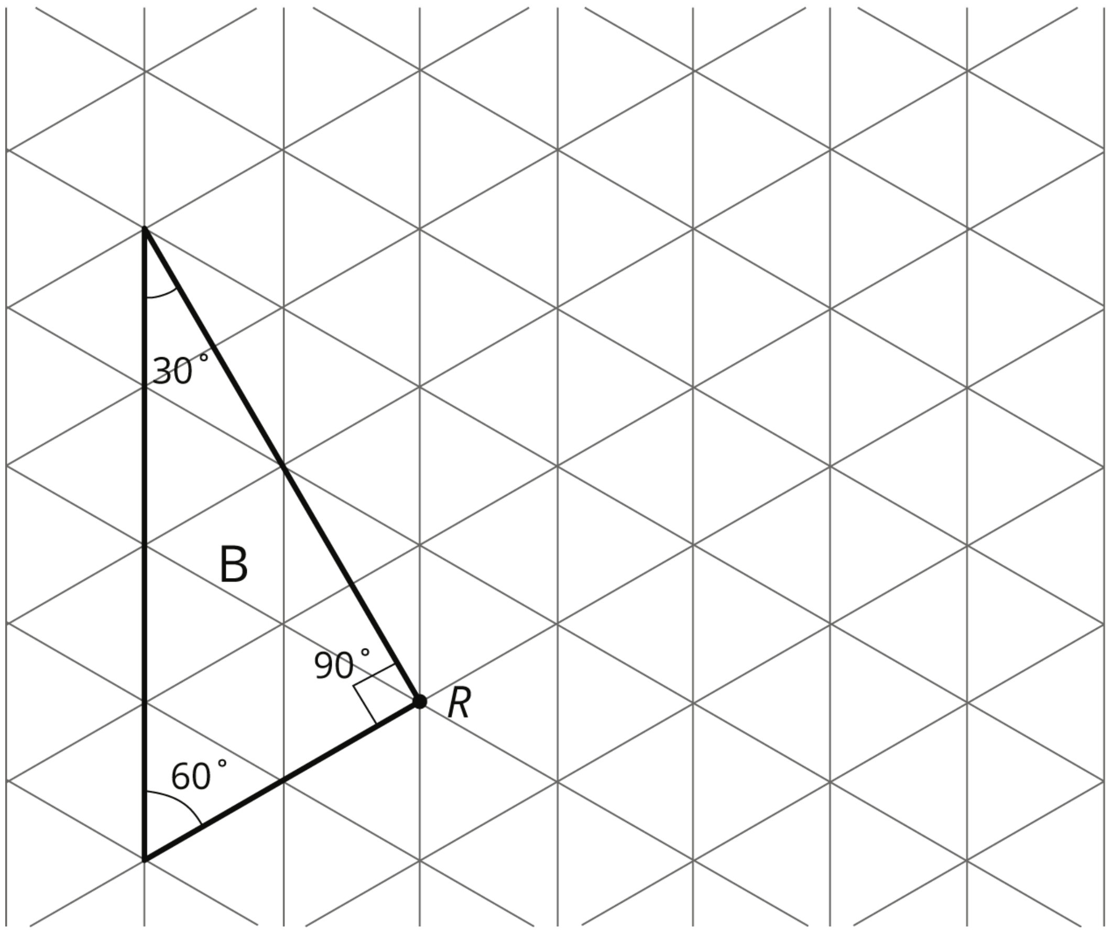

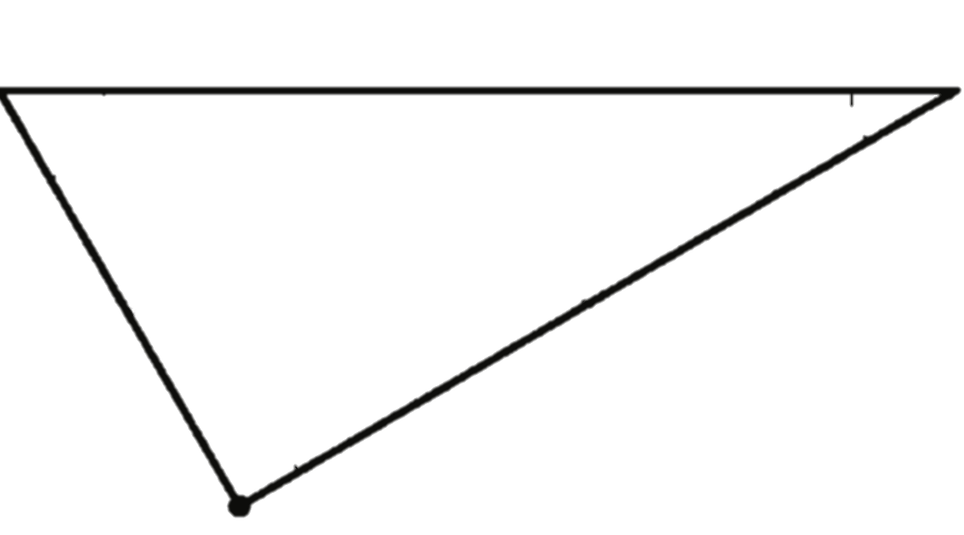
Page 55
Identify Point R as the center of rotation.
What do the red and green lines shown allow you to see?
Trace Triangle B, then using your copy paper, rotate the figure 90 degrees clockwise.

Slide 8
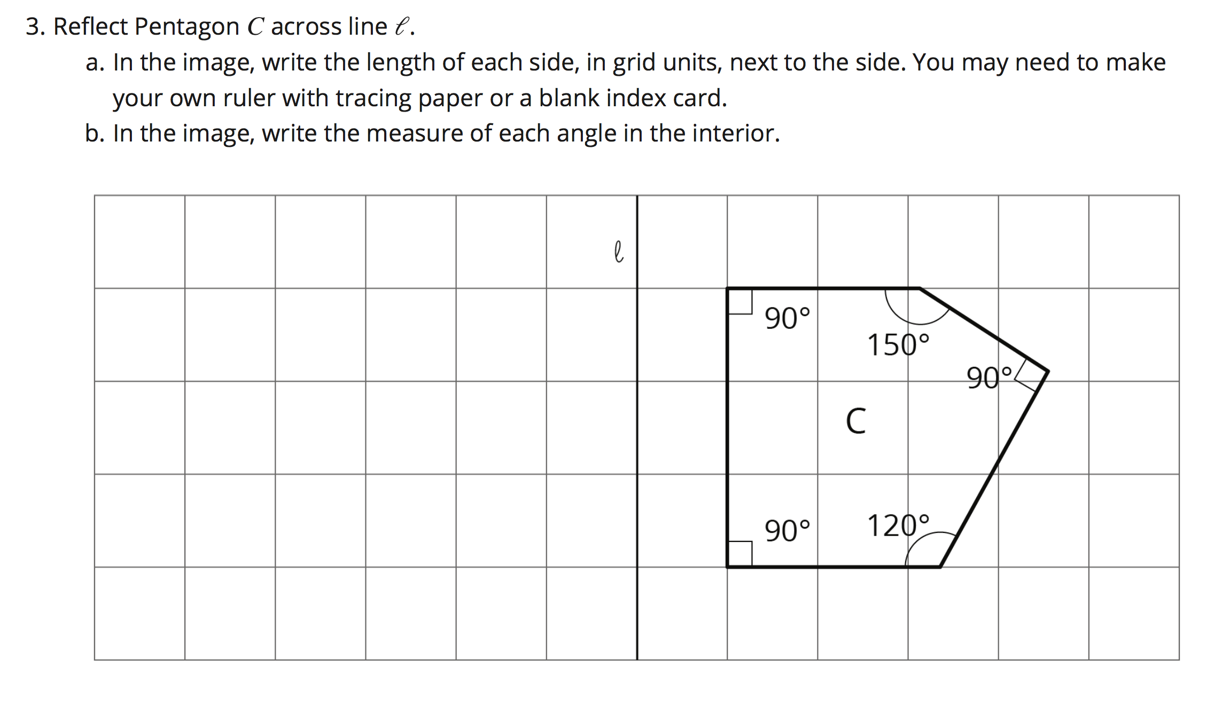

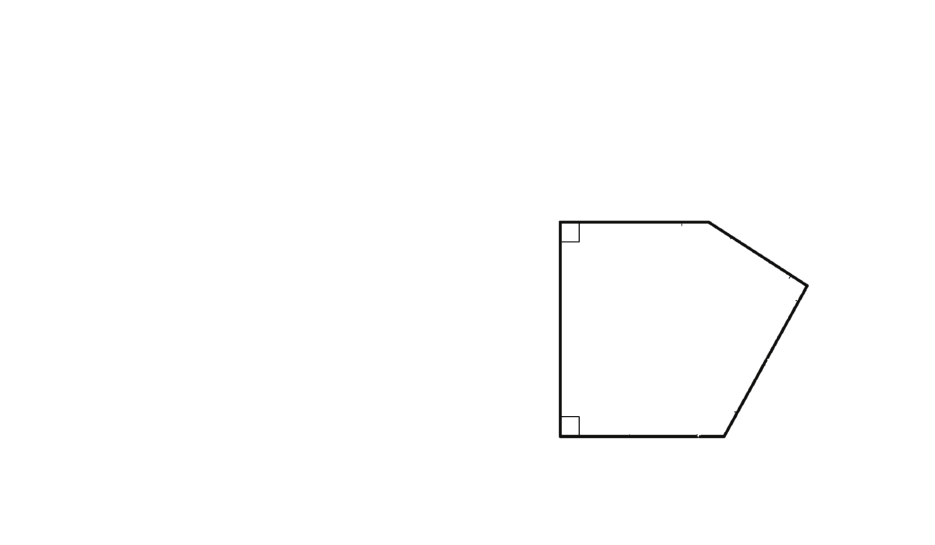

Page 55
Modified Directions: Our focus today is not going to be measuring lengths and angles.
We are going to perform our reflection and label the points A, B, C, D, and E and their corresponding parts in the reflection A’, B’, C’, D’, and E’.
B’
A’
A
B
C’
C
D’
E’
E
D
Note: Not all of the points lie on the grid lines of the coordinate plane.
Each point should be an equal distance from the line of reflection.

Slide 9
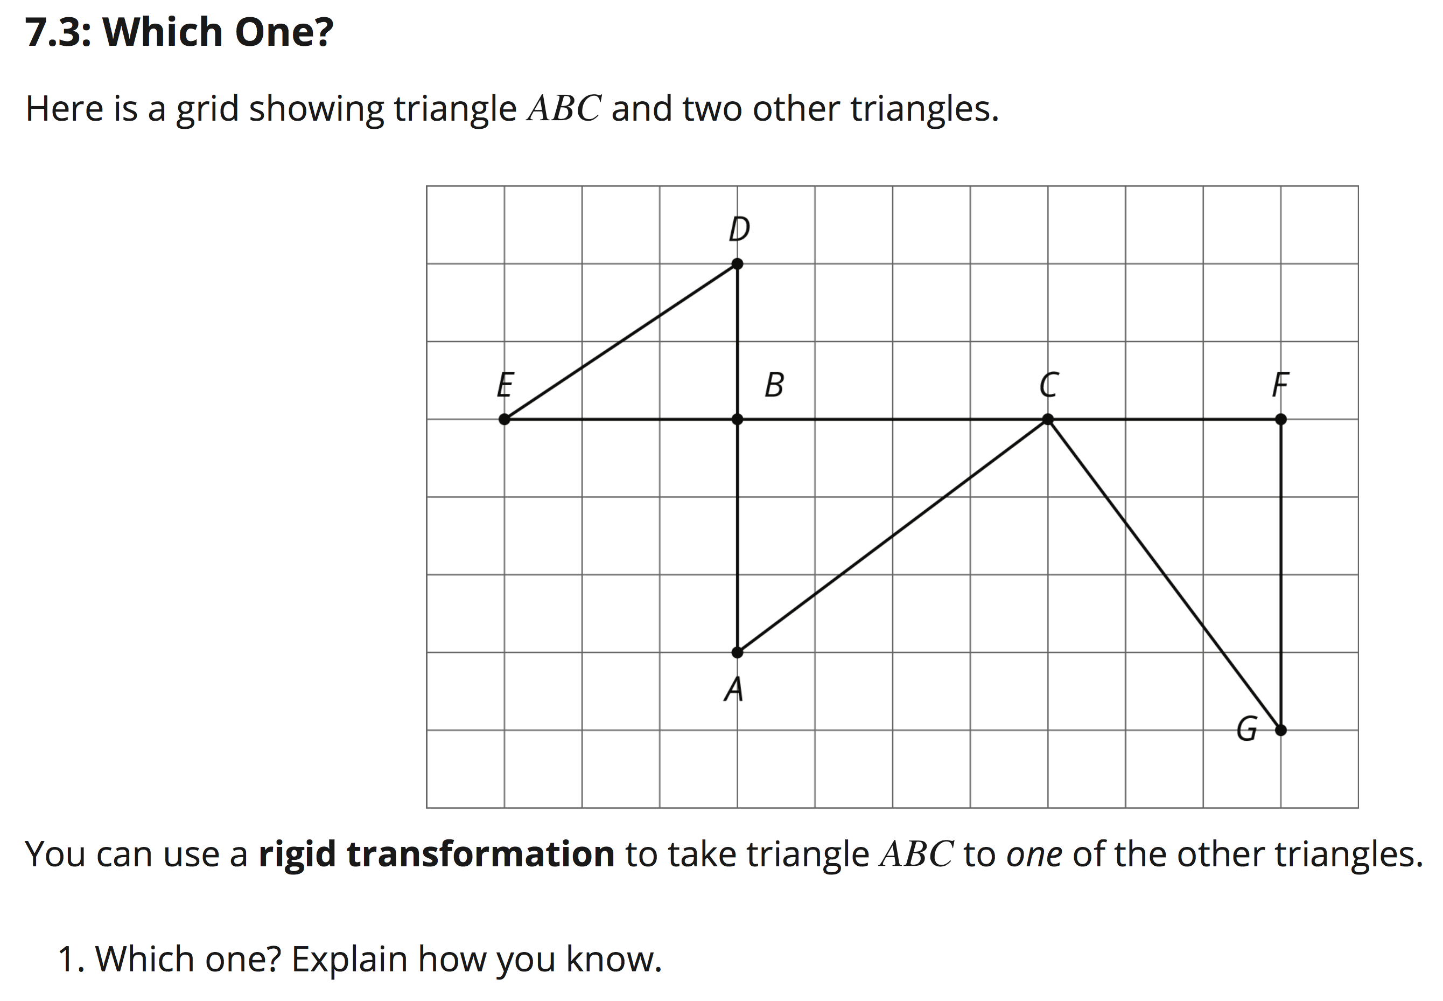
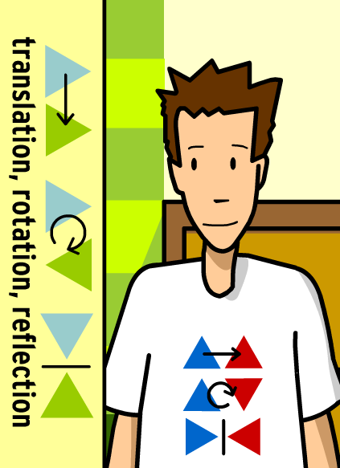
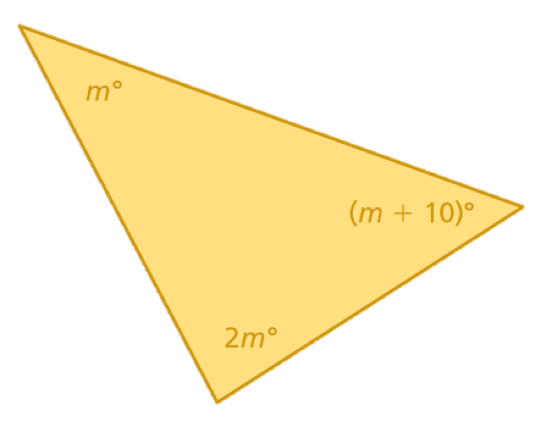
Page 56
For Example:
If Triangle ABC were rotated 90°clockwise using Point C as the center of rotation, the next step would be to __________ Triangle ABC __ units _____ and __ units _____ to map to Triangle CFG.
→ Rigid transformation can involve more than one step to map one shape to another.
Rigid Transformations:
Any of the three moves above. Do Not Change the size or the shape of the original figure.
Triangle ABC is the same size and shape as Triangle CFG.
Triangle ABC would require rotation and translation to map to Triangle CFG.

Slide 10
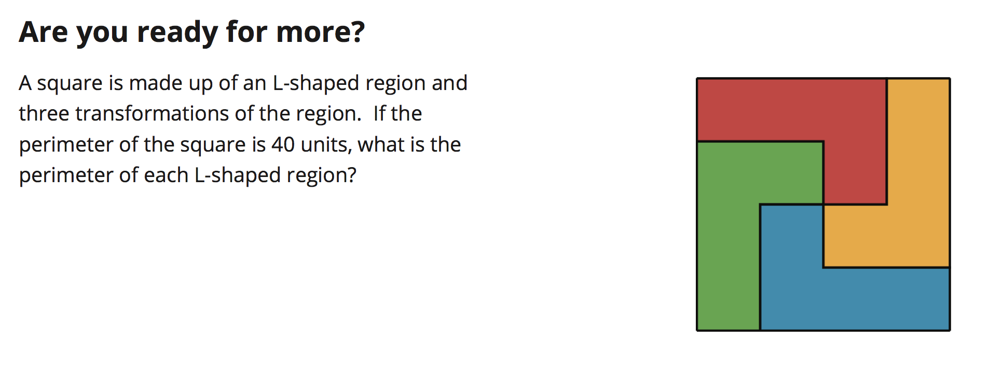
Page 57
Essential Question: How can you find the length of a given side of the figure if you know its perimeter?

Slide 11
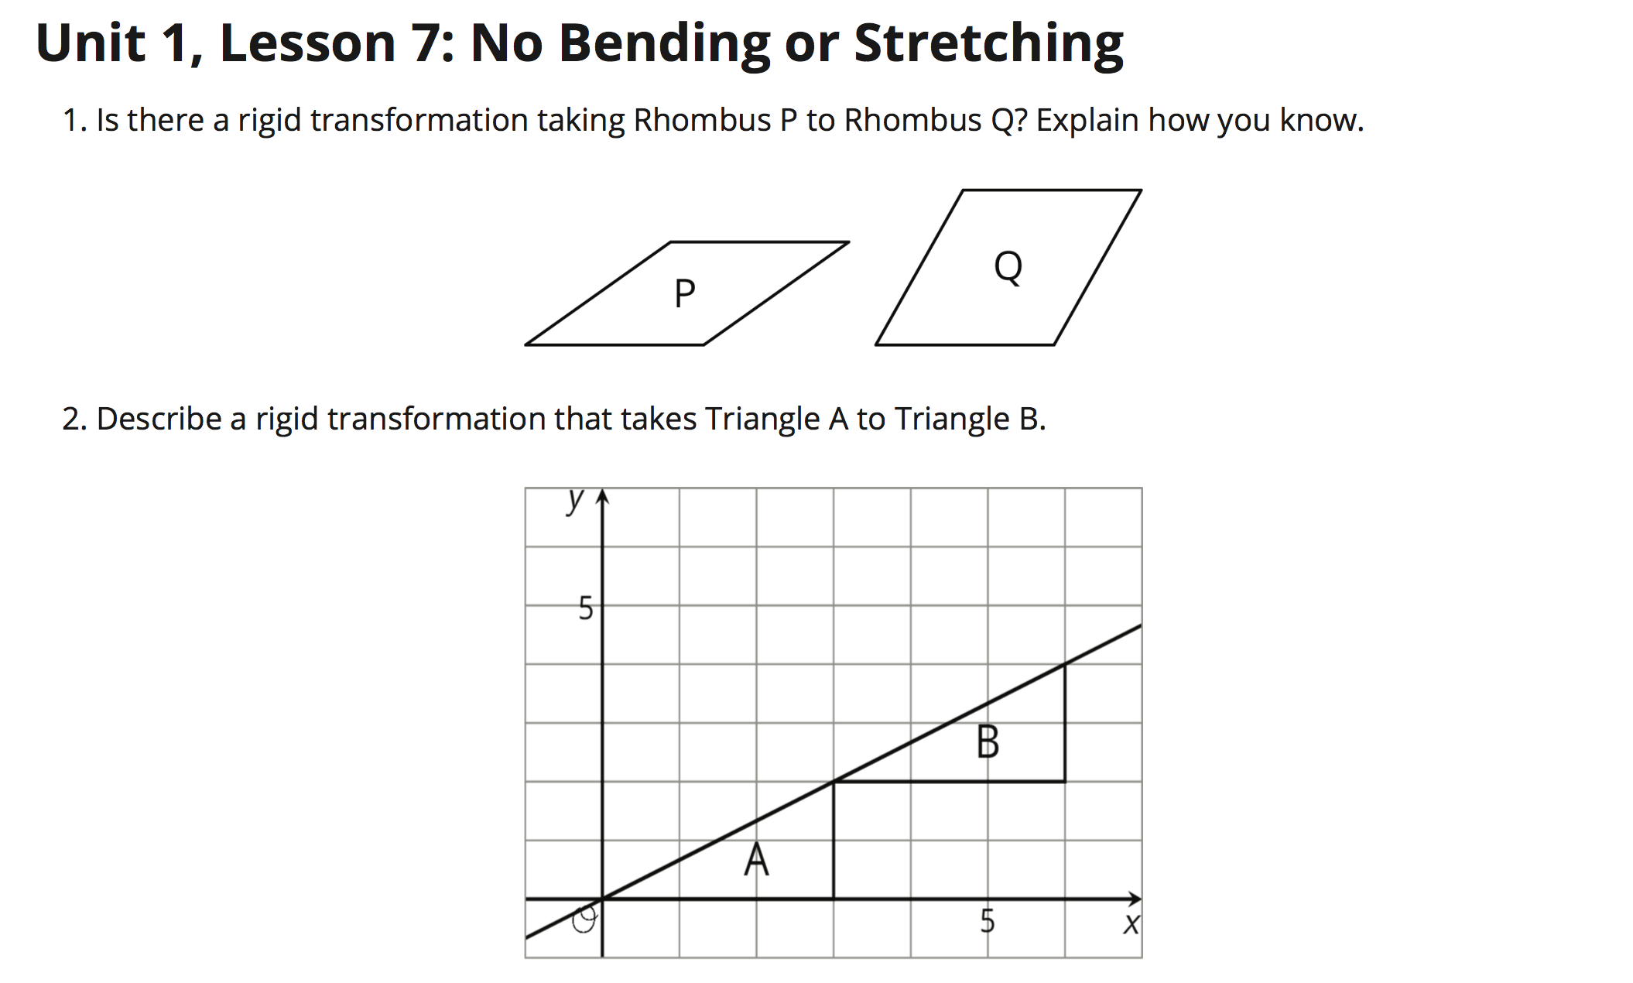
Page 59
Can you take Figure P and perform a translation to become Figure Q?
Can you take Figure P and perform a rotation to become Figure Q?
Can you take Figure P and perform a reflection to become Figure Q?
Describe why you can or describe why you cannot transform it.

Slide 12
Page 59
PART ONE: (Choose One)
Translation
Rotation
Reflection
PART TWO: (Describe it)
How did it move, turn, etc. and in what direction(s)?

Slide 13
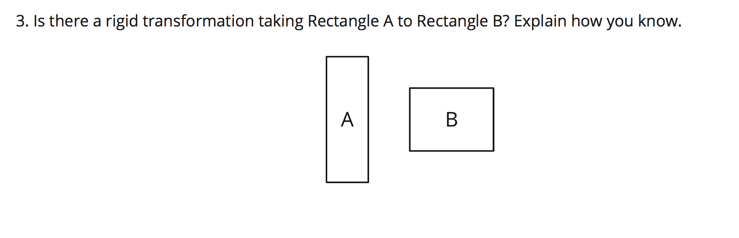
Can you take Rectangle A and perform a translation to become Rectangle B?
Can you take Rectangle A and perform a rotation to become Rectangle B?
Can you take Rectangle A and perform a reflection to become Rectangle B?
Describe why you can or describe why you cannot transform it.
Page 60
In order for a rigid transformation to take place, the figures must maintain the same _______________ and the same _________________.
size
shape

Slide 14
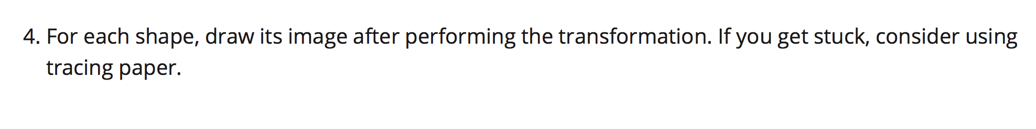
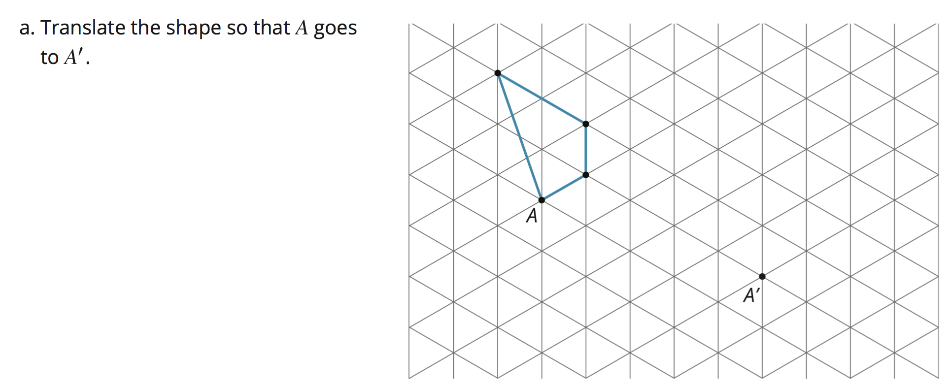
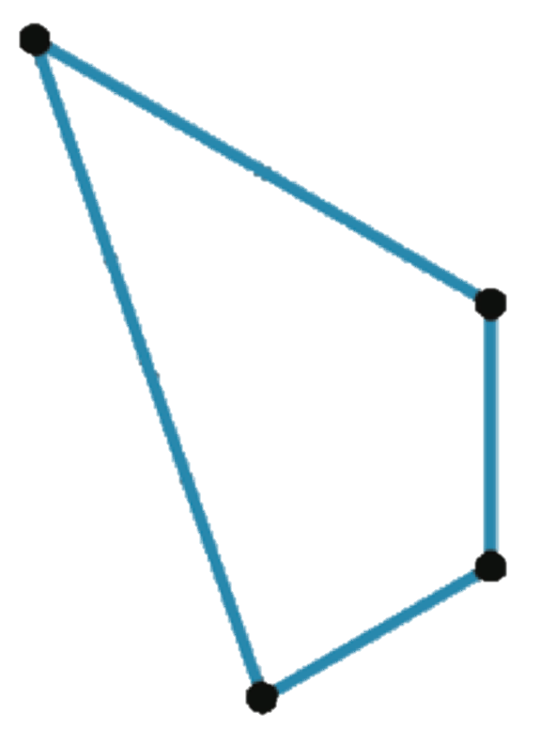

Page 60

Slide 15
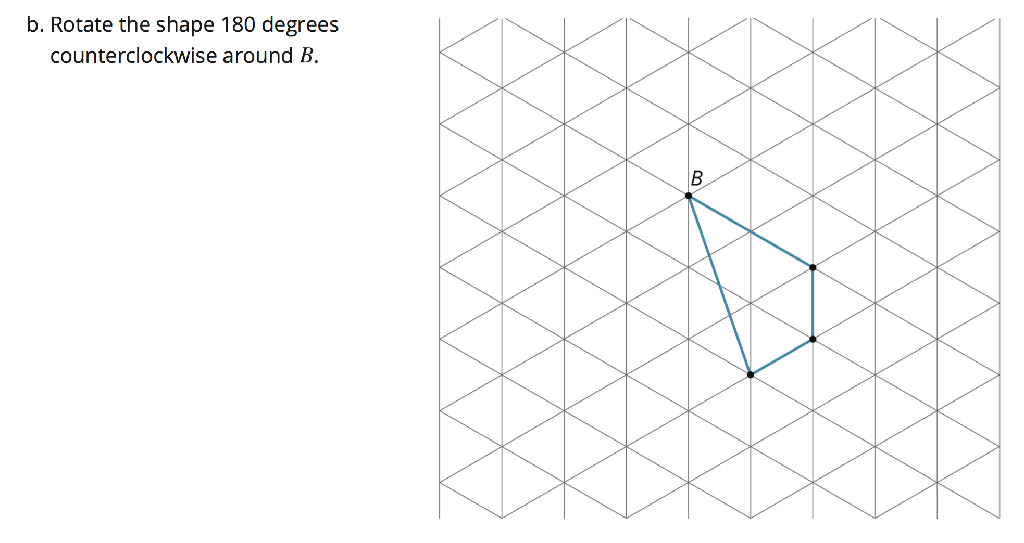

Page 60

Slide 16


Asynchronous Assignment:
This assignment is hyperlinked on www.mathpearson.com
Due by 3:00pm Monday 9.21.20

